Slide 1
Assalamu Alikum

Slide 2
Afroza Shermin
Lecturer(ICT)
Chandana High School And College

Slide 3
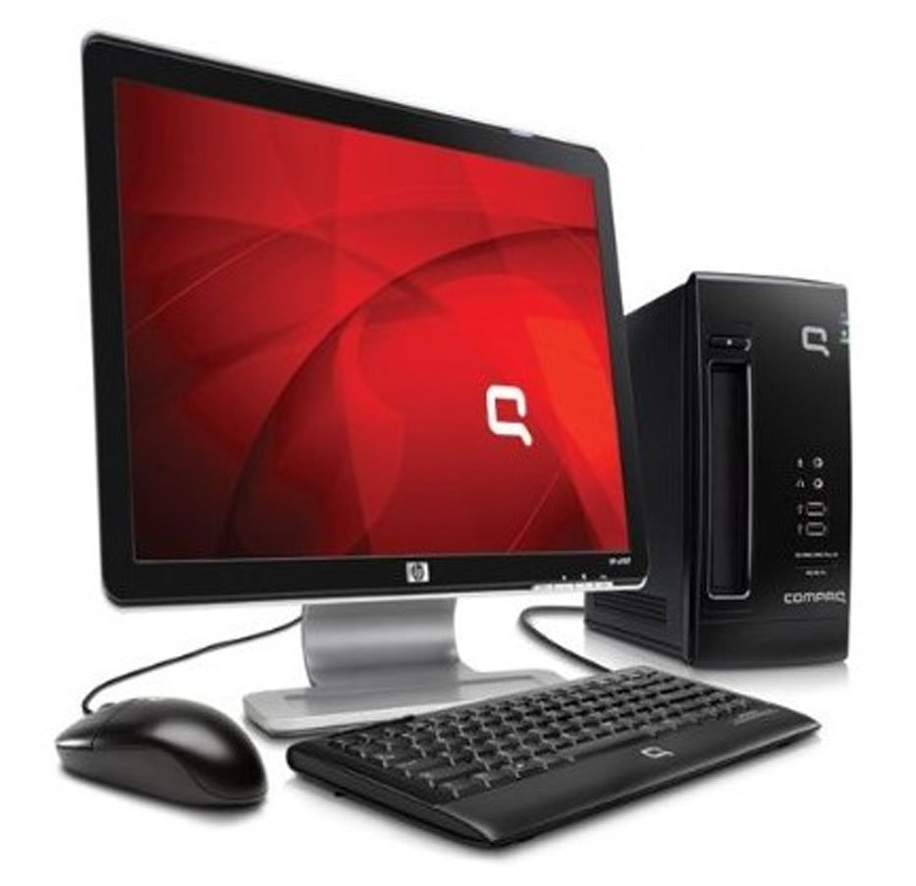
What is the Defination Of COMPUTER
a programmable electronic device designed to accept data, perform prescribed mathematical and logical operations at high speed, and display the results of these operations. Mainframes, desktop and laptop computers, tablets, and smartphones are some of the different types of computers.

Slide 4
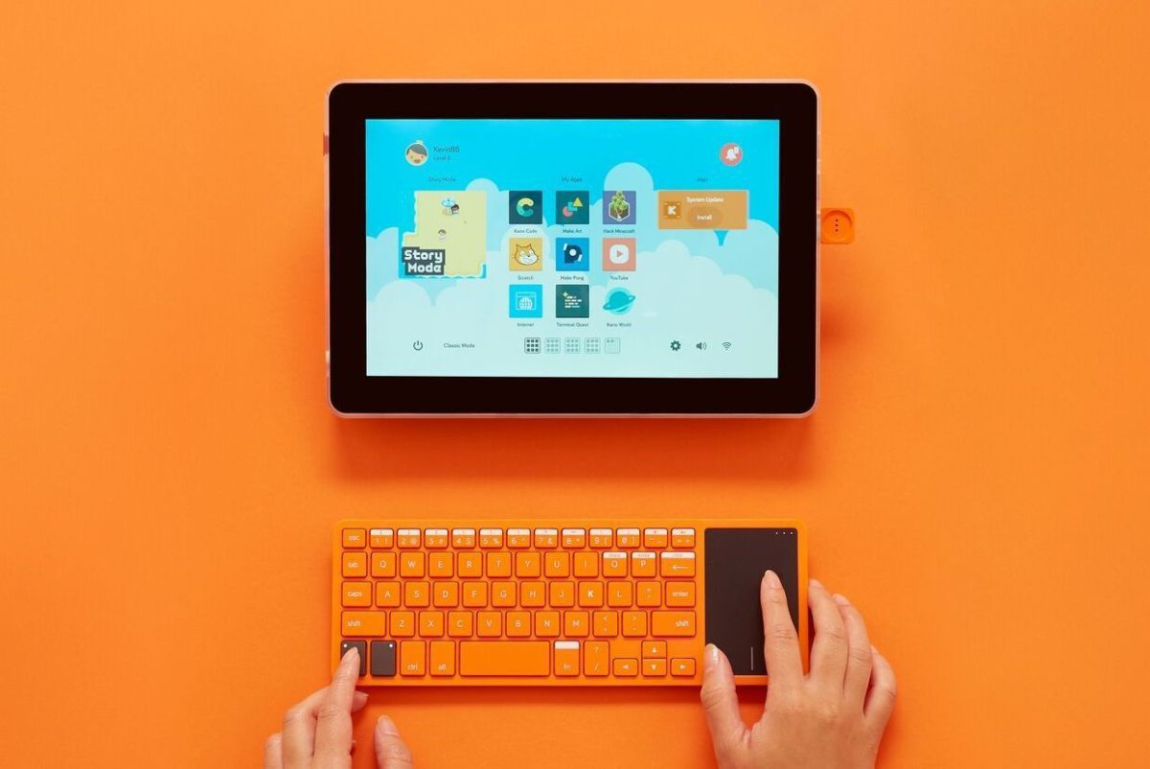
Defination of Computer in OXFORD Dictionary
An electronic machine that can store, organize and find information, do processes with numbers and other data, and control other machines

Slide 5
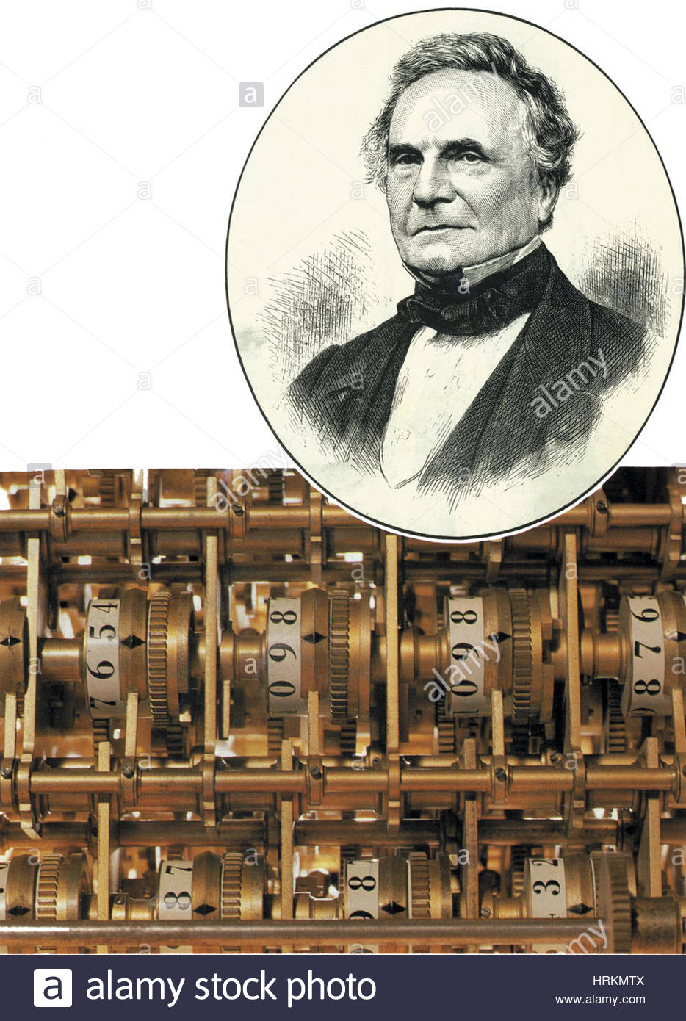
Who invented the modern computer?
But the first computer resembling today's modern machines was the Analytical Engine, a device conceived and designed by British mathematician Charles Babbage between 1833 and 1871. Before Babbage came along, a "computer" was a person, someone who literally sat around all day, adding and subtracting numbers and entering the results into tables.

Slide 6
Who is the first programmer?
British countess and mathematician Ada Lovelace is often considered the first computer programmer, as she was the first to publish an algorithm intended for implementation on Charles Babbage 's analytical engine, in October 1842, intended for the calculation of Bernoulli numbers .

Slide 7
End of the lesson,
students will be able to--------------
1.What is the Defination Of COMPUTER?
2.Who invented the modern computer?
3.Who is the first programmer?

Slide 8
HOME WORK
Now Write A Short History Of Computer

Slide 9
ALLAH HAFEZ

