Slide 1
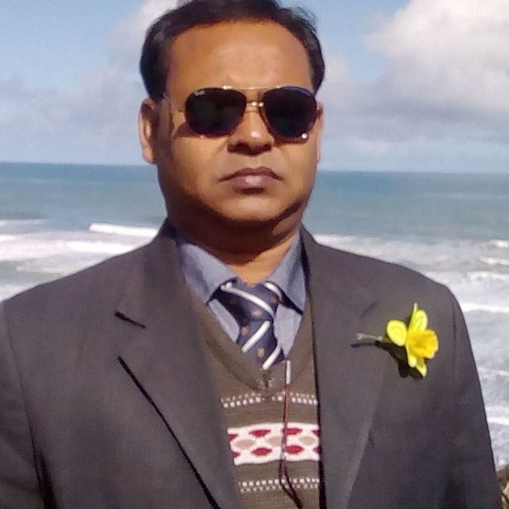
Khandoker Mufakkher Hossain
Assistant Teacher
Aftab Uddin School and Collage

Slide 4
HSC English 1st Paper Question Solution For Technical Board-2019

Slide 5
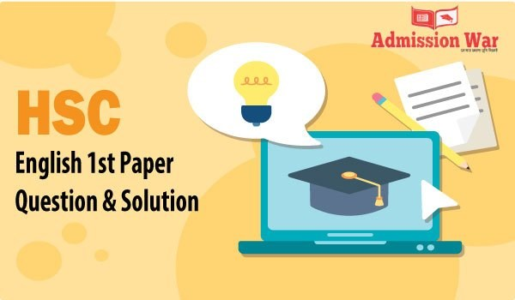

Slide 6
01. Choose the best answer from the alternatives of the following :—
The word ‘unfortunately’ means ___ Ans: Unluckily (b) The word ‘stench’ means — Ans: Stink (c) ____ is often called life. Ans: Water (d) Drinking water could be a challenge for ___ Ans: Present

Slide 7
02. Answer the questions given below :-
What are the main sources of water? (b) What fills the air around the Buriganaga? (c) What was the relation of Buriganaga with the Ganges? (d) What was the condition of the river Buriganga in the past? (e) How did Buriganga flow to the Bay of Bengal?

Slide 8
03. Fill in the gaps with suitable words.
Bangledesh is our (a) country. It fought (b) nine months to (c) gain freedom. People here speak Bangle. India is our good (d) friend/neighbor.

Slide 9
04. Summarise the above passage in five sentences.

Slide 10
Part B – Grammar
5. Make WH-questions with the following sentences:
Kazi Nazrul Islam was born in 1899. Ans: When did Kazi Nazrul Islam born?
(b) He was active and honest. Ans: How was he? (c) We planned to attend the class. Ans: What did we plan? (d) I shall go to Dhaka tomorrow. Ans: When will I go to Dhaka? (e) Shakespeare wrote Hamlet. Ans: Who wrote Hamlet? (f) My mother introduced me to all. Ans: Who did introduce me to all? (g) This book costs me 10 taka. Ans: How much this book cost for me? (h) My uncle is a teacher. Ans: What is my uncle?

Slide 11
Question 06.
a) Mr. Jamal cannot buy a mobile phone, * let alone computer.
b) His father is sick. He needs to go home * as soon as possible.
C) He behaves * as if he were mad.
D) I *would rather die than beg.
E) * There lived a famous King in Scotland.
F) Taj Uddin Ahmed was a great leader. He * was born in 1925.
G) You *have to work hard to succeed in life.
H) *It is a matter of great joy that we have won the match.

Slide 12
Question 07.
Key a) to success
Prosper b) in life
Life c) by doing hard work.
The rules d) of sincerity
A long way e) in the world
Conscious f) of the importance
Importance g) of sincerity
Benefit h) of success

Slide 13
Question 08.
If I were a child again!
The rich are not always happy.
I went to Dhaka yesterday.
Charity begins at home.
Gulliver’s Travels is a famous book.
The work is going to be done.
Each boy and every girl has a pen.
We like to go there.

Slide 14
Question 10.
Broad
Fine
Dislike
Latest
Light
Liberated
Complete
Astonished

Slide 15
Question 12.
Mary was a little girl who was asked to bring the cattle home. She went out of the house alone calling out to them. Dusk was falling by then and the day was stormy and dark, tides were rising. As soon as she landed on the shores of Dee to reach the land. She couldn’t even see where the land lay and ultimately the sea pulled her in.

