Slide 1
Welcome
to
everybody

Slide 2
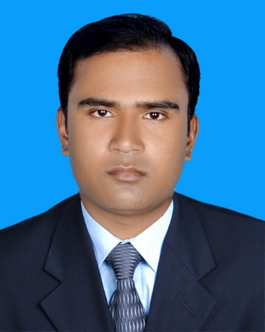
Teacher’s Identity
Sujan Garja
Assistant teacher
Guimara Government Primary School
Matiranga,Khagarachari.
sujangarja2107@gmail.com

Slide 3
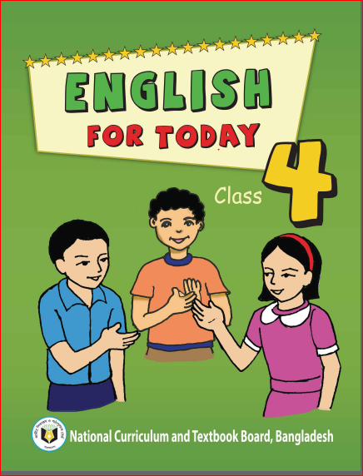
Lesson Contacts
Subject: English For Today
Class 4
Unit: 40-A Garment Worker’s Day
Lesson: 1-2(Reshma is a……… Sell them)
Time:40 minutes
Page: 80

Slide 4
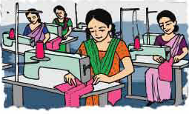
Look at the pictures and think about these
Nurse
Teacher
Farmer
Garment worker
A
woman
who
takes care
of sick
people.
A
person
who
teaches
students.
A person
who
grows
crops.
A person
who
works
in a
garment
factory.

Slide 5
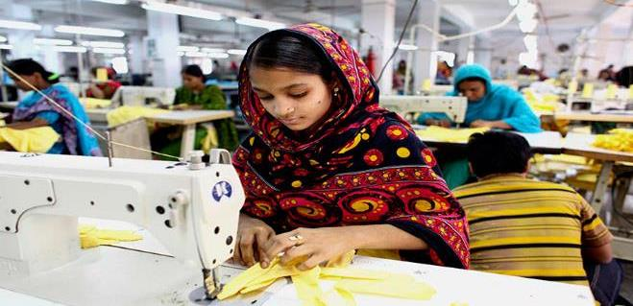
Today we are going to start a new lesson.
A garment worker’s day

Slide 6
Learning Outcomes:
Students will be able to……
Listening:
1.1.1 Recognize sound differences in the context of words.
1.2.1 Recognize which syllable in a word is stressed.
1.3.1 Recognize which words in a sentence are stressed.
3.4.1 Understand statements make by the teacher and students.
4.2.1 Enjoy and understand simple stories.
Speaking:
1.1.1 repeat after the teacher and say words, phrases and sentences with proper sounds and stress.
Reading:
1.4.1 Read words , phrases and sentences in the text.
1.5.1 To read words, sentences phrases in the text with proper pronunciation, stress and intonation.
1.7.1 Read short paragraphs, dialogues and simple letters.
5.1.1 Read silently with understanding paragraphs, stories and other text materials.

Slide 7
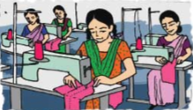
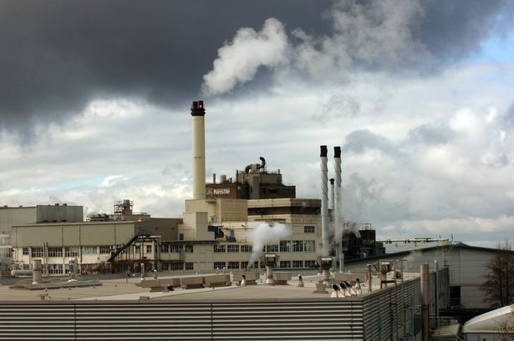
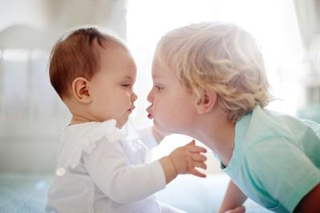
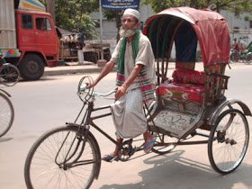
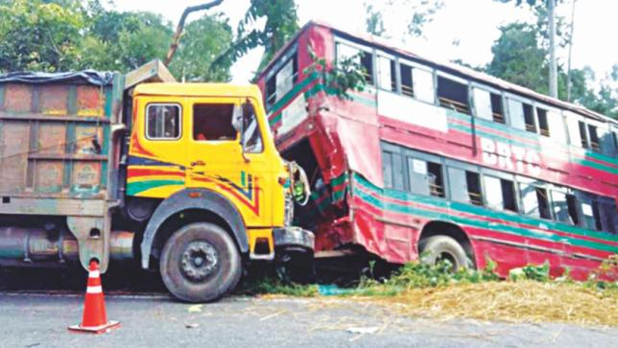
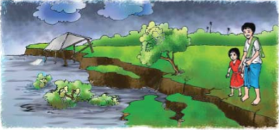
Let’s we know some new words
Garment worker
পোশাক শ্রমিক
Factory
কারখানা
Younger
ছোট
Rickshaw driver
রিক্সা-চালক
Accident
দূর্ঘটনা
River erosion
নদী ভাঙন

Slide 8
Now we are going to read a passage named.
‘A garment worker’s day’

Slide 9
A garment worker’s day
Reshma is a garment worker in Dhaka. She’s 18 years old.Her family came to Dhaka from a village eight years ago. There was a river erosion in her village. They lost their home. So the family came to Dhaka. Reshma’s father worked as a rickshaw driver, but he died in an accident.
Reshma’s uncle Ratan helped the family.He found a small house for them at Kalyanpur.He took Reshma to a Garment factory in Mirpur. She works their now.Her younger brother Babul goes to school. He is in class 5.Her mother stitches “Nakshi Kathas” at home and sells them.

Slide 10
With meaning in Bengla
‘A garment worker’s day’
পোশাক শ্রমিক দিবস
Reshma is a garment worker in Dhaka. She’s 18 years old.
রেশমা ঢাকায় পোশাক শ্রমিক । তার বয়স ১৮ বছর।
Her family came to Dhaka from a village eight years ago.
তার পরিবার আট বছর আগে গ্রাম থেকে ঢাকায় আসে।
There was a river erosion in her village.
তার গ্রামে নদীভাঙন হয়েছিলো।
They lost their home. So the family came to Dhaka.
তারা বসতভিটা হারিয়ে ছিলো। তাই পরিবারটি ঢাকায় চলে আসে।
Reshma’s father worked as a rickshaw driver, but he died in an accident.
রেশমার বাবা রিক্সা চালাতেন কিন্তু এক দূর্ঘটনায় তার মৃত্যু হয়।

Slide 11
‘A garment worker’s day’
পোশাক শ্রমিক দিবস
Reshma’s uncle Ratan helped the family.
রেশমার চাচা রতন পরিবারটির সাহায্য এগিয়ে আসেন।
He found a small house for them at Kalyanpur.
তিনি তাদের থাকার জন্য কল্যানপুরে একটি ছোট বাসা খুঁজে দেন।
He took Reshma to a Garment factory in Mirpur. She works their now.
তিনি রেশমাকে মিরপুরের এক পোশাক কারখানায় নিয়ে যান । সে এখন সেখানে কাজ করে।
Her younger brother Babul goes to school. He is in class 5.
তার ছোট ভাই বাবুল স্কুলে যায়। সে পঞ্চম শ্রেণিতে পড়ে।
Her mother stitches “Nakshi Kathas” at home and sells them.
তার মা বাসায় নকশি কাঁথা সেলাই করে তা বিক্রি করেন।

Slide 12
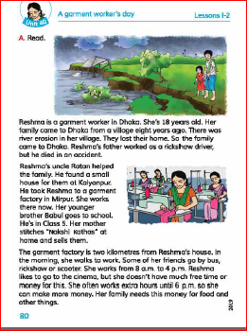
Everybody take your EFT book
and
open page at 80

Slide 13
Students group reading one student read by turn and others will listen.

Slide 14
Students individual reading

Slide 15
Assessment
Choose the correct answer…..
1.What does Reshma do?
a) She goes to school.
b) She’s a farmer.
c) She’s a garment worker.
d) She doesn’t have a job.
3. Where is the fectory?
a) in Mirpur.
b) in Kalyanpur.
c) five kilometres away.
d) near Babul’s primary school.
2. Who is Babul?
a) Reshma’s father.
b) Reshma’s brother.
c) Reshma’s uncle.
d) Reshma’s friend

Slide 16
Home work
Answer the questions.
1. Who is Reshma?
2.How old is she?
3. Why did Reshma’s family come to Dhaka?
4. What was Reshma’s father’s do?

Slide 17
Now we are going to play a game
(Bingo Game)
Here are some words..
Follow the instructions:
You have to write 4 words among them.
Then I will remove the words at random.
If you have written one of the words then circle it out.
When anyone has circled off all his words then shout “BINGO” and he/she will be the winner.
Ok lets start.
Garment worker
Driver
River erosion
Accident
River
Younger
Factory

Slide 18
Thank you

