Slide 1
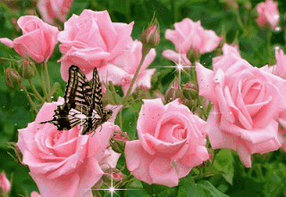
Welcome to English 2nd Paper Class
For
Alim/HSC

Slide 2
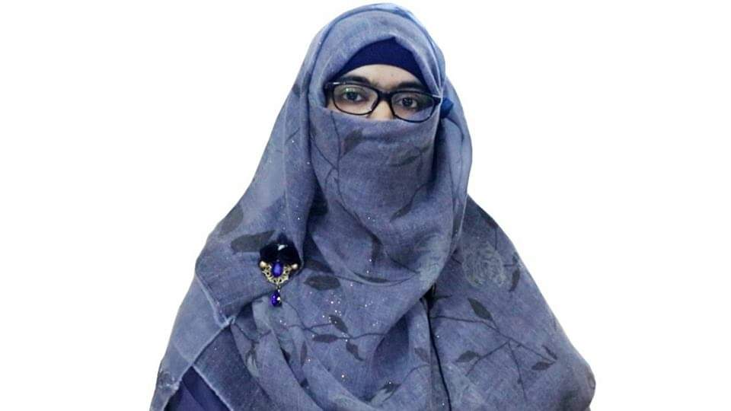
identity
Sabina Yeasmin
Lecturer in English
Baridhara Nazmul Ulum Alim Madrasah
Badda, Dhaka

Slide 3
Today’s topic is-
Transformation of sentences
Simple, Compound & Complex Part-4

Slide 4
At the end of the lesson, students will be able to-
Exercise the transformation of the sentences from Simple to Compound & Complex and vise versa spontaneously..

Slide 5
26. In winter it remains idle, but it work hard in spring. (Complex)
Ans: Though in winter it remains idle, it works hard in Spring.
27. Water, an important element of environment, is polluted in various ways. (Complex)
Ans: Water which is an important element of environment, is polluted in various ways.

Slide 6
28. The water which is pure is necessary for us. (Simple)
Ans: Pure water is necessary for us.
29. Though honesty cannot bring much wealth, it can give an absolute happiness. (Compound)
Ans: Honesty cannot bring much wealth but it can give absolute.

Slide 7
30. We should avoid the dishonest way and try to lead a perfect life. (Simple)
Ans: So avoiding the dishonest way we should try to lead a perfect life.
31. Pahela Baishakh is undoubtedly the most celebrated festival in Bangladesh. (Complex)
Ans: It is Pahela Baishakh which is undoubtedly the most celebrated festival in Bangladesh.

Slide 8
32. It is the first day of the Bengali year when the city roads get so jam packed. (Simple)
Ans: During the first day of the Bengali year, the city roads get so jam packed.
33. Although I don’t like gathering, I enjoy the activities of this day. (Compound)
Ans: I don’t like gathering but I enjoy the activities of this day.

Slide 9
34. The morning breeze is refreshing and it cools our brain. (Complex)
Ans: The morning breeze is refreshing that cools our brain.
35. People who work in the office usually walk in the evening. (Simple)
Ans: People working in the office usually walk in the evening.

Slide 10
36. But you may not get them when you need them. (Simple)
Ans: But you may not get them at the time of need.
37. The dowry seekers are very greedy and demand money from bride’s father. (Simpe)
Ans: The very greedy dowry seekers demand money from bride’s father.

Slide 11
38. Bangladesh exports tea and earns a lot of foreign exchange. (Simple)
Ans: Exporting tea, Bangladesh earns a lot of foreign exchange.
39. Tania nodded in agreement, but she was extremely nervous. (Complex)
Ans: though Tania nodded in agreement, she was extremely nervous.

Slide 12
40. He got closer to the animal and pressed the shutter button with a boyish grin in the face. (Simple)
Ans: Getting closer to the animal, he pressed the shutter button with a boyish grin in the face.

Slide 13
41. The Hong Kong based robotics company developed Sophia one and a half year ago. (Complex)
Ans: The robotics company which is Hong Kong based developed Sophia one and a half year ago.

Slide 14
42. Wearing a yellow Jamdani top and skirt, the robot came on the stage. (Compound)
Ans: The robot wore a yellow Jamdani top and skirt came on the stage.
Men pollute water by throwing waste in it. (Compoud)
Ans: Men throw waste in water and pollute it.nd)

Slide 15
44. It was 1971 when Bangladesh achieved independence. (Simple)
Ans: In 1971, Bangladesh achieved Independence.
45. Our freedom fighters sacrifice their lives for the independence of Bangladesh. (Complex)
Ans: It is our freedom fighters who sacrificed their lives for the Independence.

Slide 16
46. We shall always remember them in pride. (Compound)
Ans: We shall always remember and it is with pride.
47. They fought for the country with a patrotic zeal. (Compound)
Ans: They had a patriotic zeal and they fought for the country.

Slide 17
48. The farmers who are poor do not get loans on easy terms. (Simple)
Ans: The poor farmers do not get loans on easy terms.
49. The farmers do not get the facilities necessary for food production. (Complex)
Ans: The farmers do not get the facilities which are necessary for food production.

Slide 18
50. Unfortunately, they do not get the due price of their products. (Compound)
Ans: They produce but unfortunately they do not get the due price of their products.

Slide 19
Thank you so much
for watching

