Slide 1
Md. Manzur Rahman
B.A. (Hon’s), M.A. (English)
Assistant Teacher (English)
Goonvari B.L. High School,
Fulchhari, Gaibandha
E-mail: manzurrahman12@yahoo.com
Class: ix
Subject: English 2nd Paper
Time : 40 minutes
Title: Graph and Chart

Slide 2
Welcome to my today’s class.

Slide 3
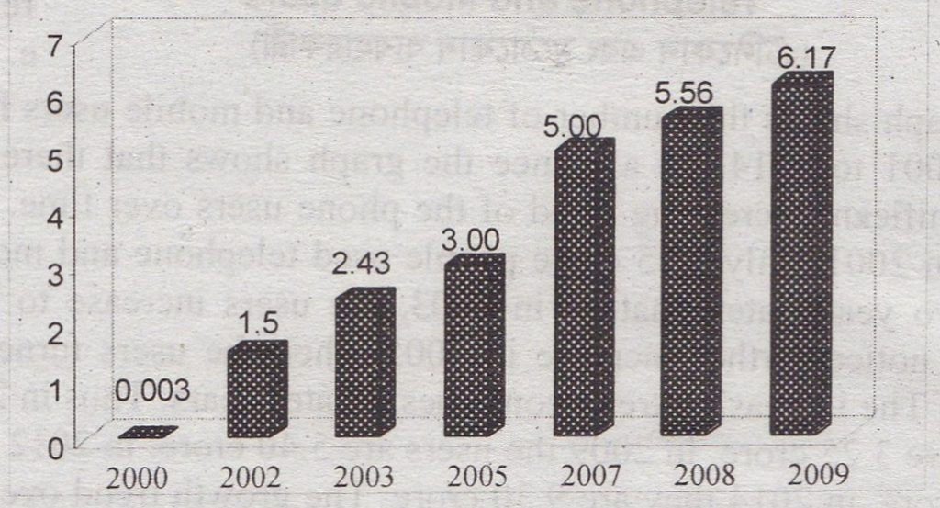
Look at the picture

Slide 4
What is this?
This is a chart.

Slide 5
So our today’s lesson is on-
Graph and Chart

Slide 6
After the end of the lesson, SS will be able to-
understand different graph and chart
able to write many graph and chart using one format

Slide 7
Read the format time and again
The graph clearly shows the number of (topic) from------------to--------------- . It shows the gradual rise/increase of (topic) within this time. We see in the graph that the number of (topic) has increased from (%) in (year) to (%) in (year).

Slide 8
Read the format time and again
In (year) the number of (topic) was (%), on the other hand, in (year) it rose to (%). Again in (year) the number of (topic) was (%) whereas in (year) it rose to (%). In (year), (topic) were (%). But it rose/fell to (%) in (year).

Slide 9
Read the format time and again
Overall, the graph illustrates that the number of (topic) continues to rise from (year) to (year). The highest number of (topic) was in (year) and the lowest number was in (year).

Slide 10
Now try to understand the graph

Slide 11
Now try to understand the graph
There are some PERSENTAGE and some YEAR

Slide 12
Now try to understand the graph
Try to find out the comparison among the years and write down them in your exercise book.

Slide 13
Now try to understand the graph
Try to find out the highest percentage and the lowest percentage.

Slide 14
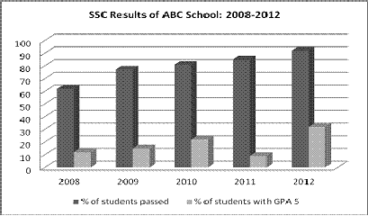
Home work
The graph below shows the results of SSC exam of ABC Secondary School from 2008 to 2012. Describe the chart in 150 words. You should highlight and summaries the information given in the chart.
Notes:
Teacher will help to make pair of students. After completing pair work, teacher show the correct answer.

Slide 15
That’s All for Today.
See you in the next class.
Bye.
Notes:
Teacher will help to make pair of students. After completing pair work, teacher show the correct answer.

