Slide 2
To Everyone

Slide 3
This is
Anjuman Ara
Assistant Teacher
Waruk Govt: Primary school
Shahrasti,Chandpur
Mobile: 01776005958

Slide 4
Lesson Introduce
Class: 5
Subject: English
Time: 45 minutes
Date :

Slide 5
Let's see a video
http://youtube.com/watch?v=x23rTDl4AMs

Slide 6
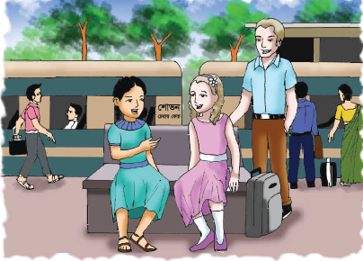
Today’s our lesson
H
E
L
L
O

Slide 7
Learning Outcomes
Students will be able to-
Listening:
3.2.1 understand questions about family and friends of students.
3.4.1 understand statements made by the teacher and students.
Speaking:
1.1.1 say words, phrases and sentences with proper sounds and stress.
8.1.1 take part in conversations on appropriate topics.
Reading:
1.5.1 read words, phrases and sentences in the text with proper pronunciation ,stress and intonation.

Slide 8
Hello!
May I introduce myself?
I’m Sima.
Hi! I’m Jessica.

Slide 9
Where are you going, Jessica?
I’m going to Chittagong.
I’m on holiday with my father.

Slide 10
Really? Where are you from?
I’m from the United Kingdom. Are you from Dhaka?
No, I’m from Sylhet. That’s where we’re going. Our train is leaving in 1o minutes.
Have a good journey.

Slide 11
Thank you. Nice meeting you, Jessica. Have fun in Chittagong.
Thanks. Nice meeting you, too, Sima.

Slide 12
Open the book
Page no 02

Slide 13
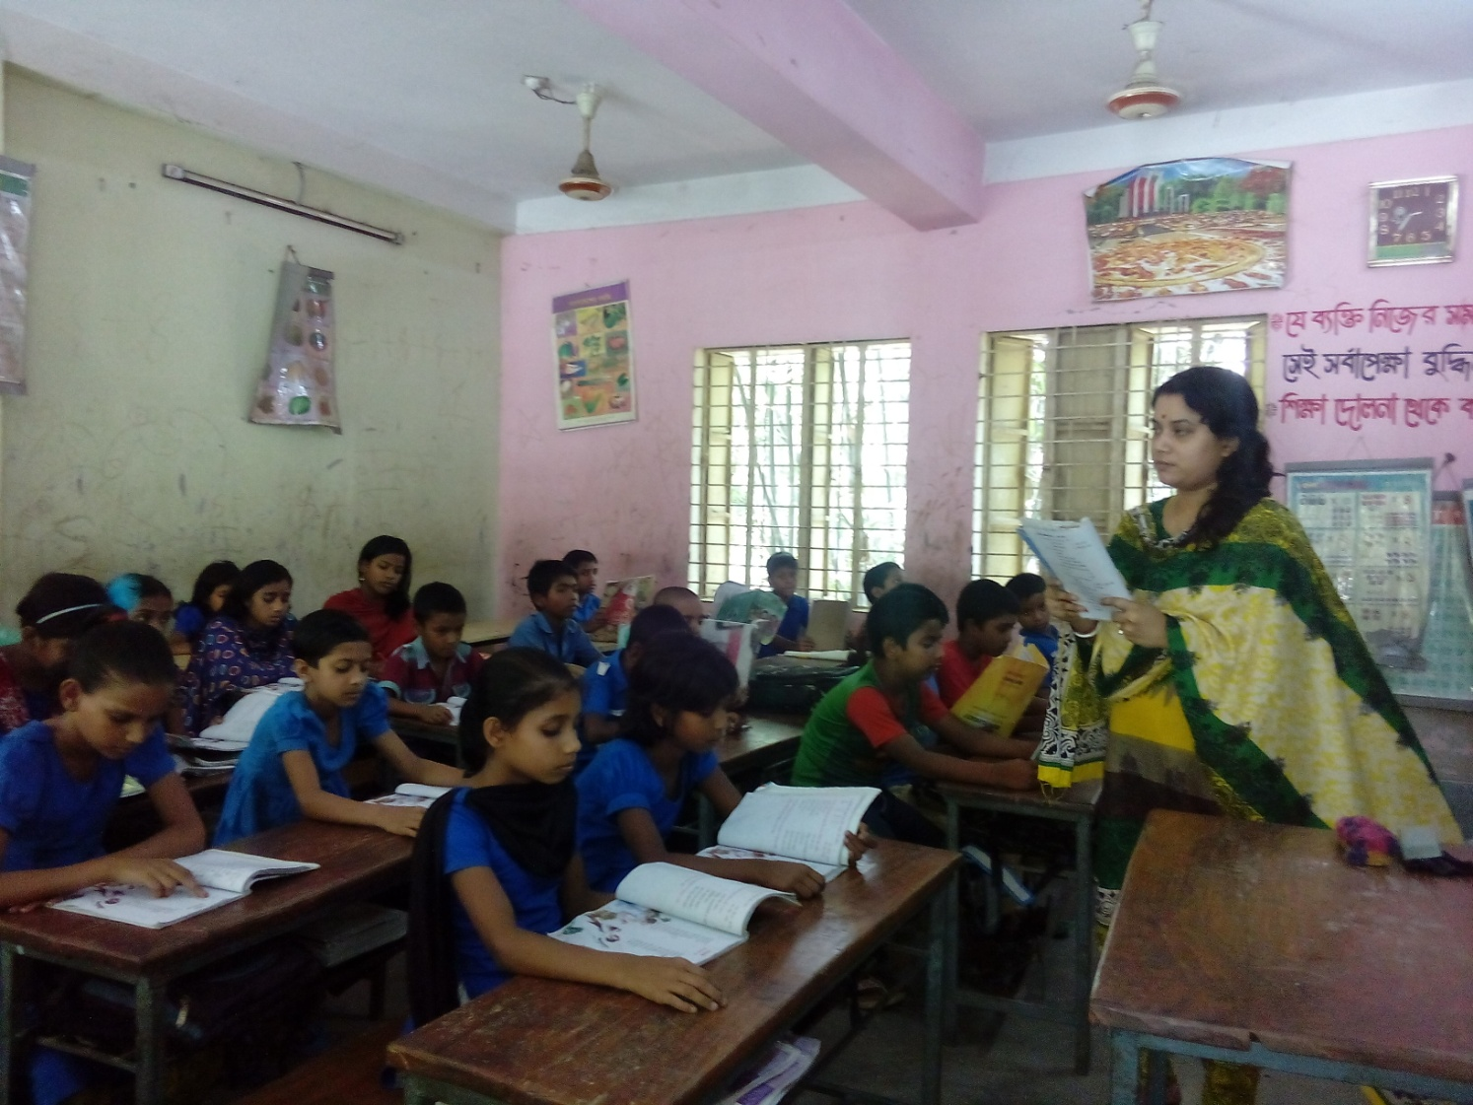
Teacher’s model reading

Slide 14
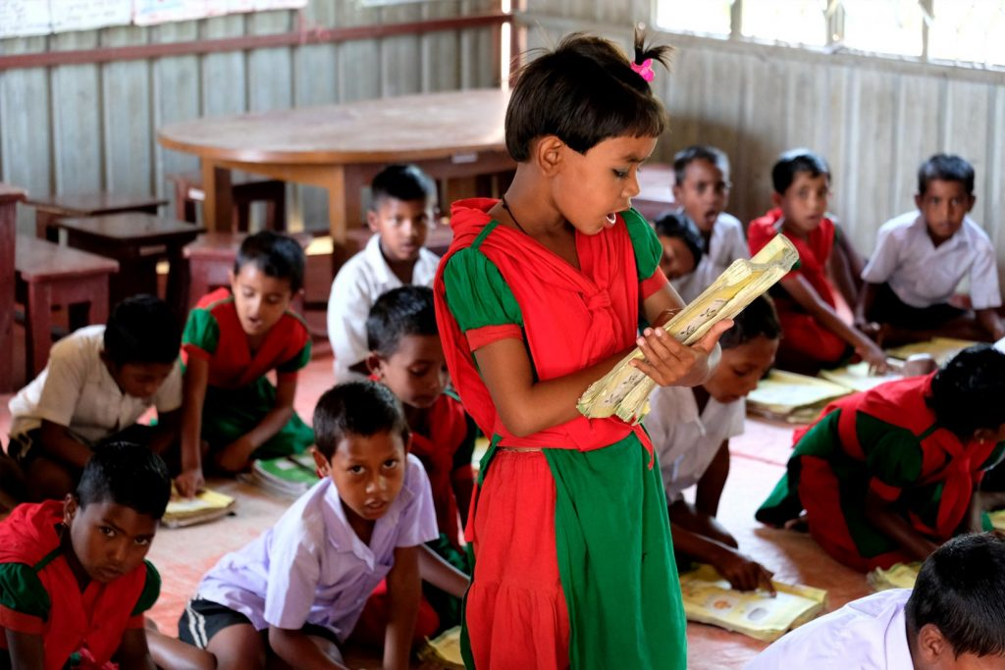
Individual reading
Students read this dialogue individually.

Slide 15
One day One word
Introduce
পরিচয় করানো
make (someone) known by name to another in person, especially formally.

Slide 16
New word in this lesson
Introduce
পরিচয় করানো
Formally known by name to another in person..
Really
সত্যি
in actual fact
Holiday
ছুটি
an extended period of leisure and recreation
Meeting
দেখা হওয়া
formal discussion
Leaving
ছেড়ে যাওয়া
go away from

Slide 17
Pair work
Dear students, To make conversation to each other about your first meet.

Slide 18
Evaluation
I will evaluated the pair work by looking around.

Slide 19
Home task
Students will be solved this questions.
a) Where is Jessica going?
b) Where is Sima from?
c) Where are Sima and Jessica?
d) Where is Sima going?

