Slide 1
Welcome today’s class.

Slide 2
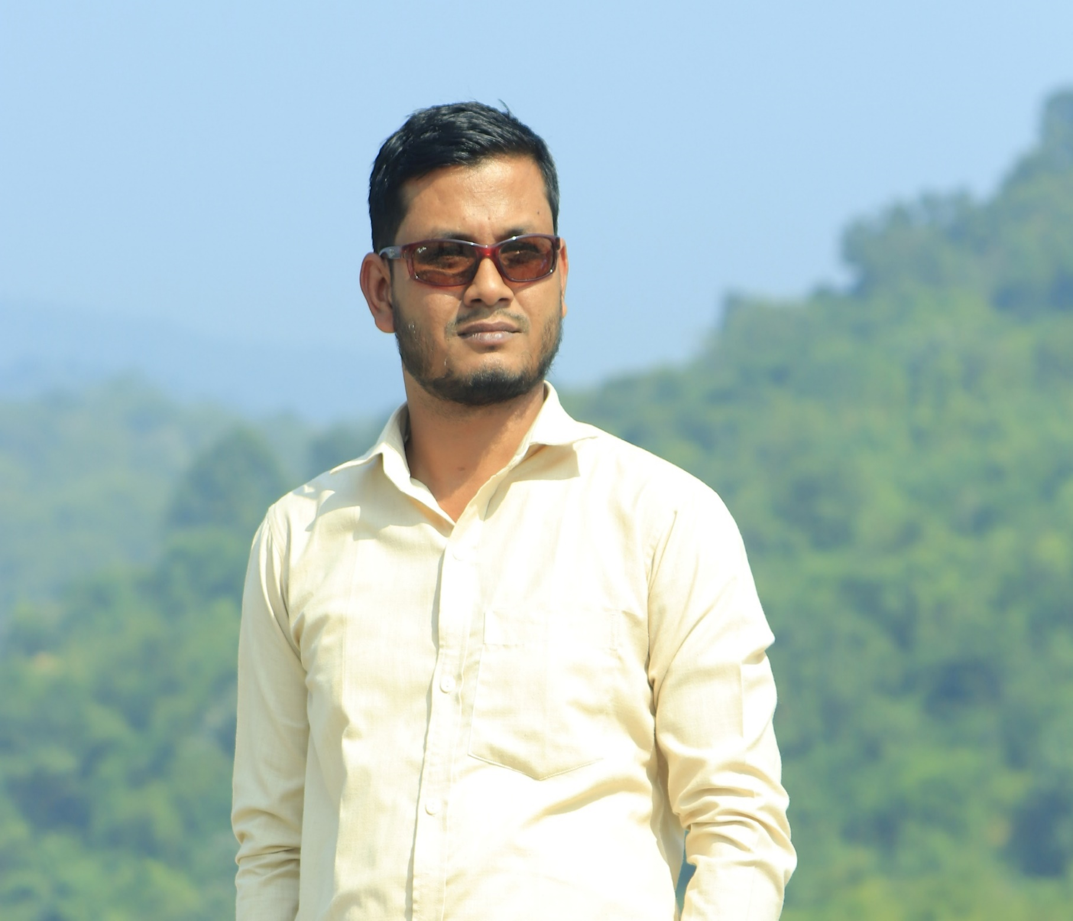
Teacher Introduction
Md Sazzadur Rahman
Assistant Teacher
Jaliarpar Government Primary School,
Companigonj,Sylhet.

Slide 3
Lesson Introduction
Class: Five
Sub: English
Lesson title: Saikat’s family
Unit:3

Slide 4
Learning outcomes
At the end of the lesson ss will be able to
Listening:
3.2.1: Understand questions about family and
Speaking:
6.1.2: Say what other doing
6.2.1:Talk about people objects, events etc.
Reading:
1.5.1: Read word, phrases, and sentences in the text with proper
pronunciation, stress and intonation.
1.7.1: Read paragraph, dialogue, stories, letters and other texts.

Slide 5
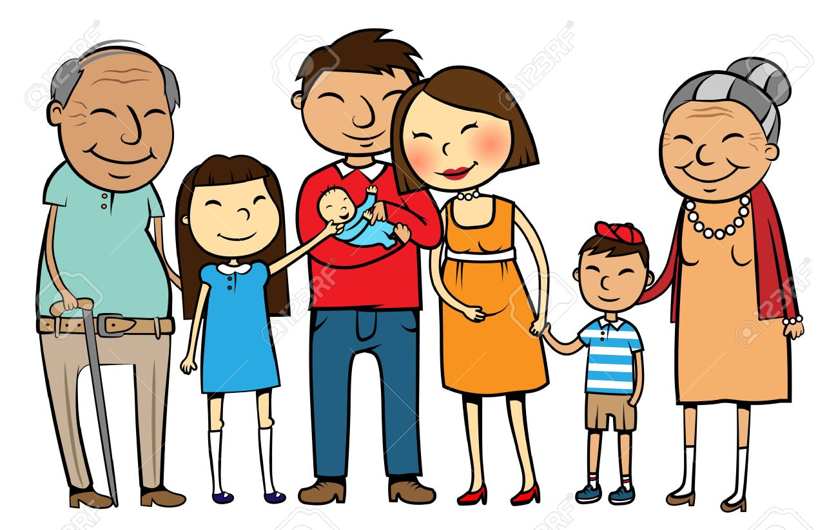
What about the picture ?
Family

Slide 6
Today we’ll read about…
Saikat’s Family

Slide 7
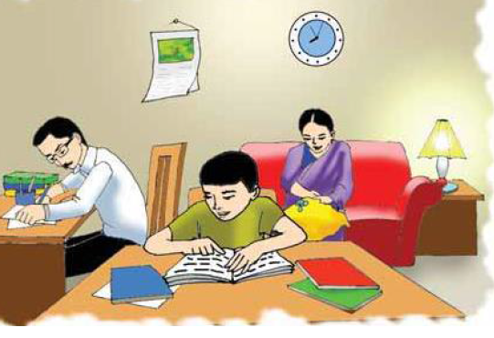
Saikat’s family

Slide 8
New words
Parents
Neighbour
Housewife
Banker
Animal

Slide 9
Let’s we know the meaning of new words
Parents
=
Father and mother.
Housewife
=
A woman who works in a house.
=
A living thing which is not human
being or plant.
Animal
Neighbour
=
Who live near to you.
Banker
=
A person who works in a bank.

Slide 10
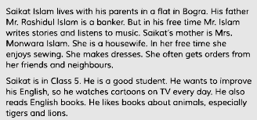
Saikat’s family

Slide 11
Family’s members
Saikat’s
family
Saikat
Mrs. Monowara Islam
MR . Rashidul Islam

Slide 12
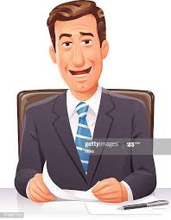
What is Mr. Rashidul Islam ?
Mr. Rashidul Islam is a banker.

Slide 13
What does he do in his free time?
He writes stories.

Slide 14
Saikat’s father
Mr. Rshidul Islam
He is a Banker.
He writes stories in his free time

Slide 15
What does Saikat mother do in her free time?
Saikat’s mother makes dresses

Slide 16
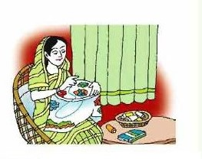
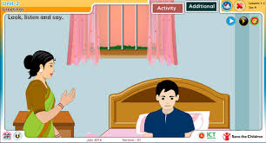
Saikat’s mother
She enjoys sewing in her free time
Saikat’s mother’s name is Monwara Islam
She is a house wife

Slide 17
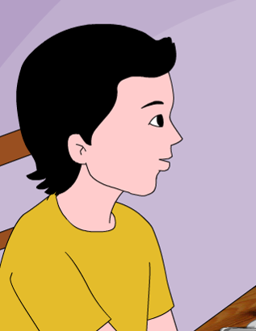
What is Saikat?
Saikat is a student

Slide 18
Saikat
Student
Read books
Watch TV

Slide 19
PAIR WORK
1.What is Saikat’s parent’s name?
2.What is Saikat’s parent’s occupations ?

Slide 20
FILL IN THE BLANKS
Parents
makes
watches
housewife
1.Saikat’s mother……….......dresses.
2.She is a …………..
3.Saikat …………..cartoons.

Slide 21
Make sentence:
Sewing
= My mother enjoys sewing.
Animals
= I like books about animals.
Dress
= She makes dresses.

Slide 22
Task
1.What is Saikat?
2.What is Saikat’s father’s name?
3.What is Saikat’s mother’s name?

Slide 23
Home work
Write five sentences about your family.

Slide 24
Thank you everybody.

