Slide 1



Slide 2
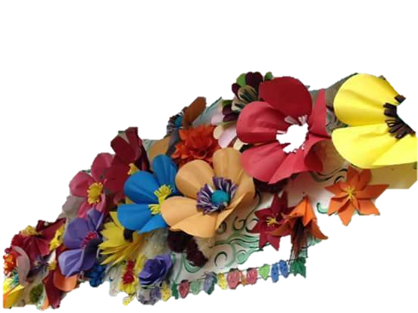
Teacher’s Identity
SHAMPA RANI DAS
ASSISTANT TEACHER
SATKORAKANDI GOVT.PRIMARY SCHOOL
BOROLEKHA ,MOULVIBAZAR.

Slide 3


Lesson Identity
Class: Two
Subject:English
Lesson: 4- 6
Unit: One (A)

Slide 4
Learning Outcomes
By the end of the lesson the students will be able to-------------
1.1.1 Become familiar with English sounds by listening to common English words.
1.1.2 Repeat after the teacher simple words and phrases with proper sounds and stress
.
1.2.1 Recognize and read the alphabet both small and capital ( non –cursive).
.

Slide 5
Emotion creat
Let,s see the Video
Discuse about the Video

Slide 6
Today’s Lesson
Alphabet

Slide 7
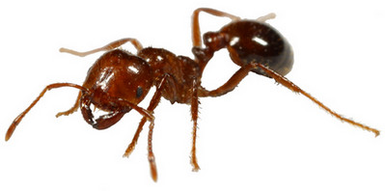

Now Look At The Picture.Say And Read Loudly.
Ant
Bat

Slide 8

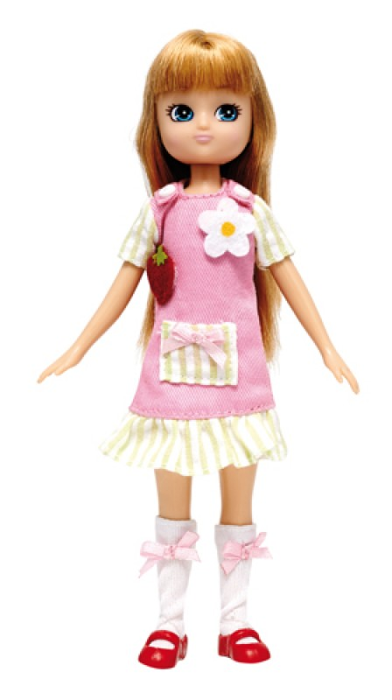
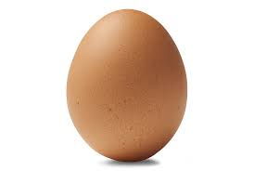
Now Look At The Picture.Say And Read Loudly.
cup
doll
egg

Slide 9
Dear students,open at page 3 of your book and look activity c.

Slide 10
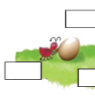
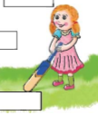
What is the ant doing?
What is the doll doing?

Slide 11
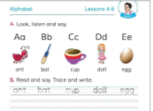
Dear students,open at page 3 of your book and look activity c.

Slide 12
Dear students,open at page 3 of your book and look activity c.

Slide 13
Evaluation
Match the words with the letter
bat
Aa
dog
Bb
ant
Cc
Dd
egg
A
Ee
cup

Slide 14



