Slide 1
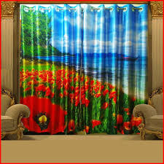

Slide 2
WELCOME

Slide 3
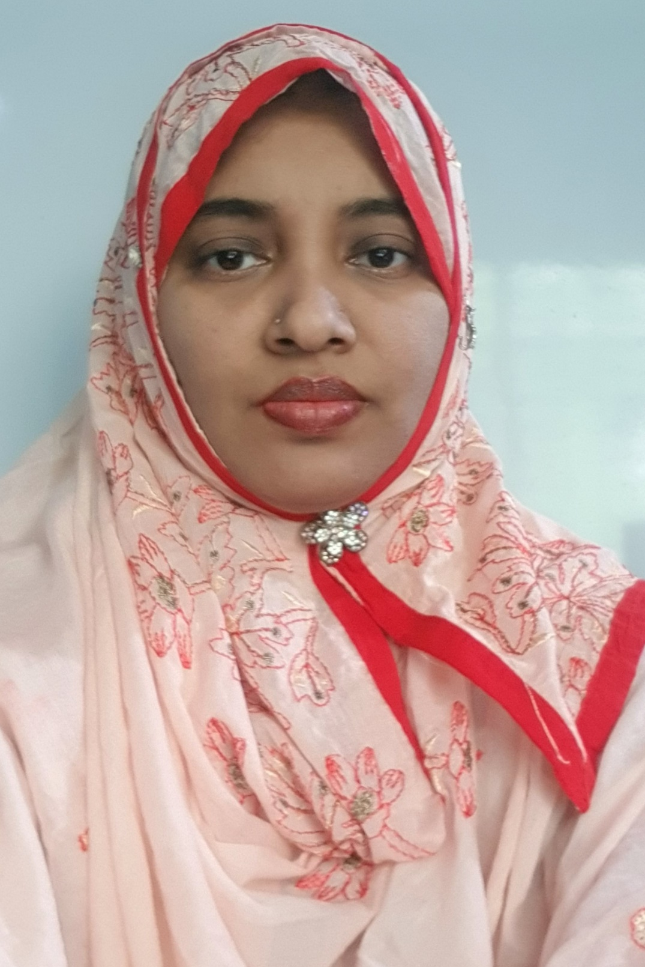
Teacher’s identity
Marina Akther
Assistant teacher
KB Govt Primary School
Begumgonj,Noakhali

Slide 4
Students will be able to :
3.1.1 understand simple questions about students. 3.1.2 understand simple questions about familiar objects.

Slide 5
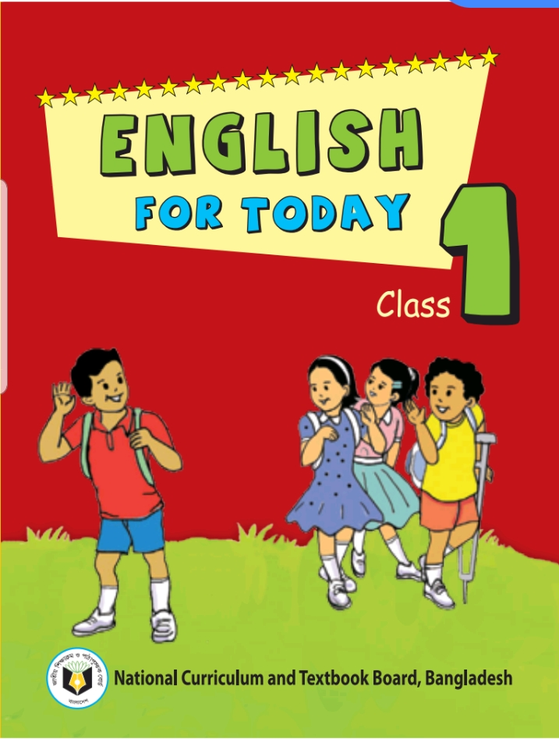
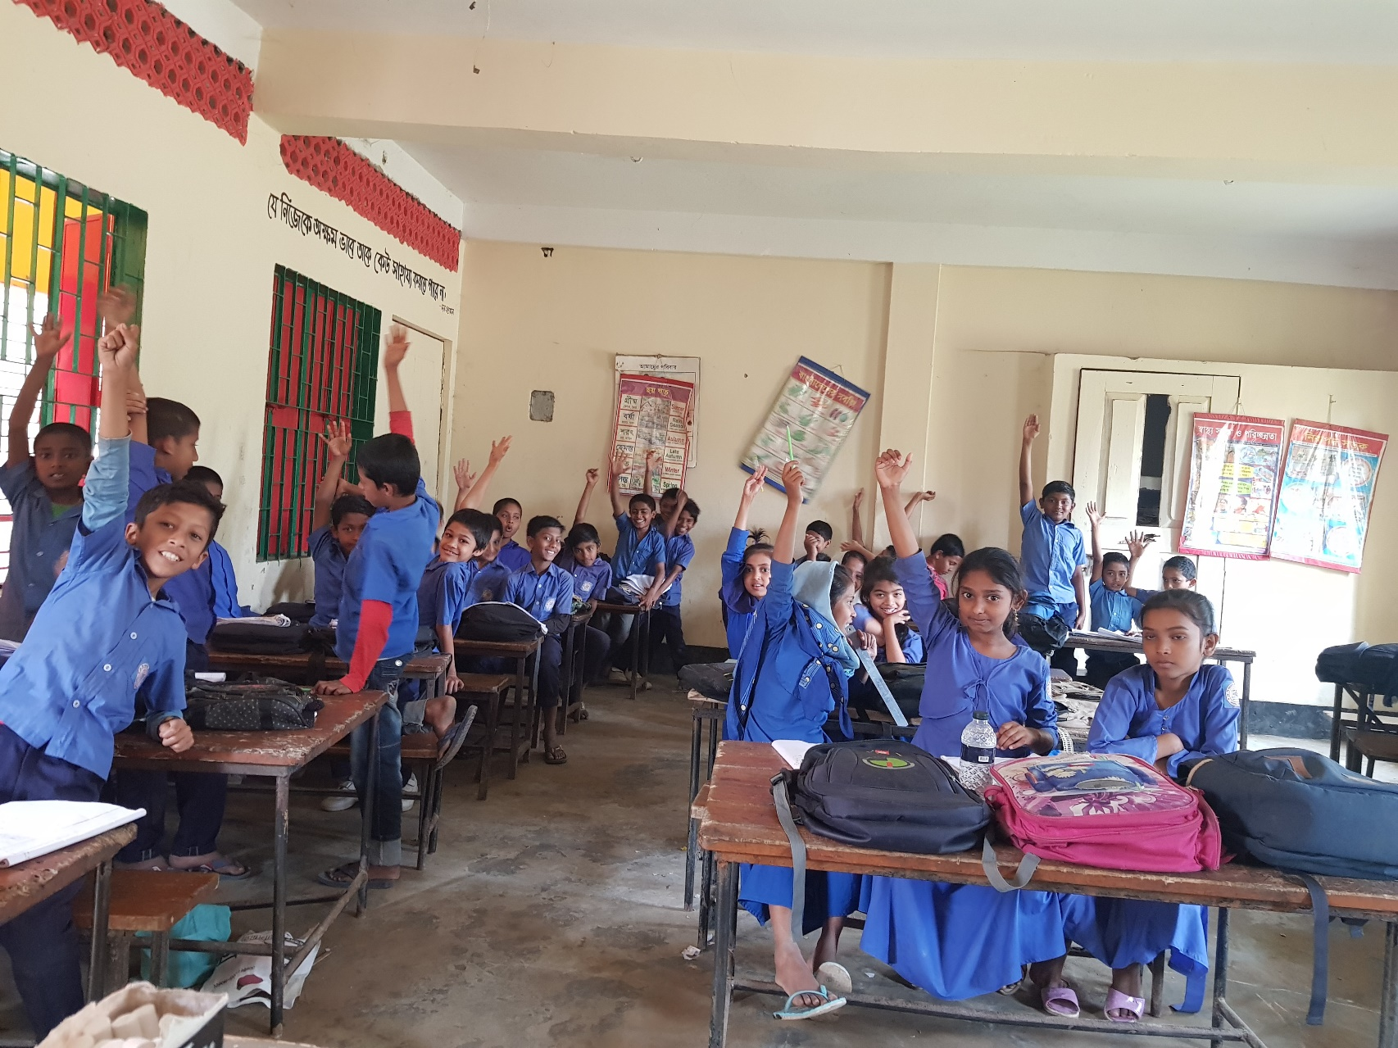

Slide 6
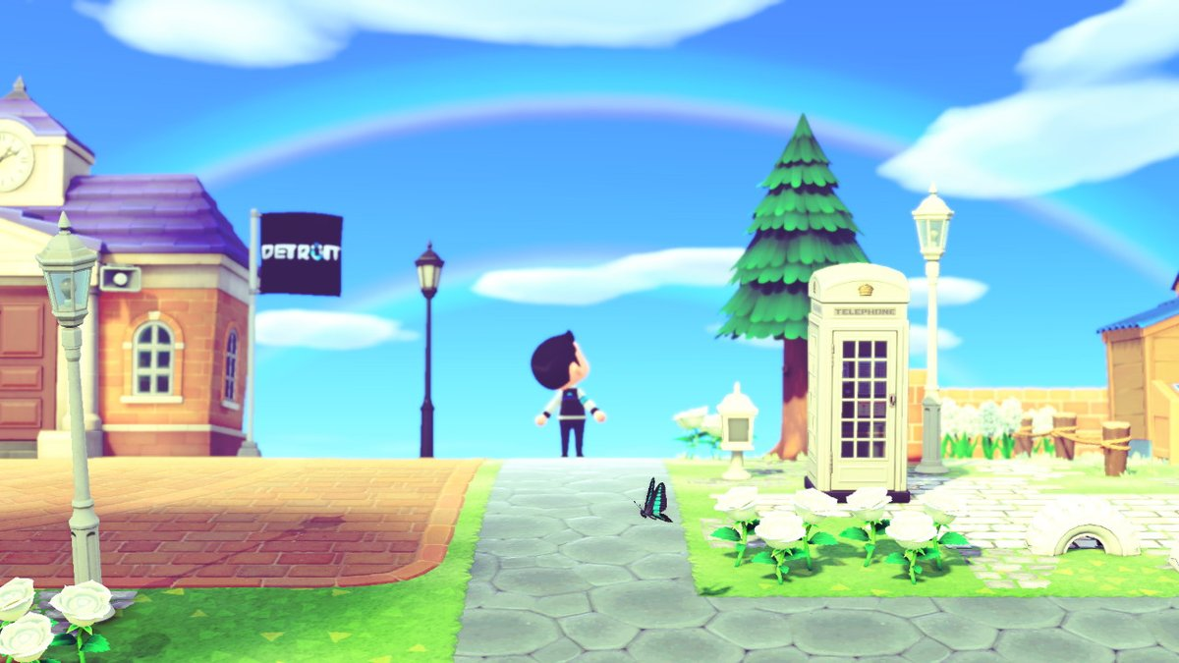
Let’s watch a video.

Slide 7
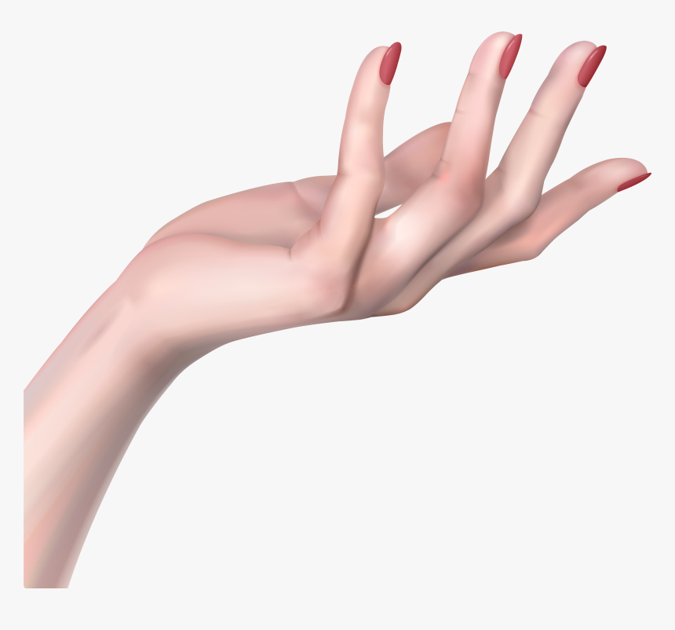
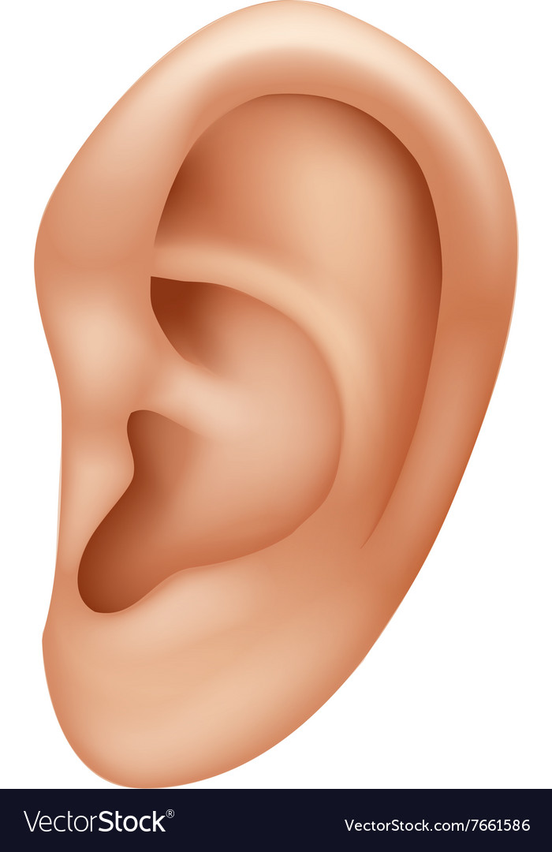
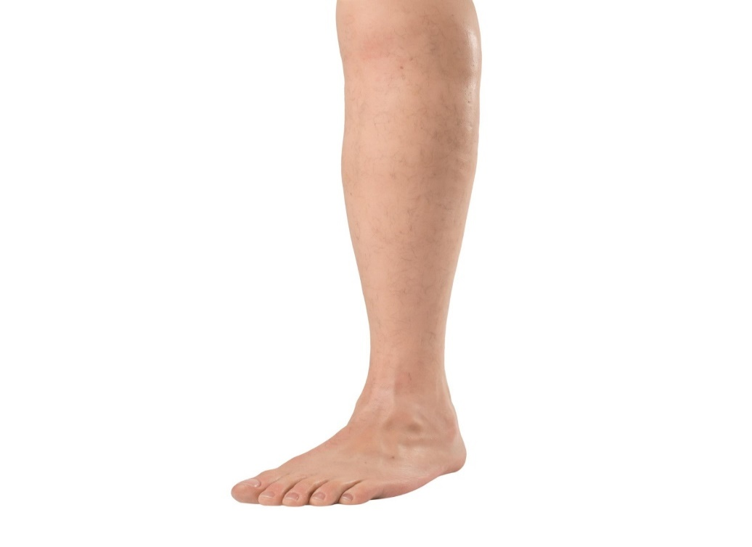
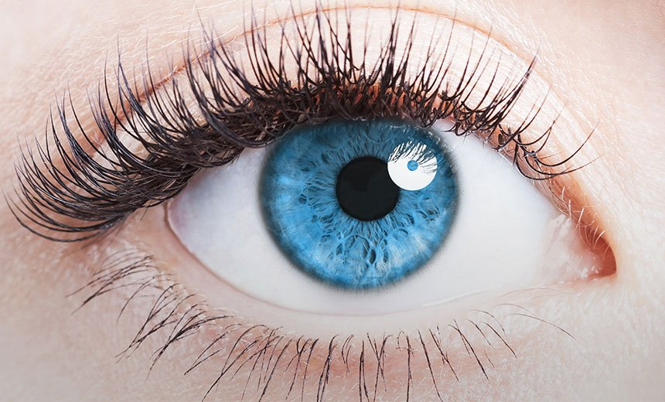
What can you see in the picture?

Slide 8
HEAD
H
E
A
D
Repeat after me and spell with me.

Slide 9
Repeat after me and spell with me.
E
EYE
Y
E

Slide 10
NOSE
N
O
S
E

Slide 11
HAND
H
A
N
D

Slide 12
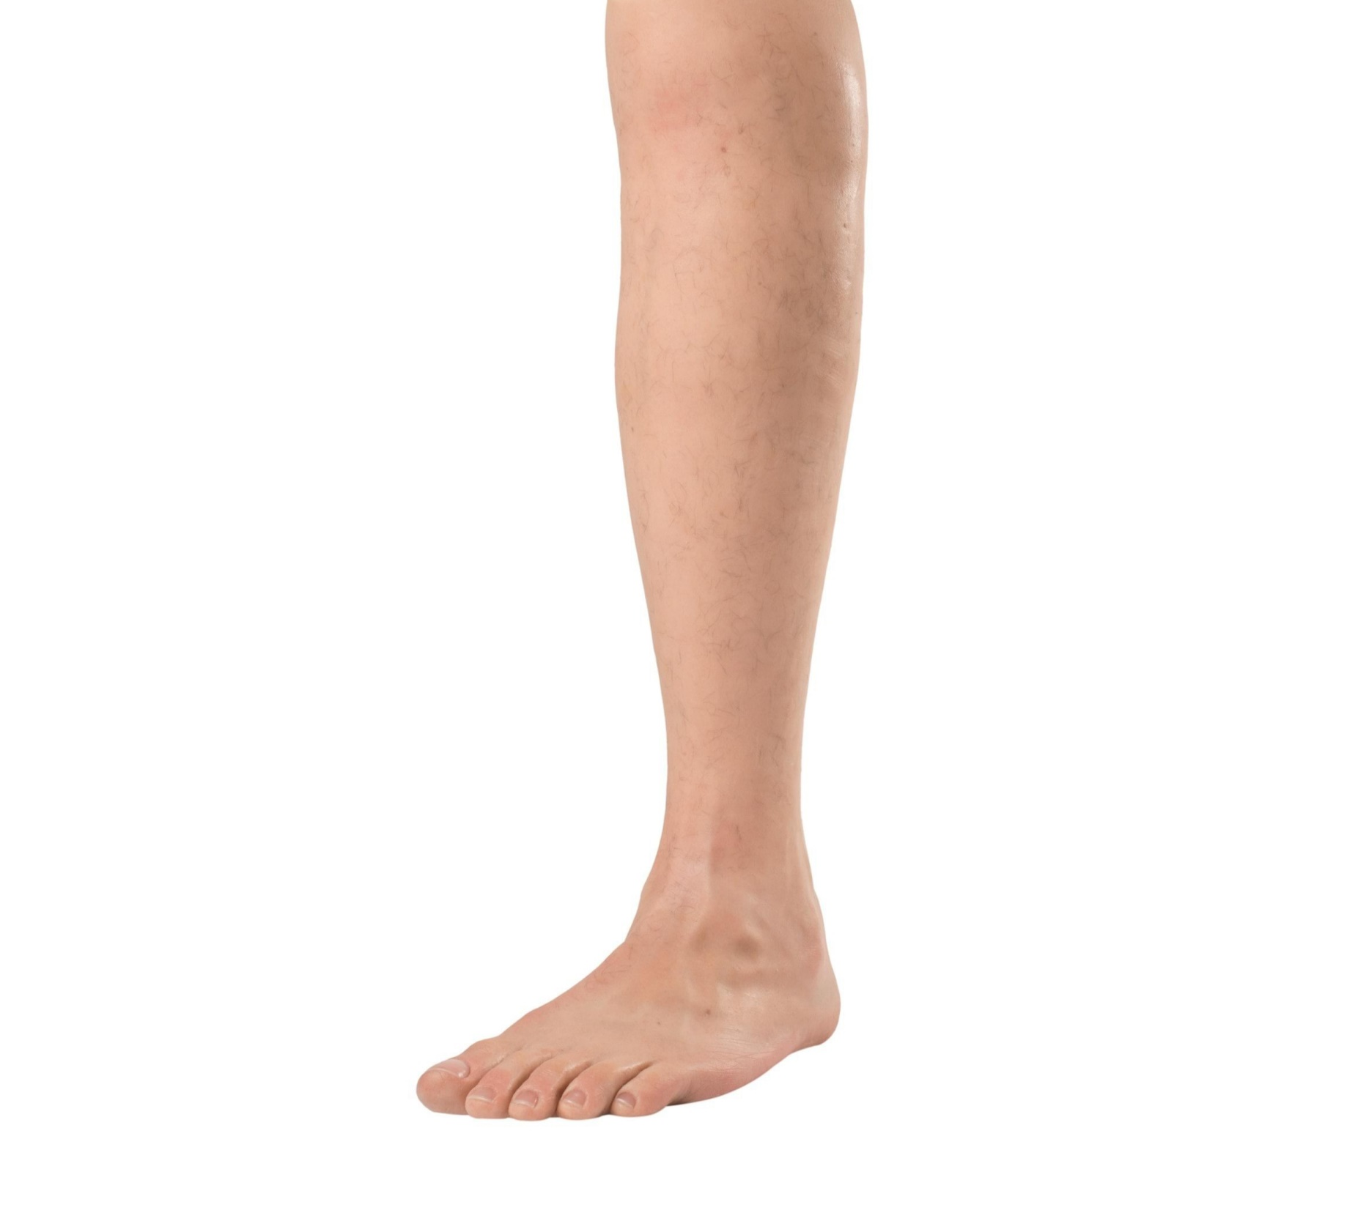
LEG
L
E
G

Slide 13
EAR
E
A
R

Slide 14
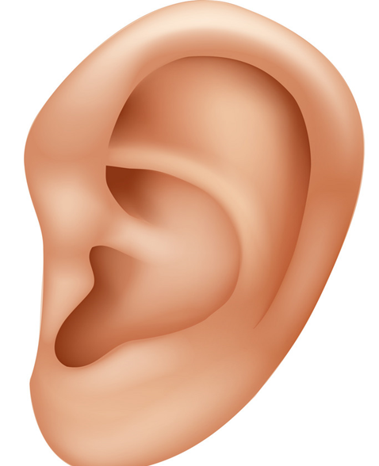
HEAD
EYE
NOSE
HAND
EAR
LEG

Slide 15
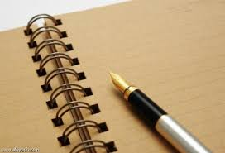
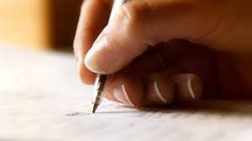
Take your exercise book
Write names of 5 parts of your body

Slide 16
Lets sing
Goodbye song.

Slide 17
Thank you.
Stay at home.

