Slide 2
identity
Class: One
Subject: English
Alphabet. Lesson:4-6,
Unite : 4. Page : 3
RIBON RANI DASH
ASSISTANT TEACHER
BHARAPURNI GOVT. PRIMARY SCHOOL
LAKHAI,HOBIGONJ.

Slide 3
Lets see the video

Slide 4
Lesson Declaration
D
d
Alphabet(Dd)

Slide 5
Learning outcome
Students will be able to-
1.1.1 to become familiar with English sounds by listen to
common English word.
1.1.2 to say simple words.
1.2.1 to recognize and read the alphabet both small and
capital (non-cursive) letters.
3.1.2 write words using non-cursive small letters.

Slide 6
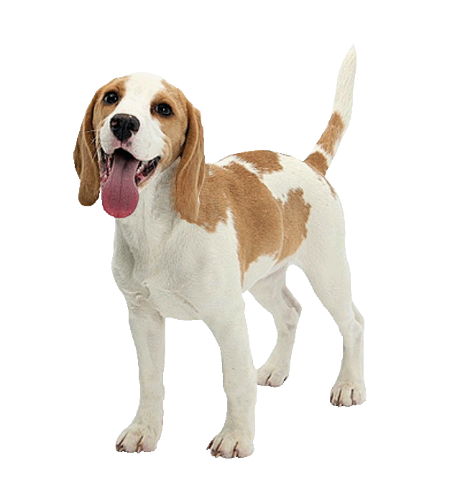
Look, listen and say
D
d
dog

Slide 7
Look, listen and say
D
d
Door

Slide 8
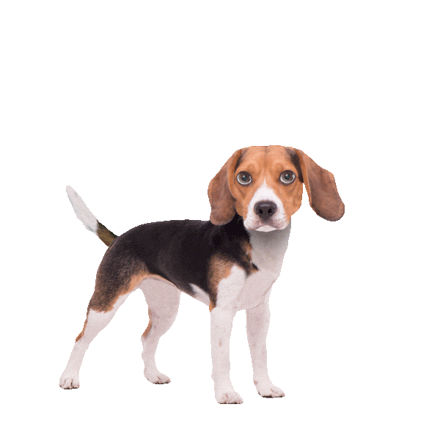
Look, listen and say
D
Dog
Capital letter

Slide 9
Look, listen and say
d
Door
Small letter

Slide 10
Look, listen and say. Trace in the air.
D
D

Slide 11
Look, listen and say. Trace in the air.
d
d

Slide 12
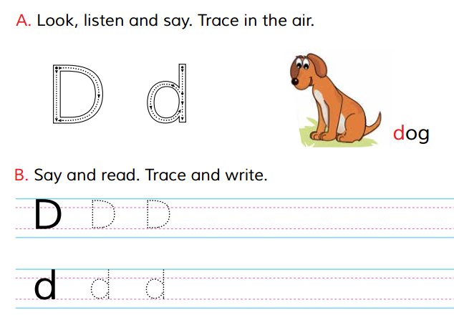
Open at page 5

Slide 13
Loud reading by the teacher
WCW
D
Dog
d
Door

Slide 14
Match the pictures with the letters:
Group work
D
door
d
Dog

Slide 15
Say and read. Trace and write.
WCW
WCW
D
D
D
d
d
d

Slide 16
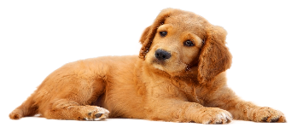
Look and say. Write.
Evaluation
Look at the picture and fill in the gaps:
Dog
Door

Slide 17
Evaluation

