Slide 1
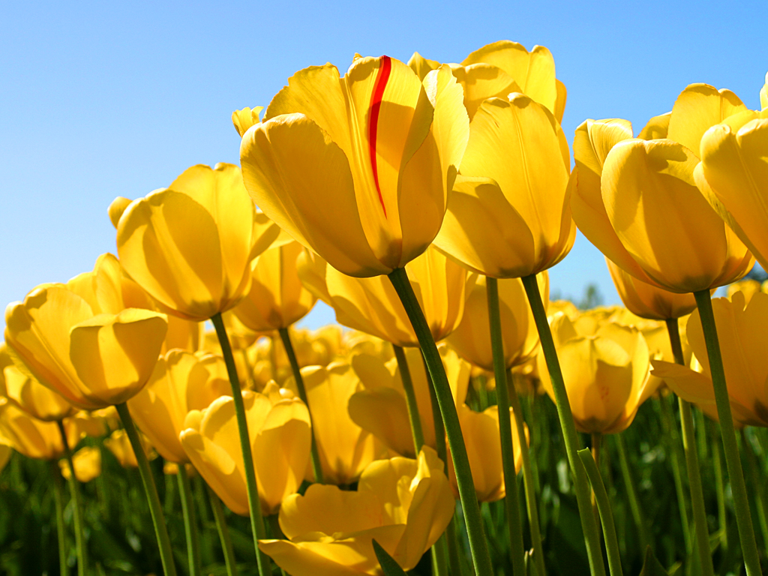
Wel Come

Slide 2
INTRODUCTION
Teachers Identity
Subject: English
Md. Bellal Hossain Lec. Eng.
Panipara Alim Madrasah.
Chandina, Comilla.
Lesson: English 2nd paper.
Class:12
UNIT:ONE.

Slide 4
TENSE

Slide 5
OUTCOME
Students will be able to-
Understand the structures of tenses.
Make sentenc.
Speak English.

Slide 6
Tense:
Firstly, tense has been divided into three.
As-
1. Present.
2. Past .
3.Future.
Then,each tense has been divided into four.
As-
1.Present Indefinite Tense.
2.Present Continious Tense.
3.Present Perfect Tense.
4.Present Perfect Continious Tense.

Slide 7
Past Tense.
1. Past Indefinite Tense.
2. Past Continious Tense.
3. Past Perfect Tense.
4.Past Perfect Continiousw Tense.

Slide 8
Future Tense.
1. Future Indefinite Tense.
2. Future Continious Tense.
3.Future Perfect Tense.
4. Future PerfectContinious Tense.

Slide 9
1.Present Indefinite Tense.
Daily activities,universal truths and proverbs are included in Pr5esent Indefinite Tense.
As-
We eat food.
The sun rises in the east.
As you sow,so you reap.etc.

Slide 10
Structure of present Indefinite:
Sub+v1+ob\other.
I go home.
We read books.
He writes songs.
They play cricket.
Reza likes flowers.etc.

Slide 11
Structure of Present Continous.
Sub+am/is/are+v1+ing+ob/other.
Iam eating food.
We are reading books.
He is making a noise.
Tina is writing poems.etc.

Slide 12
Present Perfect Tense.
Structure:Sub+have/has+v3+ob/other.
Sentence:I have eaten food.
We have gone home .
You have done it.
She has written books.
Mina has liked me.etc.

Slide 13
Present Perfect Continous.
Structure: Sub+have/has+been+v.ing+ob/other+for/since+time..
Sentence:I have been eating rice for 1 hour..
We have been reading books since morning.
He has been writing poems for 2 hours.
Sumi has been singing a song since night.etc.

Slide 14
C.W.
Make 2 sentences for each of the 4 tences.

Slide 15
H.W.
Make 5 senences for every 4 tences.

Slide 16
Thanks .

