Slide 1
Welcome

Slide 2
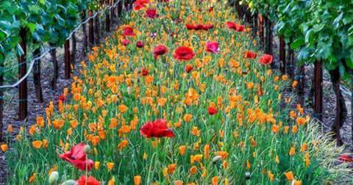
Teacher’s Identification
Md. Safiqur Rahman
Asst. Head Teacher .
Raipura Pilot Girls High School.

Slide 3
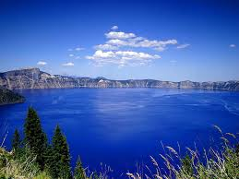
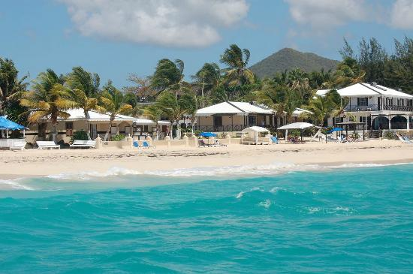
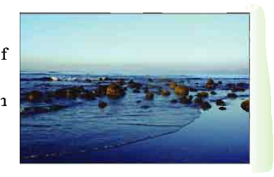
Could You tell me What types pictures are these?
Let’s see some pictures

Slide 4
Lesson declaration
Today’s topic is “Lake Baikal
Class-nine/ten, Unit-6 Lesson-5

Slide 5
Learning out comes
Ending of the lesson the learners ---
Will able to know about Lake Baikal.
Will Introduce with new words.
Will able to answering question.
They can write a short composition on “Lake Baikal”

Slide 6
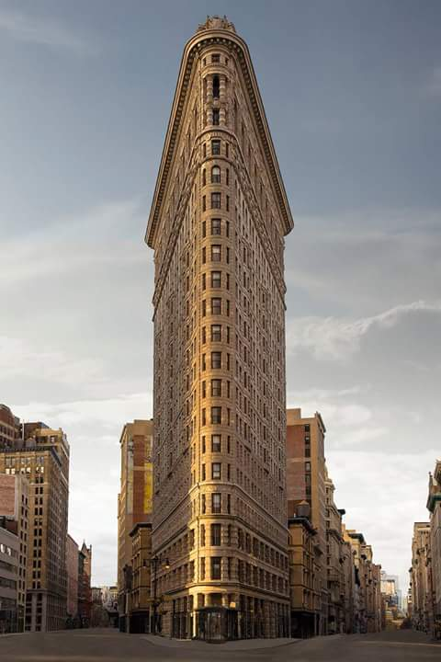
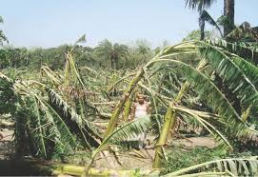
Vocabulary
Gigantic
Extremely large or huge
Exceptional
Not ordinary
Turbulent
Stormy

Slide 7
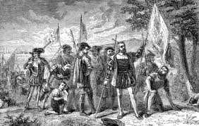
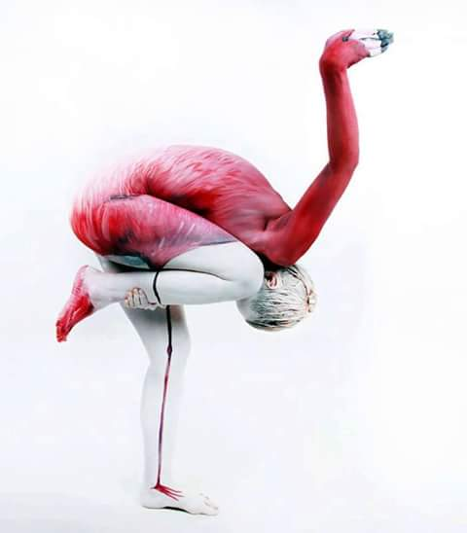
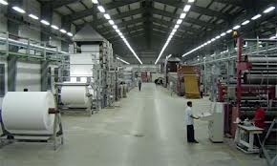
Ancient
Old
Miracle
Wonderful
Self-explanatory
Autonomous

Slide 8
Asking Questions(Individually)
What is Lake Baikal?
What is its geographical location?
What is the land area of Lake Baikal?
What is the length of the Lake Baikal?

Slide 9
Let’s enjoy the Lake Baikal at a glance

Slide 10
Group work
What do you mean by ’Fresh Surface Water’

Slide 11
Evaluation
What is the average depth of the Lake Baikal?
How does the Lake Baikal look?
What does the weather depend on?

Slide 12
Home Work
Write a paragraph on ‘Lake Baikal’

Slide 13
s

