Slide 1
Welcome to the learners.

Slide 2
Identity
Md. Safiqur Rahman
Asst. Head Teacher
Raipura Pilot Girls High School.

Slide 3
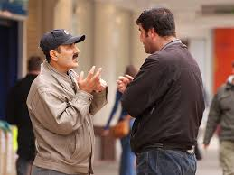
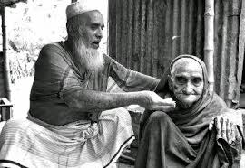
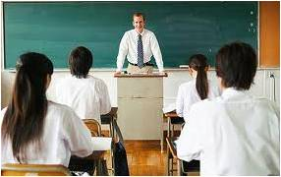
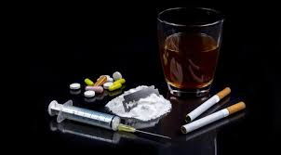
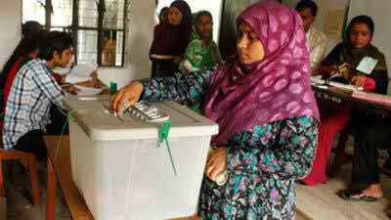
Let’s see some pictures
Can you guess what are the sign of these pictures

Slide 4
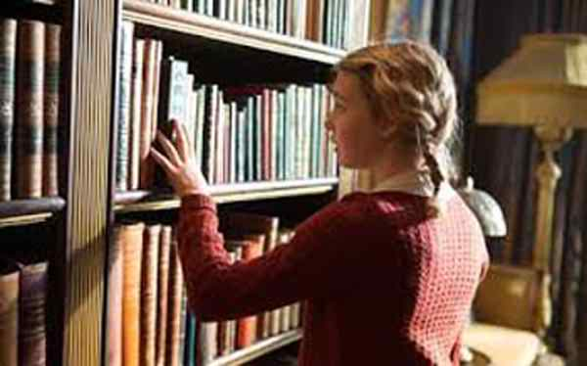
Lesson declaration
Unit one –Good citizens
.
Lesson -1.

Slide 5
Learning Outcomes
Improving reading skill
Introducing with new words
Narrate incidents .
Participate in discussion .
Asking and answering questions

Slide 6
Reading test
Please open page at 2 from your EFT and read the text silently.

Slide 7
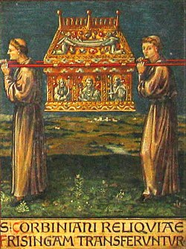
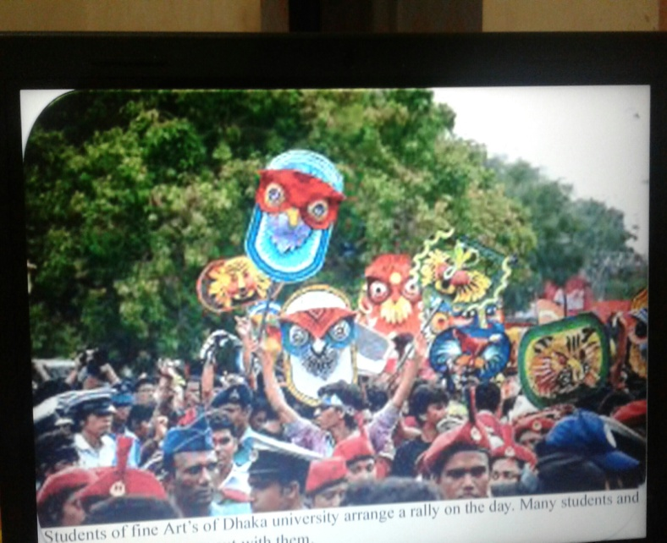
Culture
Customs
Function
Occasion

Slide 8
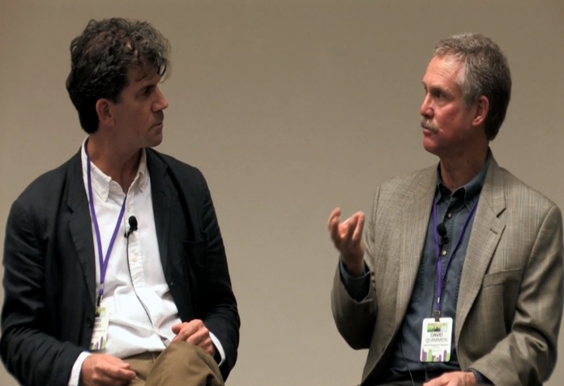
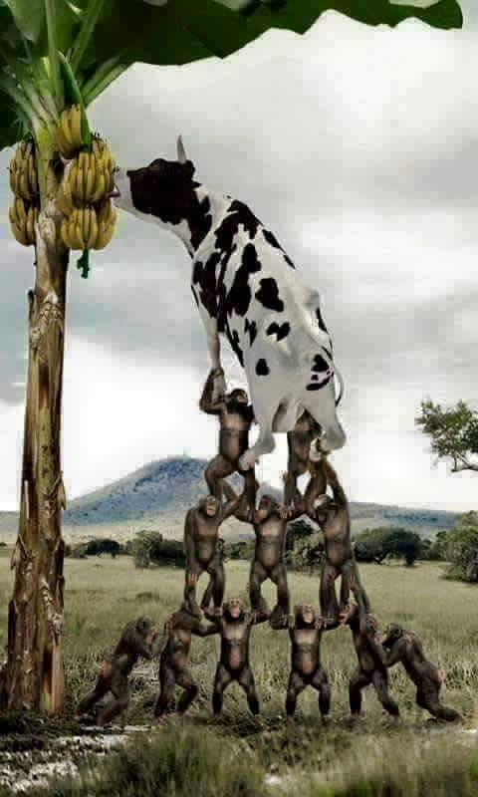
Quarrels
debate
Gradually
Step by Step

Slide 9
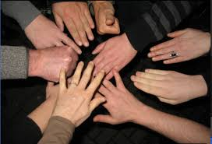
Group work
“Man cannot live alone.” Explain it in short.

Slide 10
Asking question( Individually)
How is today’s society?
Why does one need skills?
Why will you have to prepare yourself to do good work in society?
What will you have to do to be a good citizen?

Slide 11
Pair work
Make a list of responsibilities to the society as a good citizen.

Slide 12
Evaluation
What is the main purpose of the author of the text?
What does one need to do things?
What do you need first to be a good citizen?

Slide 13
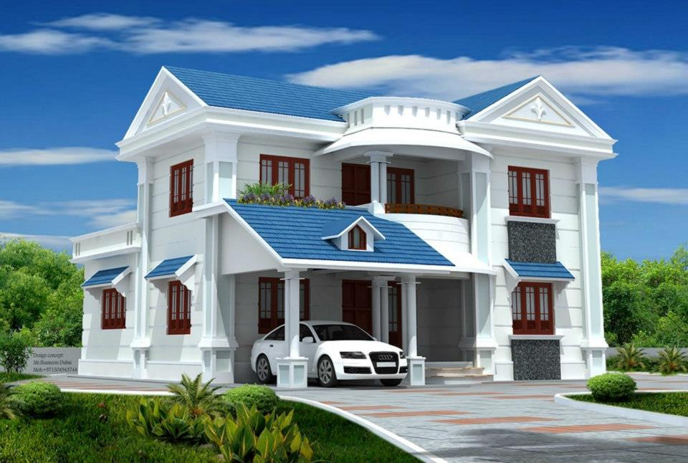
Write a story on ………
“Man is asocial being.”

Slide 14
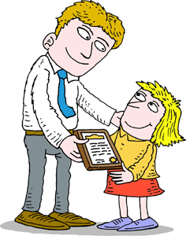
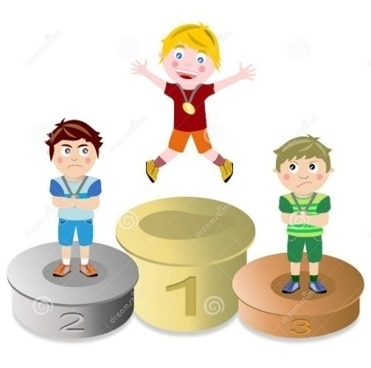
Thank you everybody

