Slide 1
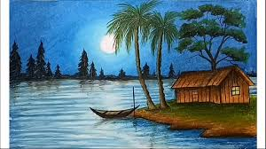
Welcome

Slide 2
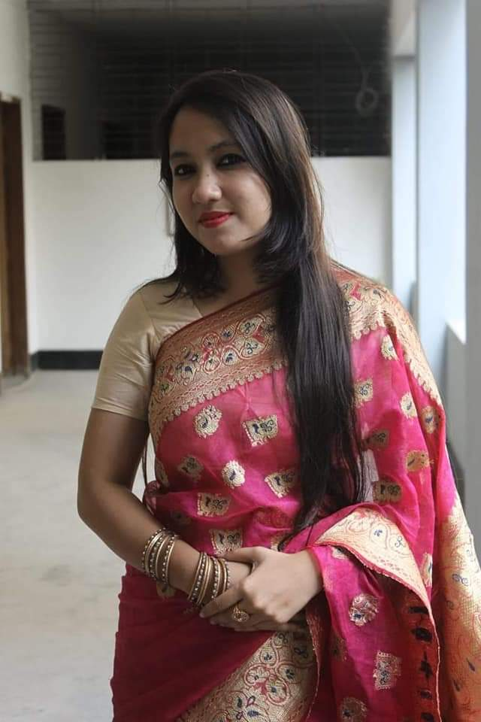
SAJIDA ASRAF
Assistant teacher(English)
Haripur M/L High School
Sylhet

Slide 3
Class:9-10
Sub: English 2nd Paper
Part:Grammar

Slide 4
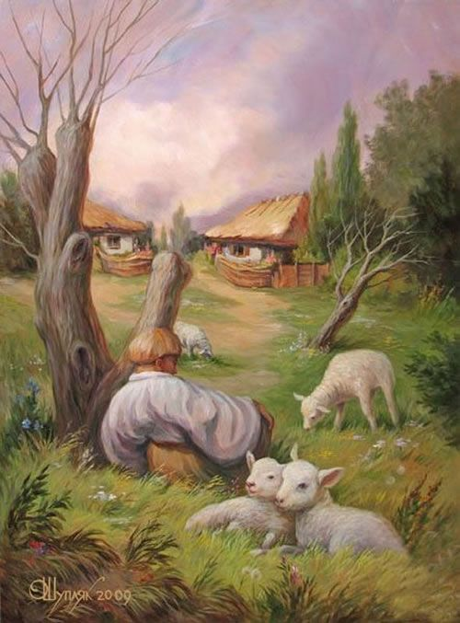
This picture has one surface meaning and one hidden meaning . At the very first sight one may define it in one way but if you see deeply you will find another meaning.
Guess the name of today’s topic
Describe what have you understood from the pictre?

Slide 5
Lesson Declaration
Our Today’s Topic is
Idioms and phrases

Slide 6
Learning Outcomes
After this lesson Students will be able to….
Define Idioms and phrases.
Tell the meaning of idioms and phrases.
Make meaningful sentences with idioms and phrases.

Slide 7
Idioms and Phrases
Idioms are expressions, words, or phrases that have figurative meanings conventionally understood by native speakers. This meaning is different from the literal meaning of the idiom's individual elements.

Slide 8
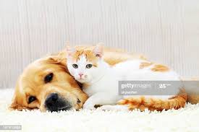
Idioms and phrases
 | Simple meaning | Idiomatic meaning
 | Pets and pups | Heavy rain
Cats and dogs
It has been raining cats and dogs for two hours.
Notes:
Showing the picture you may ask the phrase then show the other accordingly.

Slide 9
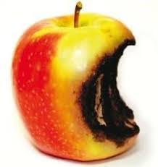
Idioms and phrases
 | Simple meaning | Idiomatic meaning
 | damaged apple | criminal
Bad apple
We can’t expect good thing from him because he is a bad apple.
Notes:
Showing the picture you may ask the phrase then show the other accordingly.

Slide 10
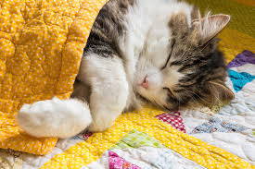
Idioms and phrases
 | Simple meaning | Idiomatic meaning
 | a cat sleeping | act of sleeping
Cat’s sleep
Don’t expose the truth before him because he is in cat’s sleep.
Notes:
Showing the picture you may ask the phrase then show the other accordingly.

Slide 11
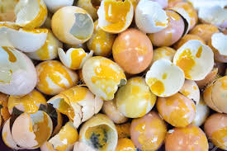
Idioms and phrases
 | Simple meaning | Idiomatic meaning
 | damaged egg | characterless
A bad egg
Nobody loves him because he is a bad egg.

Slide 12
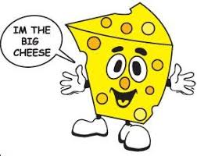
Idioms and phrases
 | Simple meaning | Idiomatic meaning
 | One kind of food in big size made by curd | influential
Big cheese
You can not go against him as he is a big cheese.
Notes:
Showing the picture you may ask the phrase then show the other accordingly.

Slide 13
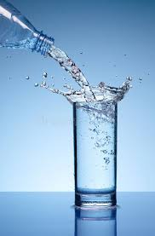
Idioms and phrases
 | Simple meaning | Idiomatic meaning
 | the water which is very cold | demoralize
Cold water
Throwing cold water on anyone’s doing noble deed is not good.
Notes:
Showing the picture you may ask the phrase then show the other accordingly.

Slide 14
Individal work
Make meaningful sentences with the following idioms:
A blessing in disguise
Beat around the bush
Better late than never
On the ball
That’s the last straw

Slide 15
homework
Make meaningful sentences with the following idioms:
Break the ice
See eye to eye
Once in a blue moon
A piece of cake
To kill two birds in one stone
The elephant in the room

Slide 16
THANK YOU

