Slide 1
Welcome

Slide 2
Class : 8 English 1st paper Unit : 9 Lesson : 1
Teacher : MD MOQBUL HOSSAIN BULBUL
Alhaj Dhanai Bepari memorial High School
Sreepur, Gazipur

Slide 3
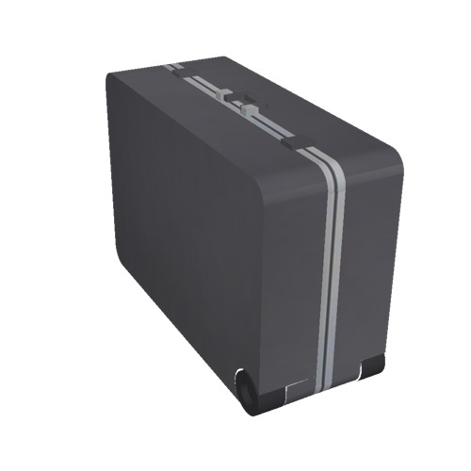
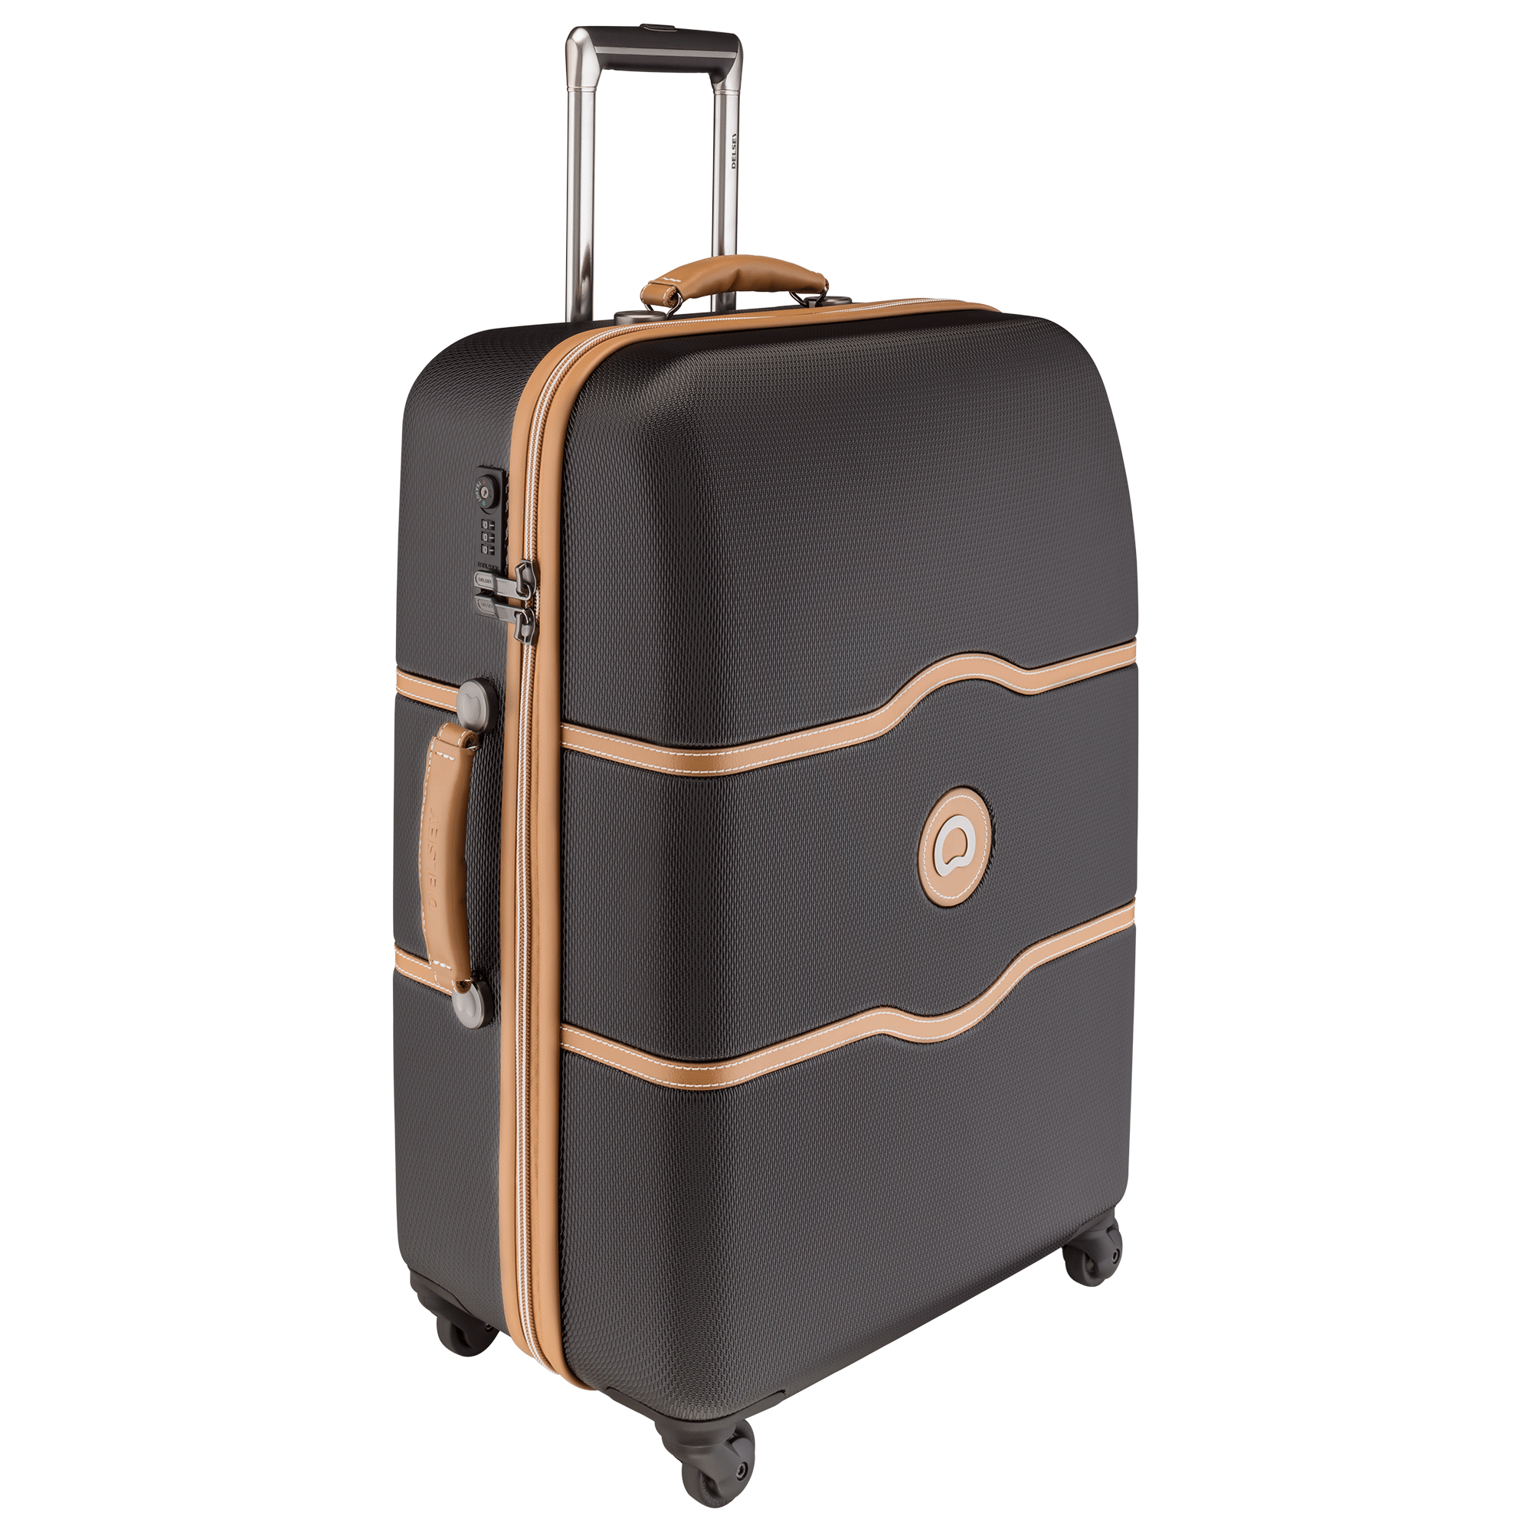
Topic : the wheel
Look at the pictures and say which is easier to move and why

Slide 4
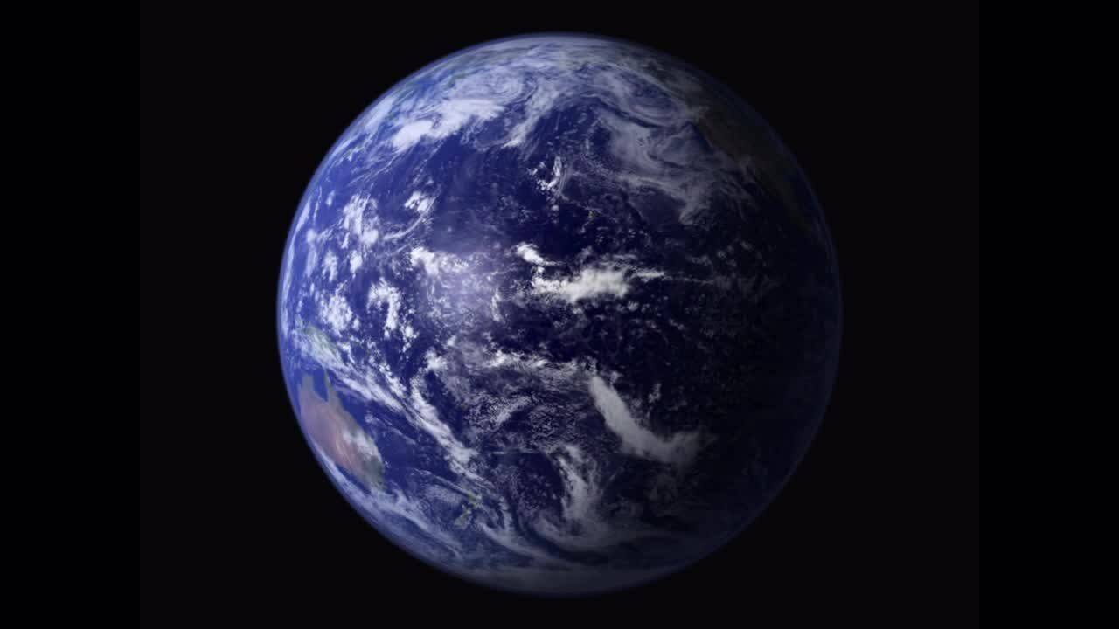
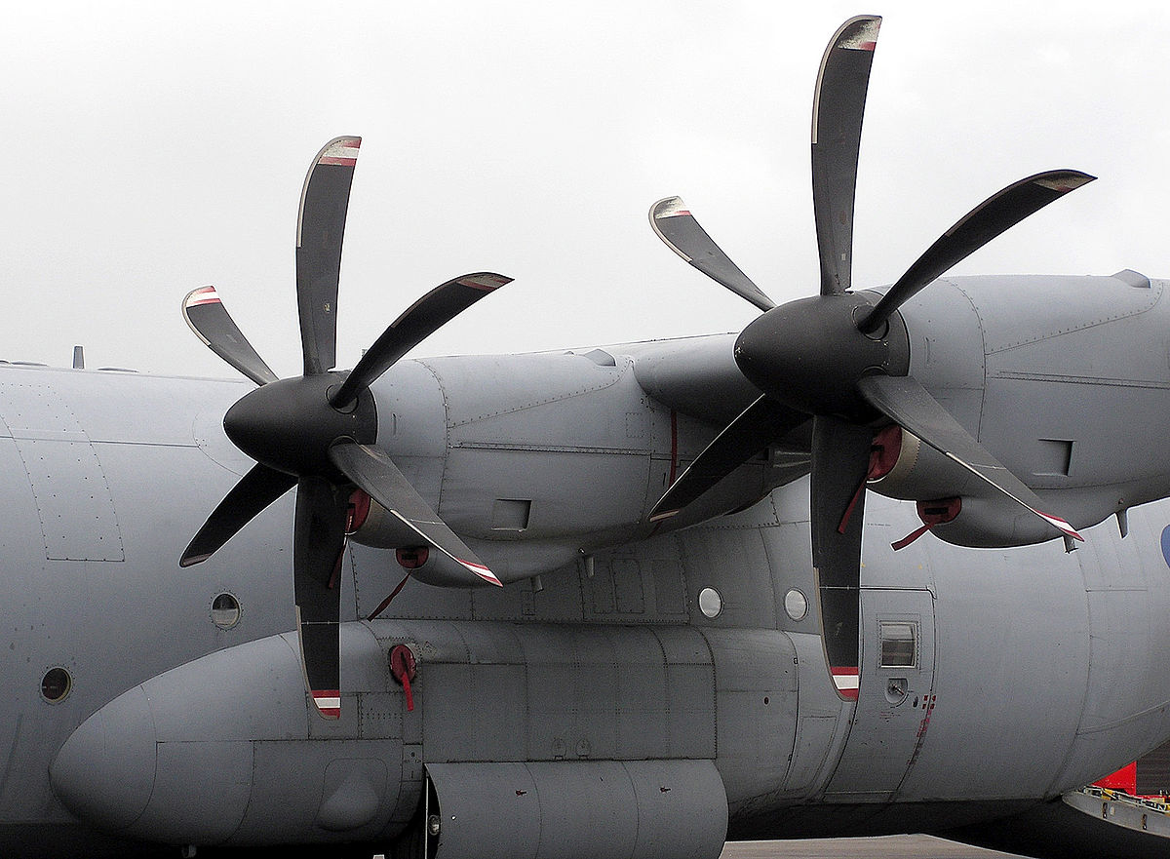
Ask the students to read the text B and learn about the key words and their meaning
Circular = Round shape
Rotate = Move
Propeller = fan

Slide 5
Say and write the questions
What is a wheel ?
What can a wheel do ?
Where can we find wheels?
The students will read the text and answer the questions.

Slide 6
Make as many correct sentences as you can using the table
The wheel A plain wheel It A propeller | is has rotates | A type of wheel. Around its axis. One of the simplest machines. Wheel on vehicles and machines. Helped in rapid progrees of civilization.

