Slide 1
Good Morning

Slide 2
GREETINGS
Good morning, students
Teacher
Good morning, teacher
Student’s
Teacher
How are you today ?
Fine
Student’s

Slide 3
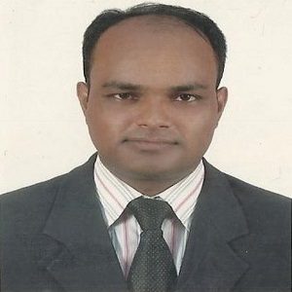
Lesson Identity
Teacher’s Identity
MD. ABDUL KADER
Assistant Teacher
Borni Govt. Primary School,
Companigonj, Sylhet.
Subject: English.
Class: Five. Unit:20, Lessons: 1-2
(Life is beautiful!)
Topic: It’s a beautiful-ready for school.

Slide 4
Let’s enjoy a video

Slide 5
Can you guess what is our today’s lesson?
Today we will read…
Life is beautiful!

Slide 6
Learning Outcomes
Listening:
1.3 Recognize which words in a sentence are stressed.
3.4 Understand statements made by the teacher and students.
4.2 Understand and enjoy simple stories.
Speaking:
1.1.Say words, phrases and sentences with proper sound, stress and
intonation.
6.2.Talk about people, objects, events etc.
Reading:
1.5 Read words, phrases and sentences in the text with proper pronunciation, stress and intonation.
1.7 Read paragraphs, dialogues stories, letters and others texts.
Writing:
8.1 To make sentences using words and phrases, following instructions.

Slide 7
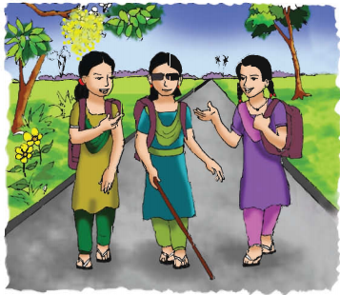
Let’s see a picture
What are the girls doing in the picture?
They are going to school.

Slide 8
Teaching Vocabulary
Do you know the meaning of these following words?
Neighborhood, Visually impaired

Slide 9
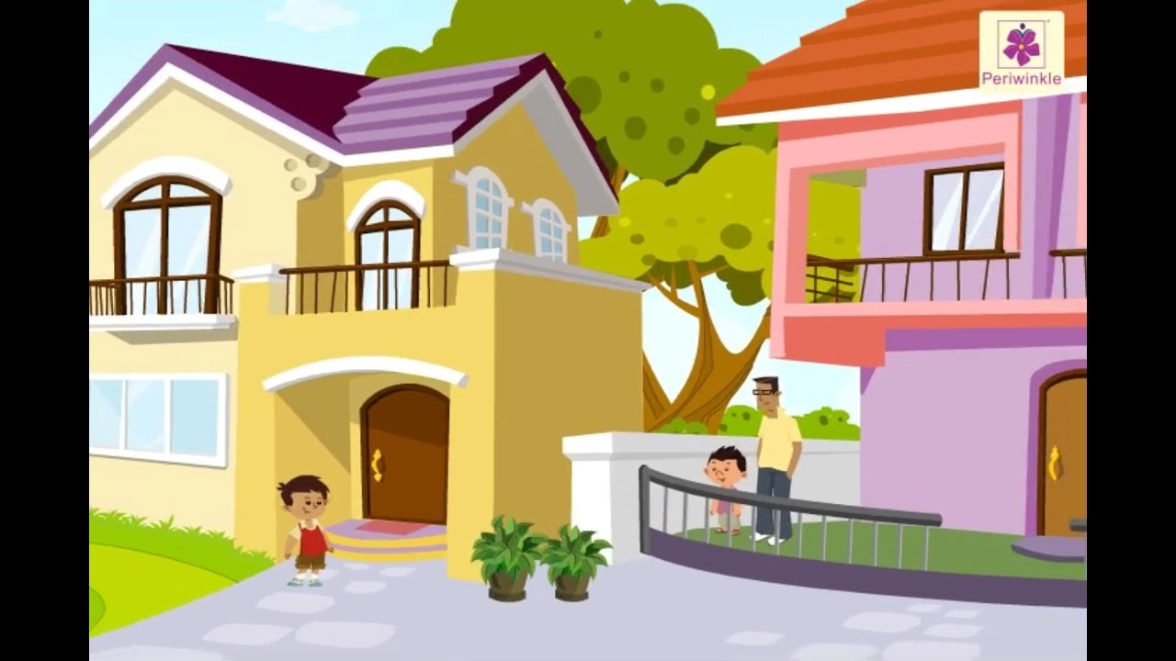
Neighborhood
Similar meaning
:
Locality

Slide 10
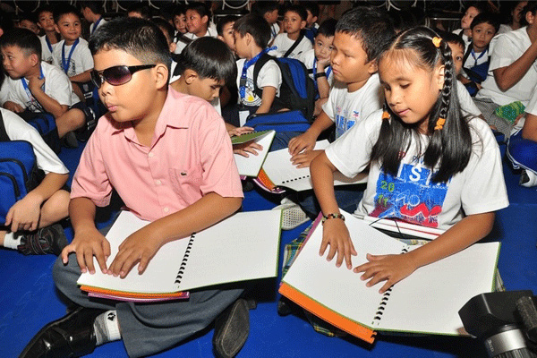
Visually impaired
Similar meaning
:
diminished

Slide 11
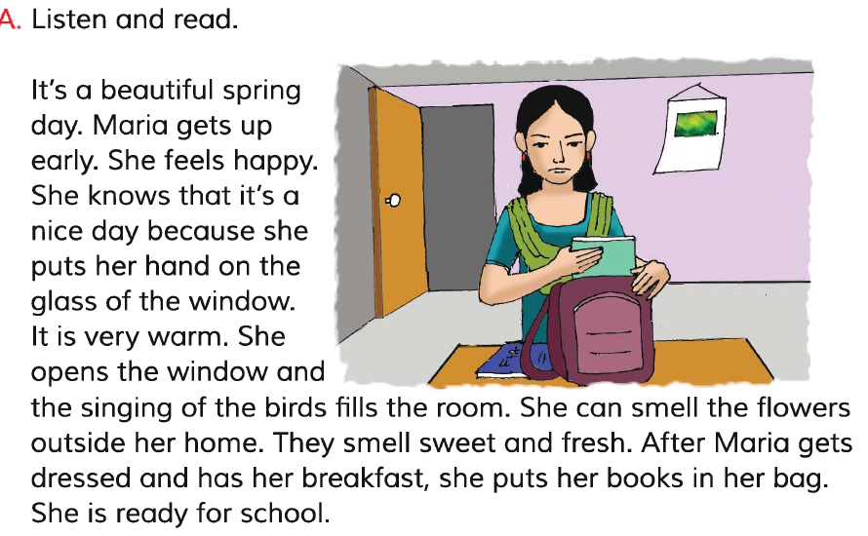
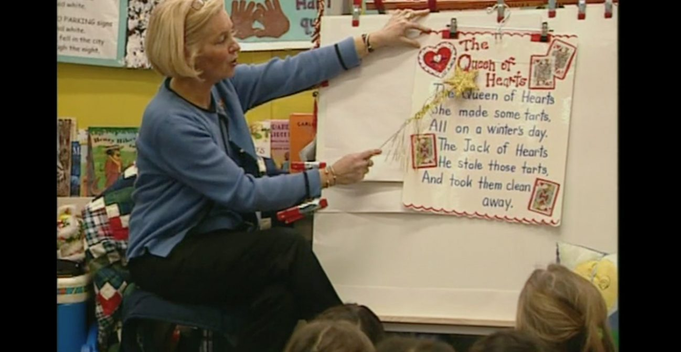
Teacher’s Model Reading
Dear students, open your English book at page 78. I am reading the text loudly, please put your fingers on the text.

Slide 12
Group Reading
In this stage the students will read the text in group.

Slide 13
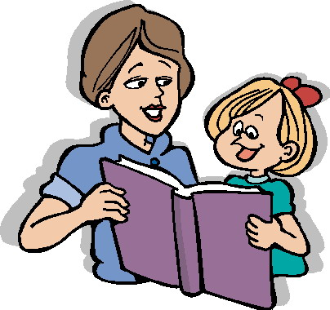
Pair Reading
In this stage the students will read the text in pair.

Slide 14
Student’s reading
In this stage one student reads the text and others listen.

Slide 15
True or false
Maria is not like school.
false
She is visually impaired.
True
She can see the bird.
false
She can see the blue sky.
false
She can not see the beautiful flower.
True

Slide 16
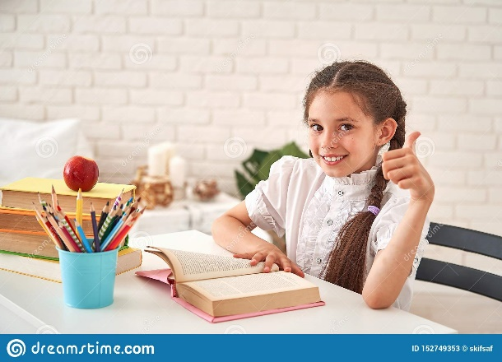
HOME WORK
Ans. The question
1. who like school?
2. What is the sky colour?
3. How was Maria?
4. She has been unable to see……….?

