Slide 1
INDEX
Thank you
SLIDE 2 WELCOME
SLIDE 7 : individual work
SLIDE 3 : IDENTIY
SLIDE 8 : individual work
SLIDE 4: MENTAL PREPARATION
SLIDE 9: pair work
SLIDE 5 : LESSON DECLARATION
SLIDE 10 : group works
SLIDE 11: Evaluation
SLIDE 6 : LEARNING OUTCOME
SLIDE 12: Thanks

Slide 2
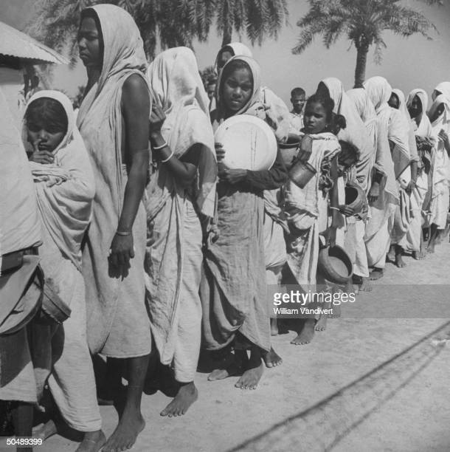
Welcome
Thank you

Slide 3
INTRODUCTION
Abdul Aziz
B.A(Hon’s), M. A(English)
Assistant Teacher (English)
Madhaia Bazar Sadim High School
Unit : 07, Lesson : 01
Mobile : 01921767310, 01741627571

Slide 4
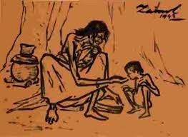
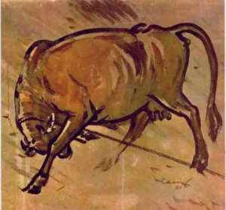
Thank you
Zainul Abedin

Slide 5
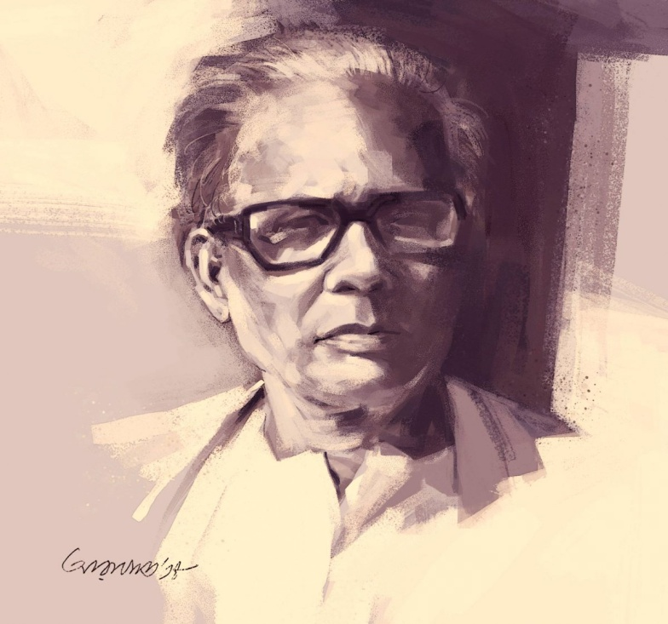
Zainul Abedin, the great artist
Thank you
Our Today’s Topic

Slide 6
Learning Outcome
Thank you
01
Read texts through silent reading
02
Ask and answer questions
03
Infer vocabulary

Slide 7
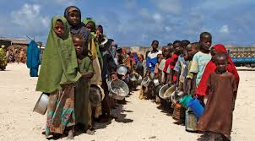
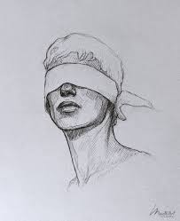
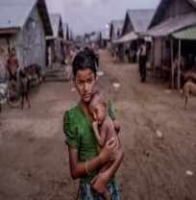
Keywords
Thank you
Individual Work
Founder
Pioneer
প্রবর্তক
Famine
Scarcity of food
দুর্ভিক্ষ
Sketch
Drawing
রেখাচিত্র
Plight
A serious condition
দুর্দশা
Compassion
Pity for the suffering
সহমর্মিতা

Slide 8
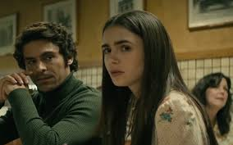
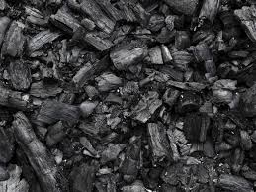
Keywords
Thank you
Individual Work
অতিমাত্রায়
Extremely
tremendously
Charcoal
a black substance
made by burning wood
কাঠ কয়লা
Knack
a natural skill
নৈপুণ্য
Visionary
স্বপ্নচারী
imaginative
Exhibition
display
প্রদর্শনী

Slide 9
(Section B) Discuss the questions
Thank you
Pair Work
What do you see in the first picture ?
I can see a skeletal human figure sitting beside a road. I think
is suffering from starvation.
What can you see in the second picture?
I can see in picture 2 two women are going to work
WHat can you see in the third picture?
In picture 3 I can see a crow is sitting on a dead body. The person might
die from hunger.

Slide 10
(Section B) Discuss the questions
Thank you
Group work
What do you see in the picture 4 ?
In picture 4 I think it is about a rainy season.
What can you see in the 5th picture?
I can see in picture 5 a village. The village is beside a river.
WHat can you see in the picture 6?
Picture 6 depicts two men and two cows. It is a scene of plouhghing land.

Slide 11
Answer the following questions
Thank you
Evaluation
Write in details how Zainul Abedin portrayed the sufferings of people?
Zainul Abedin was shocked at the sufferings of the deprived people
during the famine of 1943. He wanted to do something for the people.
He started to do paintings on the sufferings of the people. He depicte
d the shocking pictures with human compassion. He made his own ink
and used ordinary packing paper to draw those shocking pictures that
depict the sinister face of famine. Besides, he exhibited a 65 feet long
school portrait in the “Nabanna” exhibition in 1969 showing how the
people of East Pakistan were becoming poorer.

Slide 12
_{Thank You}
Thank you

