Slide 1
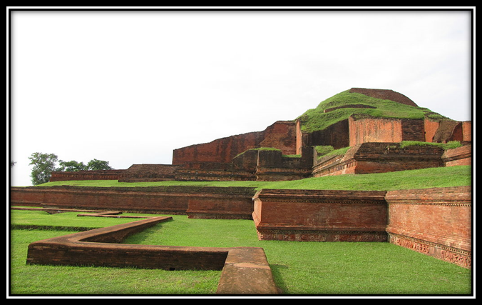
The Somapura Mahavihara

Slide 3
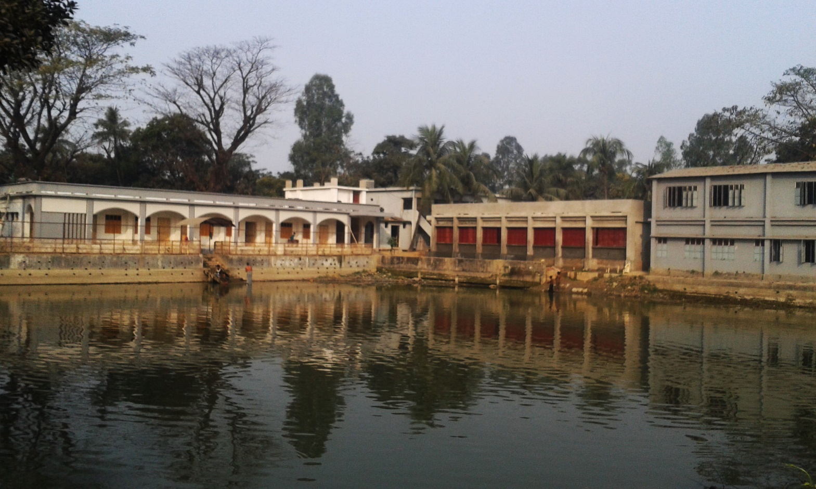
SHITALPUR HIGH SCHOOL

Slide 4
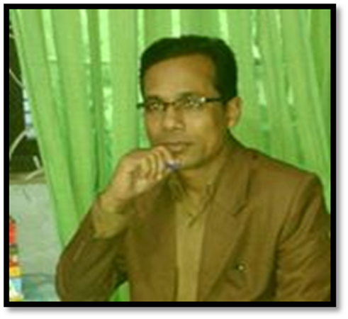
Md. Ismail Shaikh
B.A. B.Ed. M.A.(English) M.Ed. BOU
Senior Teacher in English
Shitalpur ML. High School, Chittagong.
Contact No- 01716086548, 01865228207
Email- ishaikhcitygate2014@gmail.com

Slide 5
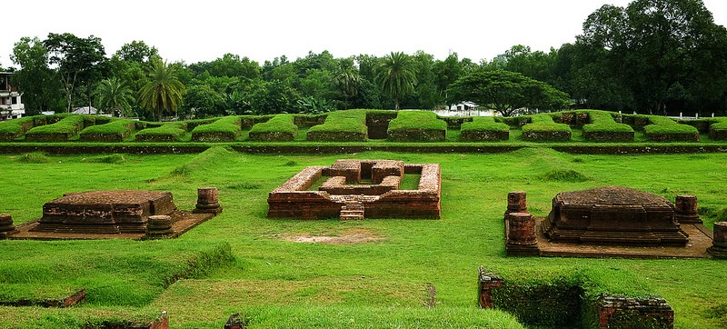
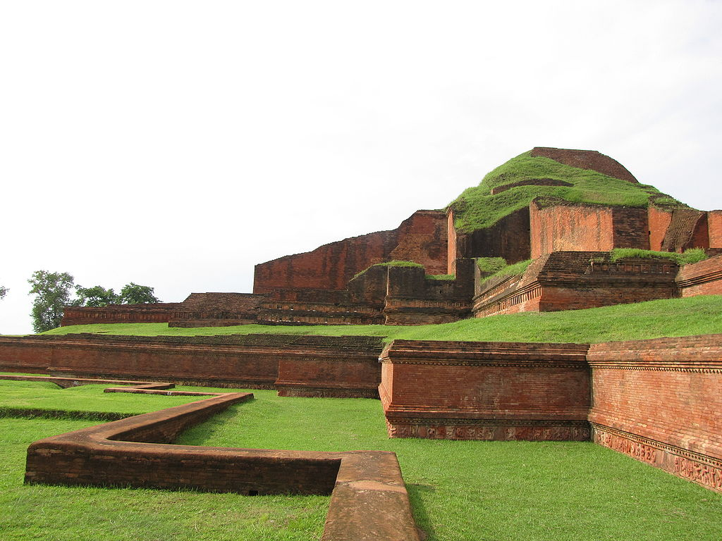
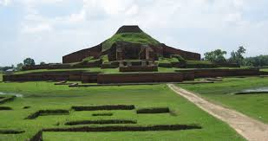
Look at the pictures

Slide 6
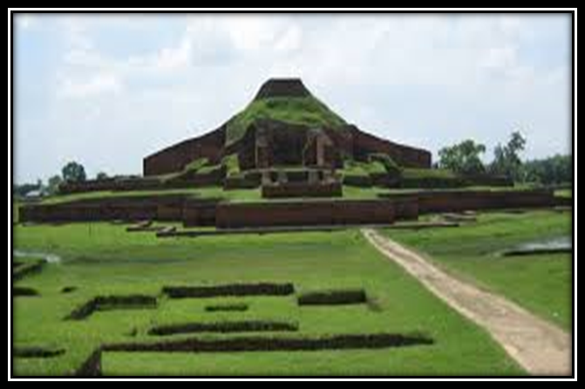
What is this?
What do we call it?

Slide 7
The Somapura Mahavihara
Unit: Eight Lesson : 2

Slide 8
Learning out come
After completing the lesson, students will be able to…
read and understand text through silent reading.
ask and answer questions.
write some vocabulary .
describe a place.

Slide 9
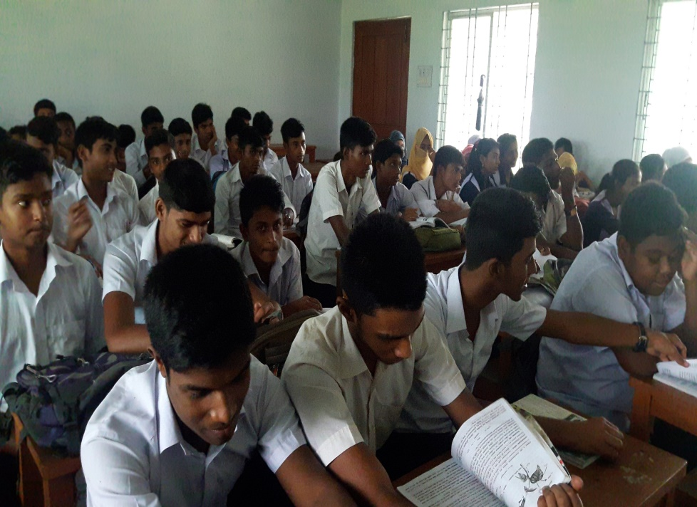
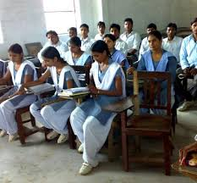
Silent Reading

Slide 10
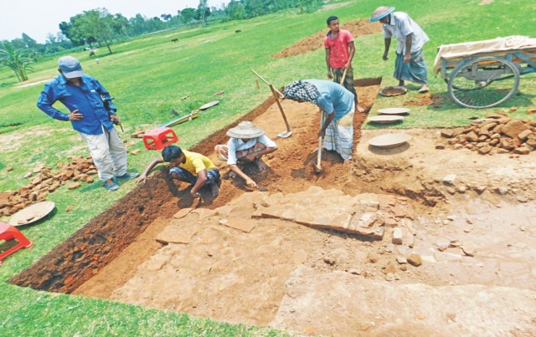
VOCABULARY
Extensive
large
Excavate
dig out
Plain
smooth

Slide 11
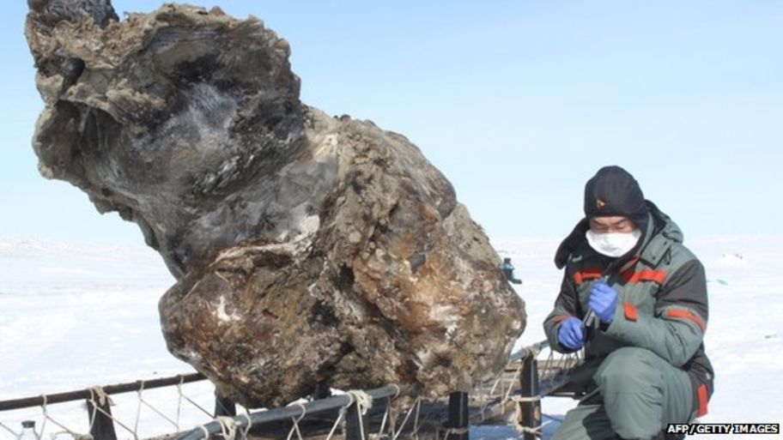
Prevent
obstruct
Satisfy
please
Discover
explore

Slide 12
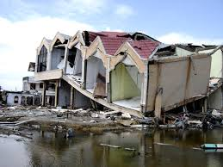
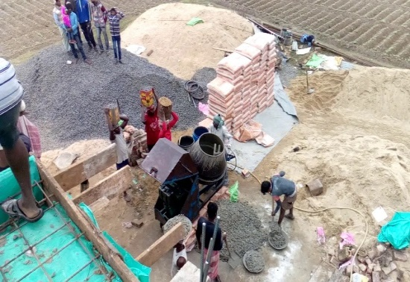
Ruin
destruction
Build
construct
Attention
Concentration

Slide 13
Group work
B. Match the words with their meanings
Words | Meanings
Archaeological Excavate Lofty Extensive Systematic Debris Devout | Rubbles/wreckage Widespread Ancient cultural remains Pious Uncover something with difficulty Grand Done methodically

Slide 14
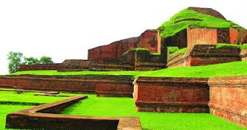
Paharpur
Paharpur is an important archaeological site in a village named ‘paharpur’in Naogan district of northern Bangladesh. Naogoan is mainly plain land but in the middle of it stood a hill covered with jungle.Pahar means hill.Hence is the name Paharpur.

Slide 15
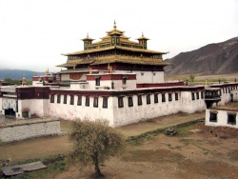
Buddhist institution
Somapura Mahavihara was one of the most famous Buddhist institutions for monks of ancient Bengla and in Southern Asia.

Slide 16
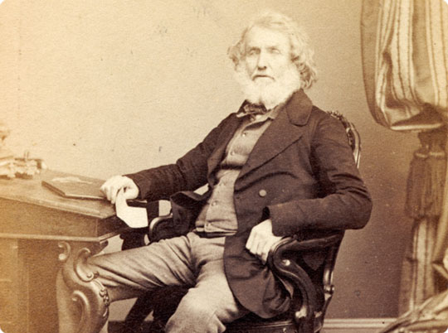
Sir Alexander
The Paharpur site has been excavated and re-excavated a number of times by archaeologists.Sir Alexander visited the place in 1879.Cunningham intended to carry out an extensive but was prevented by the land owner.

Slide 17
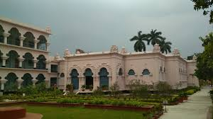
Systematic and regular excavation started jointly by Archaeological Survey of India and Varendra Research Society of Rajshahi and Kolkata University in 1923. They excavated the northern part of the monastery.

Slide 18
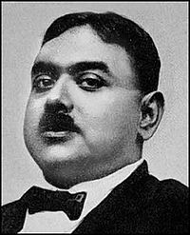
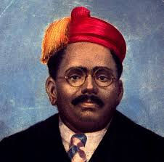
In 1925-26, R.D Banerjee excavated the northern part of the central mound. From 1026-27 onward, excavation was carried out under the supervision of KN Dikshit.
R.D Banerjee
KN Dikshit

Slide 19
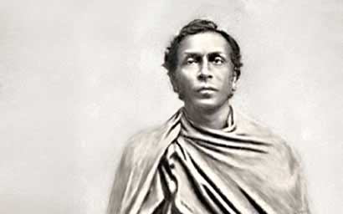
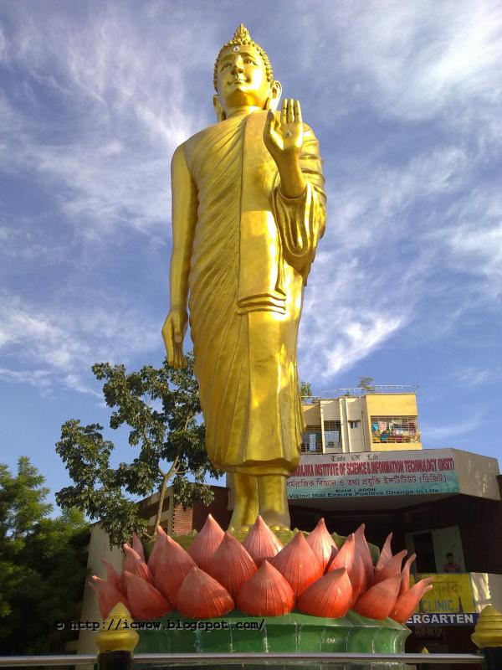
Pala king Dharmapala
The excavated complex at Paharpur has been identified as somapura Mahavihara built by the second Pala king Dharmapala (781-821 AD). The Pala rulers were devout Buddhists and they founded a number of monasteries throughout their growing empire.

Slide 20
Individual Work
Read the text in ‘A’ again and choose the best answer
1. Paharpur is a---
i) a very small village. ii) an extraordinary village
iii)important archaeological site iv) a village on top of a mountain.
2. After excavation,the archaeologists discovered a lofty-
i) Hindu temple ii) Kings palace
iii) Buddhist monastrry iv) Emperor’s court yard.
3. How many phases of excavation of Paharpur has been mentioned in the text?
i) Two ii)Three iii) Six iv) Seven

Slide 21
Learning Assessment
Answer the following questions.
a. Where is Paharpur located?
b. What is it famous for?
c. Which department brought the site under further excavation after independence?
d. What did Cunningham find when he was digging the Paharpur site?
e. What did expeditions reveal?

Slide 22
REFRESHMENT

Slide 23
Home Work

Slide 24
THANK YOU

