Slide 1
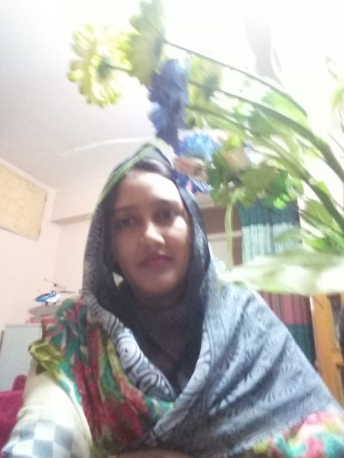
Welcome

Slide 2
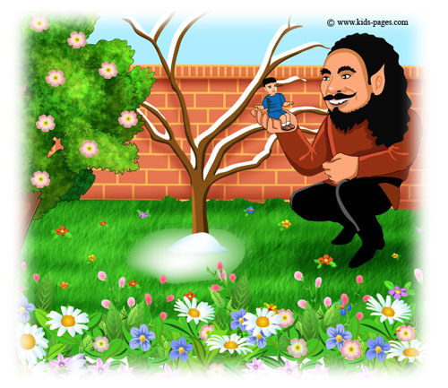

Slide 3
Today’s topic-
The selfish Giant ( 3 )
Uint-6, Lesson- 10

Slide 4
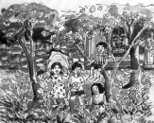
One morning the Giant lying awake in bed when he heard some lovely music. It was so sweet to his ears that he thought it must be the King’s musicians passing by. But in fact it was only a little bird singing outside his window. Then the north wind stopped and a delicious perfume came to him through the open window. “ I believe the spring has come at last,” said the Giant. He jumped out of bed and looked out. What did he see? He saw the most wonderful sight.

Slide 5
Through a little hole in the wall the children crept in and they were sitting in the branches of the tress. In every tree there was a little child. And the trees were so delighted to have the children back again that they covered themselves with blossoms. They were their arms gently above the children’s heads. The birds were flying about and twittering delightfully. The flowers were looking up through the green grass and laughing.

Slide 6
But only one corner of the garden it was still winter. There under a tree a little boy was standing alone crying. He was so small that he could not reach up to the branches of the tree. The poor tree was still covered with snow, and the north wind was blowing above it.

Slide 7
Match the words with their meanings.
Words | Meaning
1. awake | a) sweet smell
2. perfume | b) sing in a delightful voice
3. sight | c) not sleeping
4. twitter | d) things objects that you see

