Slide 2
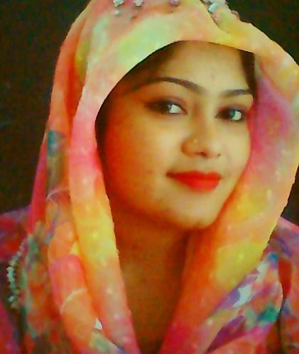
Presented by
Class: Two
Subject: English
Unite : 6.
Alphabet.
Lesson:4-6,
Page : 13
Hafiza Khanam. Assistant teacher.
99 No. Nilokhi G.P. S.
Gopalganj Sadar,
Gopalganj.

Slide 3
Do you want to sing the song with me ?
Today we will sing a song
First listen to the song with the mind and then sing the song with me.
We were watching a video.
Now tell me what about the video is?

Slide 4
Today’s lesson
Alphabet

Slide 5
Learning Outcomes
Students will be able to :
Speaking:
j
1.1.2 say simple words and phrases with proper sound and stress.
Reading:
1.2.1recognize and read the alphabet both small and capital(non-cursive).

Slide 6
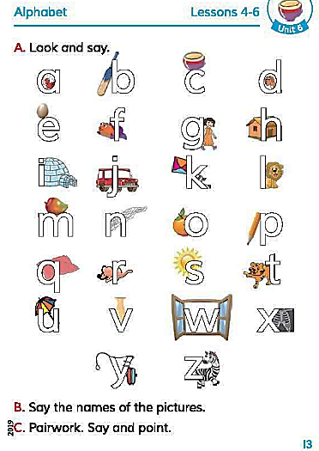
Open at page 13
Now what do you see in the textbook?
This is a revision class of the English alphabet.

Slide 7
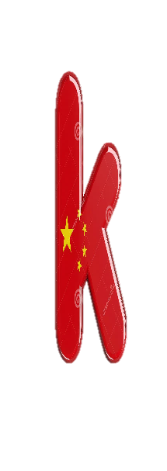

Slide 8
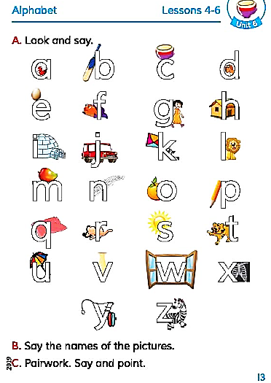
Listen to me very carefully.
I will say you a letter sound.
You have to say the name of an object with that sound.

Slide 9
Pair Work
Sit in pair and one will show the letter to the textbook randomly and the other will say the sound of the letter.

Slide 10
Evaluation
Say the sound of this following letters.
a, c, I, q, u, v, w, x, y, z

Slide 11
ONE DAY WORD
Sound =
Tone= (আওয়াজ)
We will say the letter sound.

Slide 12
Homework
You have to write the name of an object from the letter sound on your textbook.

Slide 13
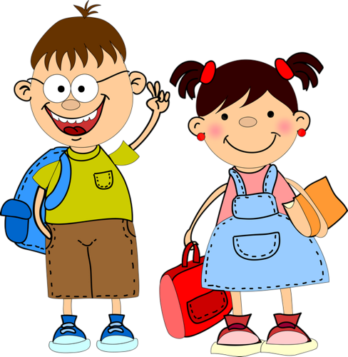
Good
bye

