Slide 1
Welcome to
Our online class

Slide 2
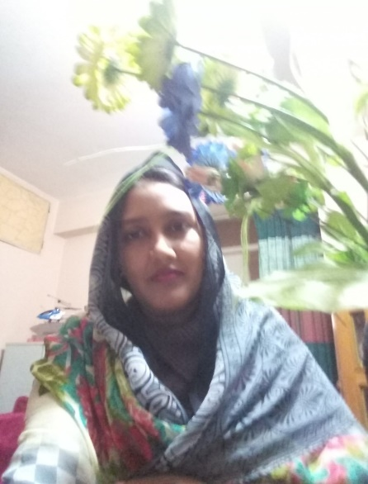
Shanaj Akther
Assistant Teacher
Dabua T. S . High School
Rawzan, Chittagong,
Class-Seven
Lesson-6
Sub: English 1st paper
Time-50 minute

Slide 3
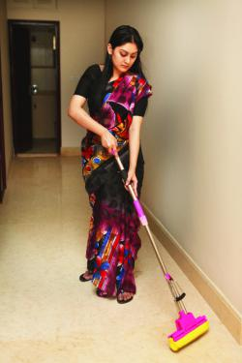
Can you guess what type of maker they are?
cooking
cleaning

Slide 4
Todays our topic is…….
The homemaker

Slide 5
Learning outcomes
By the end of the lesson students will be able to……..
Talk about the pictures and peoples.
Ask and answer questions.
Read and understand text.

Slide 6
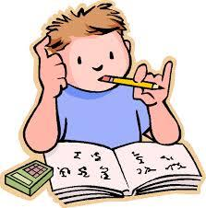
Individual work
Silent reading
Open your book at page 32 and read out section C

Slide 7
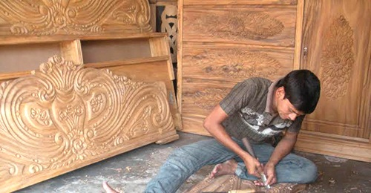
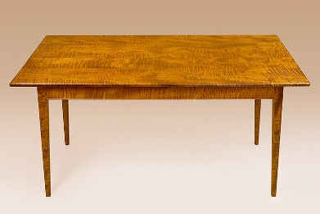
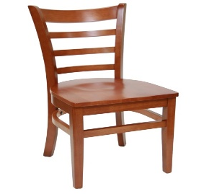
Read about the family.
Mrs Nazma and Mr Joynul Ali live in a small village with their daughters, Mitu aged 7 and Nitu aged 5.
Joynul is a carpenter. He is hired by the villagers to make chairs, tables, pira (low stool) and other furniture. He is also asked to do small repair work.

Slide 8
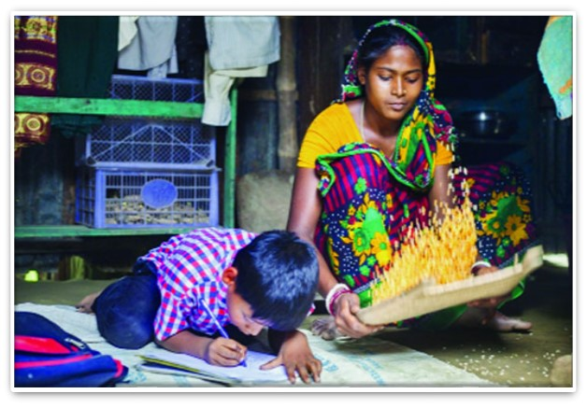
But Joynul does not find work every day. He lives from hand to mouth. Nazma does all the work at home from morning to night, rain or shine. Sometimes she sits with Mitu and Nitu, and teaches them Bangla and English alphabets and some number. They do not go to school. Nazma could study only up to class 5. Joynul is illiterate.

Slide 9
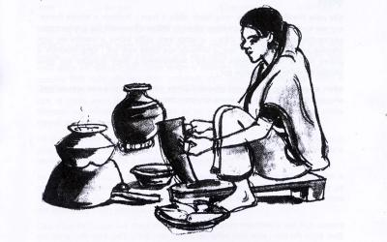
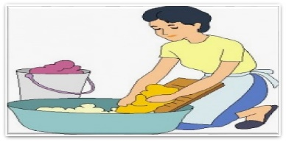
D Make two lists of what Nazma and Joynul do in the table below.
List A ( Nazma ) | List B Joynal )
Cook Washing clothes Cleans | Make cots ………………. ………………..
continue

Slide 10
Check your answer with slide
Sl | Najma’s work | Joynal’s work
01 | Cooks | Makes cots
02 | Washes cloth | Makes chair, sofa
03 | Cleans utensils | Makes pira (low stool)
04 | Teaches children etc. | Makes door, windows etc.

Slide 11
Answer to the question below.
► What is Mr Joynal?
Mr Joynal is a carpenter.
► Who is Mrs Najma?
Mrs Najma is Mr Joynal’s wife
► How old is Mitu and Nitu?
Mitu is 7 and Nitu is 5 years old.

Slide 12
Home work
What do you think is the reason why Mitu and Nitu do not go to school?

Slide 13
See again, bye.

