Slide 1
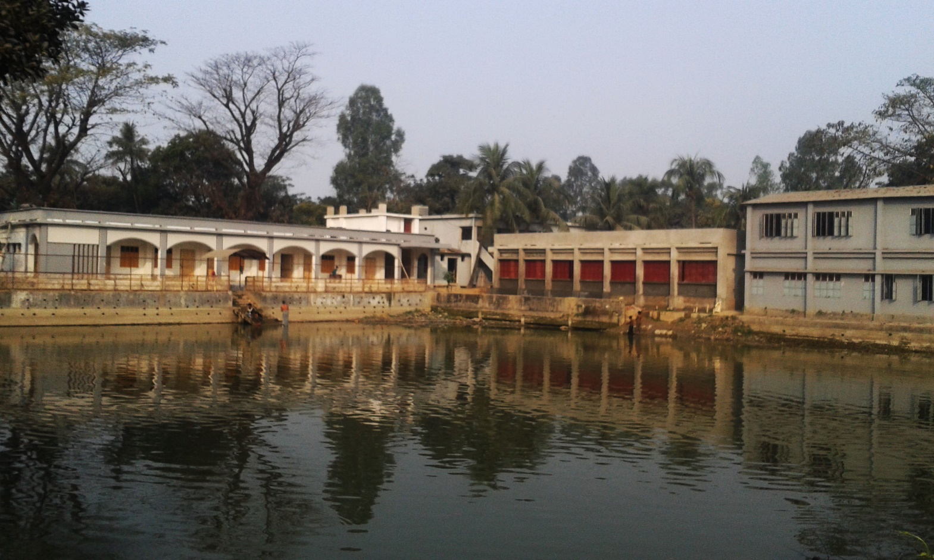
SHITALPUR HIGH SCHOOL

Slide 3
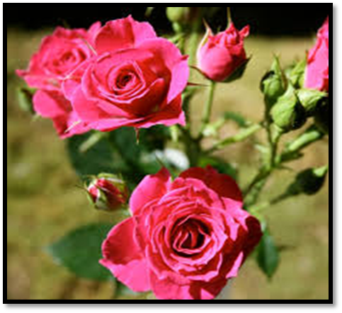
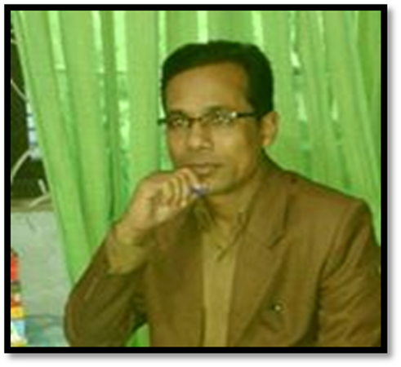
Md. Ismail Shaikh
B.A. B.Ed. M.A.(English) M.Ed. BOU
Senior Teacher in English
Shitalpur ML. High School, Chittagong.
Contact No- 01716086548, 01865228207
Email- ishaikhcitygate2014@gmail.com

Slide 4
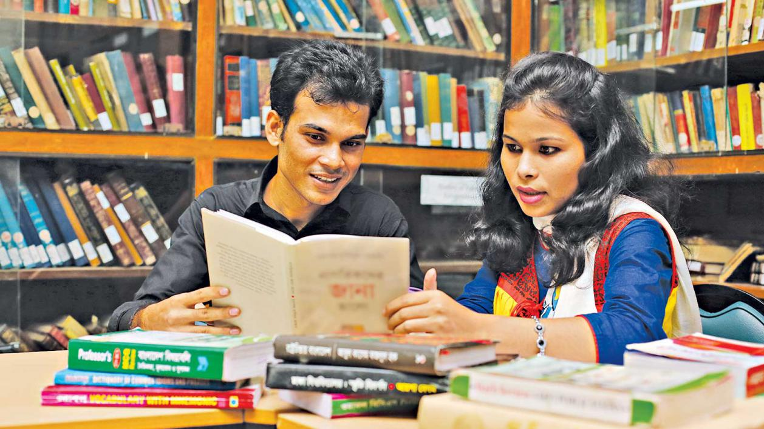
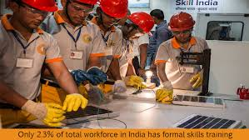
Look at the picture
knowledge
skill
Attitude

Slide 5
Knowledge, skills and attitudes
Unit : One Lesson : 2
Time: 50 Minutes
Class: ix – x
English – First Paper

Slide 6
Learning out come
After the end of this lesson we will be able to—
read and understand texts through silent reading.
ask and answer the questions.
write some new vocabulary .
Choose the best answer.
fill in the gaps.
write answer of some questions.

Slide 7
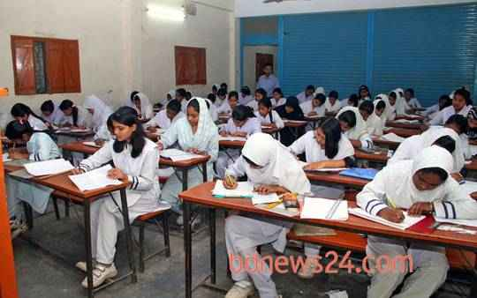
Silent Reading
Read the text silently and answer the following questions:
a. Which features are equally important for good character?
b. What are the knowledge are that you should have as a good citizen?
c. What will bring about a change in your behaviour?
d. What are the subjects that will help you living a good life?
e. What is group work?

Slide 8
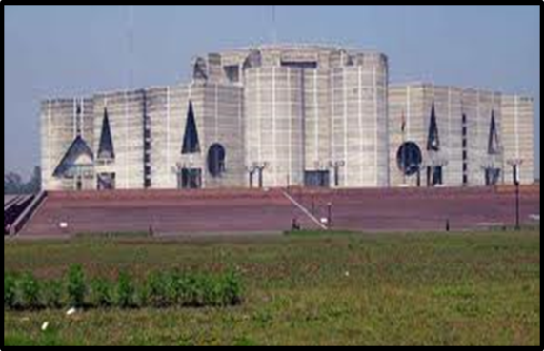
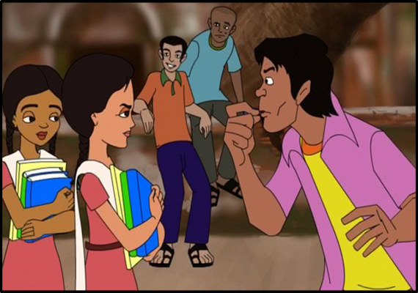
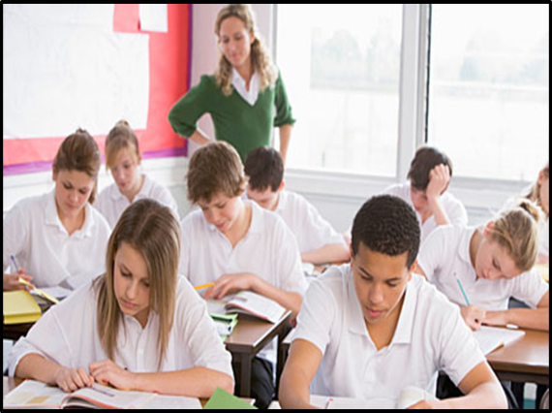
VOCABULARY
Constitution
Rules of governing
attitudes
Look/ Vision/ feelings…
monitor
Supervise /check

Slide 9
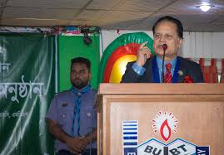
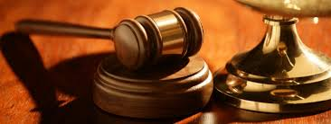
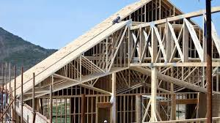
Executive
High official
Regarding justice
Legislative
Structure
Frame work

Slide 10
Evaluation
Choose the best answer from the alternatives.
i) You have to prepare yourself. Here, what part of speech is prepare ?
a) Noun b) pronoun c) verb d) adverb
ii) Modern technology is closely related to the life of a..
a) farmer b) fisherman c) good citizen d) thief
iii) a good citizen is an ............... to his country.
obstacle b) asset c) anger d) all of the above
iv) A student should know about …… in the class room.
a) home work b) group work c) reading d) writing
Through regular group work, we can get noticeable .........
in our behavior.
a) changes b) money c) gold d) wealth

Slide 11
Group Work
Read the following text and fill in each gap with a suitable word.
You need skills to do (a)--------.(b)------ is not enough. You must be able to apply your knowledge to do things (c)--------.Finally knowing and (d)-------things will bring about a change in your behavior towards(e)--------.
Ans:
a) things
b) knowledge
c) practically
d) doing
e) other.

Slide 12
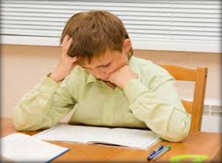
INDIVIDUAL WORK
Answer the questions individually:
1. What do you have to do to be a good citizen?
2. Why do you need skill?
3. What should you have knowledge about in class room?
4. What should a good citizen have?
5. Who is the right person to monitor and help you to do the group work?

Slide 13
Answer:
1. We have to prepare ourselves to do good deeds in society to be a good citizen.
2. We need skill to apply our knowledge in practical situations.
3. We should have knowledge about group work in the classroom.
4. A good citizen should have a vast knowledge about his country, its constitution, people, history, culture and traditions.
5. Teacher is the right person to monitor and help me to do the group work.

Slide 14
REFRESHMENT

Slide 15
Home Work
Write a short paragraph on ‘A good citizen’.

Slide 16
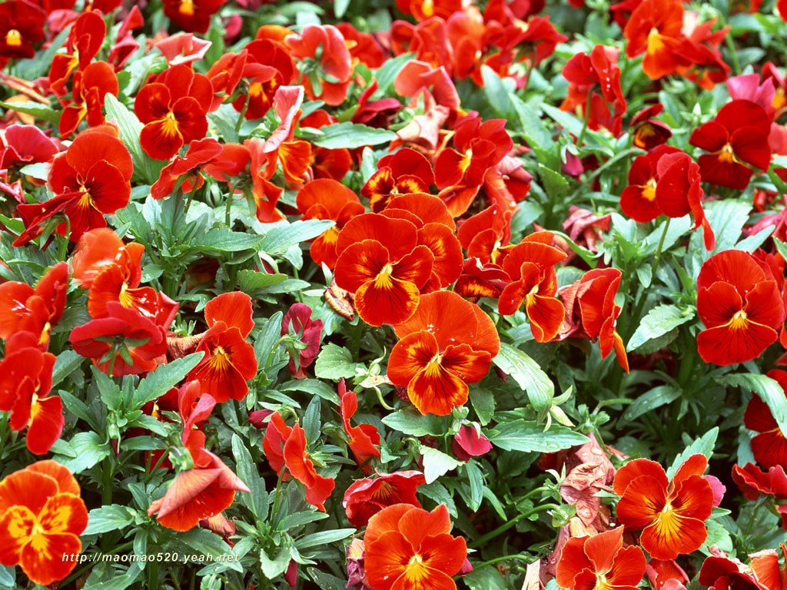
THANK YOU

