Slide 2
Welcome to my class

Slide 3
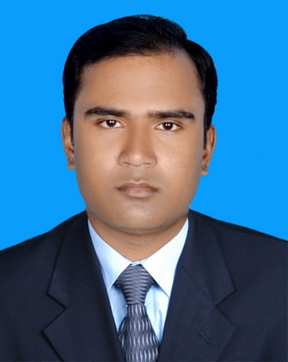
Sujan Garja
Assistant Teacher
Guimara Govt. Primary School
Matiranga,khagrachari

Slide 4
Sub:English
Class:4
Unit: 15
Lesson:(4-5)SAGAR And his family

Slide 5
Learning Outcome :
By the end of the lesson the student will be able to:
1.4.1-recognize and use intonation patterns for Wh-and yes/No questions,greetings and statements.
3.2.1.-Understand questions about family and friends .
3.1.1-ask and answer Wh and Yes ?No questions.
8.1.1-make sentence using words.

Slide 6
Let’s see a video

Slide 7
Let’s see a video

Slide 8
How many words did you see in the 1st video?
Ans:I saw 6 words in the video.
What can we say with these words?
Ans:We can say these words “Wh-words”.
What did you see in another video?
Ans:We saw a do/does song.

Slide 9
Our today’s lesson is……
Wh- words and do/does
Unit-15
Lesson-4-5
Page no-31

Slide 10
Do you know what Wh words is?
Notice that......
মনে রাখবে......
What,who,where, why,when এবং how শব্দগুলো ব্যবহার করে বিভিন্ন প্রশ্ন করা হয়।এই শব্দগলোকে Wh-word বলা হয়।আরWh-word ব্যবহার করে যে প্রশ্ন করা হয় তাকে Wh-question বলা হয়।
Wh-word দ্বারা প্রশ্ন করার সময়Wh-word বাক্যের প্রথমে বসাতে হয়।

Slide 11
Let me learn more…….
Do you know Where we use do/does?
Subject যদি Third person plural Numberহয়, তাহলে Do ব্যবহৃত হয়।যেমনঃWhere do Mita and Sumon live?
Person ভেদে Do বা Does ব্যবহার করতে হয়। First person বা Second person এর ক্ষেত্রে do ব্যবহৃত হয়।যেমনঃWhen do you go to school?
কিন্তু,Subjectযদি Third Person Singular Number হয়,তাহলে Does ব্যবহৃত হয়।যেমনঃ
How does she come home?

Slide 12
Practice……..
Where do you live?
Who do we know?
How do you open this?
When do I go to school?
What does his father do?
Why does it rain?

Slide 13
A.Questions with Wh-words and do/does.
Question word | Do/does | I/you/we/they/he/she/it
Where | do | I/you/we/they | sit?
Who | Do | I/you/we/they | know?
How | Do | I/you/we/they | open this?
What | Does | He/she | study?
When | Does | He/she | get up?
Why | Does | it | rain?
Language Focus

Slide 14
Complete the questions with do/does.
What are your friend’s name?Where _______they live?
do
What’s your father’s name?What_________he do?
does
When __________we leave school today?
do
Who __________you sit next to in school?
do
does
What is your mother’s name?What ________she do?

Slide 15
One day one word
Question word
Query sound
প্রশ্নবোধক শব্দ

Slide 16
Today’s Homework
How ______the biscuits taste?
We are the English class now.When _______it finish?
When_______ you get up in the morning?
What________ you do on the weekend?
How______ you come to school ?

Slide 17
Thanks to all

