Slide 1
Welcome to my class.

Slide 2
Teacher’s information.
Syeda Nusrat Sarmin
Assistant Teacher
Ayjuddin Matubbar kandi GPS
Faridpur Sadar,
Faridpur

Slide 3
Lesson’s information.
Class: Two
Subject: English
Unit: 20
Lesson: 1-3
Activity: A
Page: 40

Slide 4
LEARNING OUTCOMES
By the end of the lesson the students will be able to :
Listening: 1.1.1 become familiar with English sounds by listening to common English words.
Speaking: 1.1.1 repeat after the teacher simple words and phrases with proper sounds and stress.
1.1.2 say simple words and phrases with proper sounds and stress.
Reading: 2.1.1 recognize and read cardinal numbers up to 30.
Writing: 2.1.1 write cardinal numbers up to 30 in figures.

Slide 5
Teaching aids :
Colour pencils;
Pictures of colour oranges, pencils, suns and flowers;
Number cards;
Poster paper;
Slide.

Slide 6
Let’s enjoy a rhyme.

Slide 7
1
2
3
4
5
6
7
Rainbow, rainbow,
I see you!
Red and orange,
Yellow, green and blue,
Indigo and violet, too!
Rainbow, rainbow,
I see you!
Red and orange,
Yellow, green and blue,
Indigo and violet, too!
How many colours do you find in the rainbow?

Slide 8
Our today’s lesson is
Numbers
Unit: 20, Lesson: 1-3, Activity A; Page: 40

Slide 9
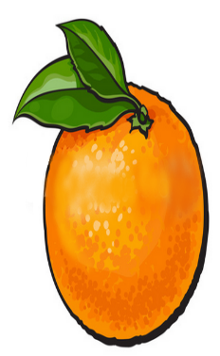
Let’s count these oranges.
WCW
1
2
3
4
5
6
7
8
9
10
11
12
13
14
15
16
17
18
19
20
21
28
29
30
22
23
24
25
26
27

Slide 10
Write the number that comes before each number.
___ 17
___ 25
___ 12
___ 20
___ 30
16
24
11
19
29
SGW

Slide 11
Write the number that comes between
the two numbers.
15
14 ___ 16
22 ___ 24
17 ___ 19
24 ___ 26
28 ___ 30
23
18
25
29
PW

Slide 12
Open your EFT ( English for Today book) book at page 40 and look at the activity A .

Slide 13
Open your EFT book at page-28.

Slide 15
29
30

Slide 16
evaluation
Write the number that comes after each number.
26 ___
12 ___
29 ___
15 ___
18 ___
27
13
30
16
19

Slide 17
b
HOME WORK
Write the numbers 1-30 on your notebook and draw a pencil and colour it.

Slide 18
Eat properly.
Goodbye, Dear students.

