Slide 1
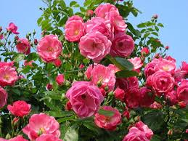
GOOD NOON STUDENTS.

Slide 2
I
N
T
R
O
D
U
C
E
Mohammad Abdul Gafur Mozumder
Assistant Teacher
Gaiar Bhanga Govt. primary School,
Lalmai, Comilla.
Class:Five
Subject:English
Unit: 24(Cyclone Aila)
Lesson: 1 (A,B)
Time:45 minutes

Slide 3
Let’s see a video.
What do you see in the video?

Slide 4
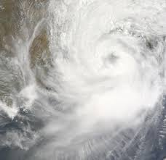
Today’s lesson is -
Cyclone
Aila

Slide 5
Learning outcomes--
Listening:
3.4.1:Understand statements made by teachers & students.
Speaking
6.2.1:Talk about people, objects, events etc.
Reading:
1.5.1:Read words, phrases and sentence in the text with
Proper pronunciation, stress and intonation.
writing:
8.1.1:Make sentences using words & Phrases given in
the textbook.

Slide 6
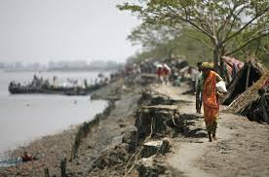
Look at the pictures and think about these.
What about are these pictures ?
These pictures are natural disaster
( flood and river erosion ).

Slide 7
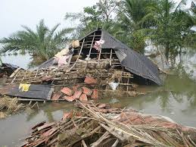
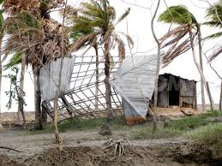
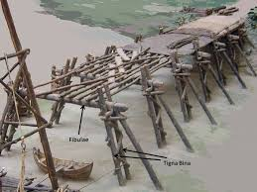
Everybody see the pictures and say , what are about these?
These pictures are about natural Calamity ‘Cyclone’.

Slide 8
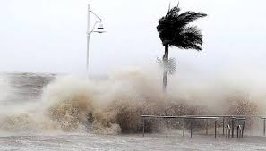
The pictures are about ‘Cyclone Aila’
What do you see in the pictures ?

Slide 9
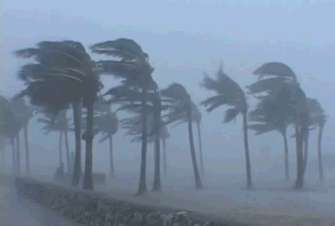
What can you see in the pictures ?
We can see the wind and rain are blowing heavily.

Slide 10
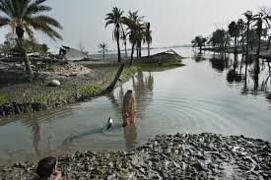
What can you see in the pictures ?
The river is rising.
Cyclone is in the Sea.

Slide 11
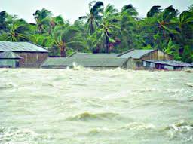
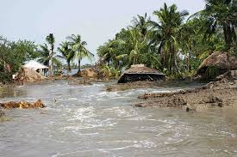
What do you see in the pictures ?
The river flooded the field.

Slide 12
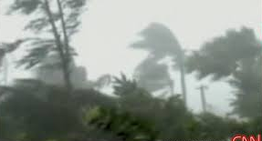
Look at the pictures and think about these.
The wind is blowing and the roof away.

Slide 13
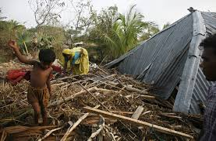
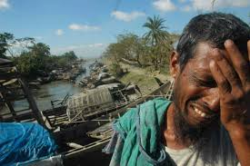
See another pictures and think about these.
The wind is blowing the roofs away and the man is so sorrow.

Slide 14
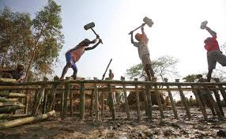
What can you see in the pictures ?
After Cyclone Aila
The bridge is damaged by Cyclone.
The workers are repairing the bridge.

Slide 15
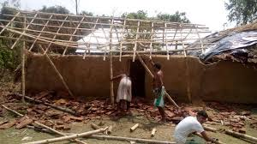
Look at the pictures and discuss in pairs.
The wind is blowing and the roof away.
The workers are huts repairing.

Slide 16
Everybody look at the blackboard and
write the meaning of these words.
Rising
Flooded
Blowing
Roof
Away
Repairing
বৃদ্ধি পাওয়া।
বন্যাকবলিত / পানিতে ডুবে যাওয়া।
বহা ( বাতাস বহা )।
ছাদ / ঘরের চালা।
উড়িয়ে নেয়া।
মেরামত করা / পুনরায় তৈরি করা।

Slide 17
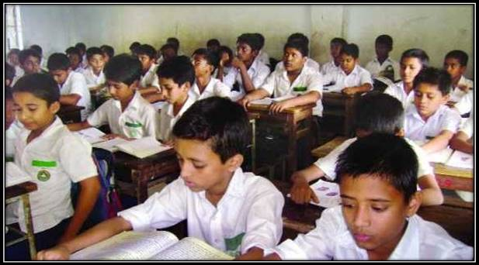
Everybody take your book and open page at 94 .

Slide 18
Everybody read silently.
Read the sentences. Number them in correct order from 1 to 4.
-------The workers are repairing the huts and fields.
-------The river is rising and the winds are blowing.
-------The storm starts.
-------The wind is blowing the roofs away and the river
is flooding the fields.

Slide 19
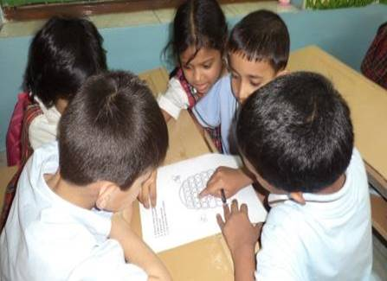
Look at the pictures and discuss in group and write your notebook.
Group- A
Group- B
The wind is blowing the roof away.
The storm starts.
The river is rising.
The workers are reparing the bridge.

Slide 20
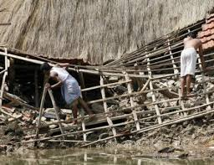
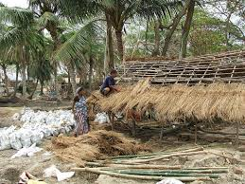
Look at the pictures and think about these lonely.
The huts are repairing after Aila.

Slide 21
Evalution
Write the sentences in your notebook and number them in correct
order from 1 to 4.
-------The workers are repairing the huts and fields.
-------The river is rising and the winds are blowing.
-------The storm starts.
-------The wind is blowing the roofs away and the river
is flooding the fields.
1. The storm starts.
2. The river is rising and the winds are blowing.
3. The wind is blowing the roofs away and the river
is flooding the fields.
4. The workers are repairing the huts and fields.
4
2
1
3

Slide 22
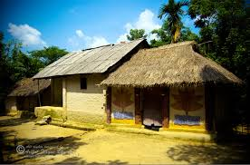
Home Work.
Everybody will read today’s lesson at your home
and write five sentences about “Cyclone Aila”.

Slide 23
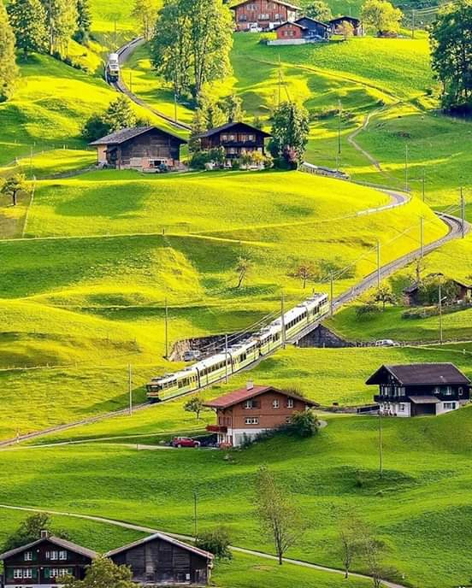
GOOD-BYE TO ALL FOR TODAY.

