Slide 2
Welcome

Slide 3
Md. Saifuddin Khan
Lecturer in English
Haji Goyes Uddin Mohila Fajil Madrasah
Bhangura ,Pabna.
Mobile : 01710-449379
E-mail:skhan84bd@gmail.com.

Slide 4
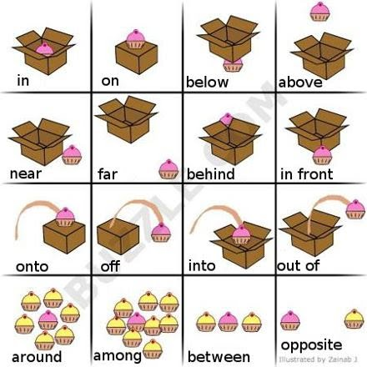
Let’s see some images

Slide 5
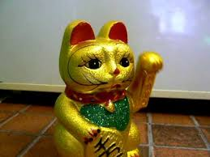
.
*The cat is on the car
The cat is in the car.
The cat is under the car.

Slide 6
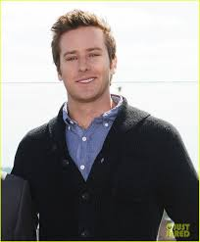
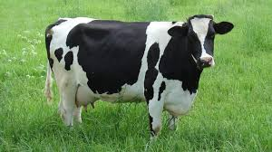
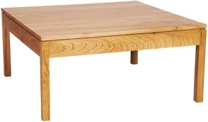
There is a man in the picture.
There a cow looking at me
The flowers are on the table.

Slide 7
The butterfly is above the table.
The cat is in front of the chair.

Slide 8
Dear ss do you know what types of words on, in , under, at,above
“Preposition”

Slide 9
So our Today’s Lesson is …..
preposition

Slide 10
LEARNING OUTCOMES
By the end of the lesson the learners will be able to
1.Tell about preposition .
2.Write the kinds of preposition .
3.Identify the prepositions .

Slide 11
Definition of preposition
A preposition is a word placed before a noun or a pronoun or a noun equivalent to show its relation to some other word in a sentence.

Slide 12
Kinds of preposition
Simple preposition
Detached
Double preposition
Disguised
Compound
Participle
Phrase

Slide 13
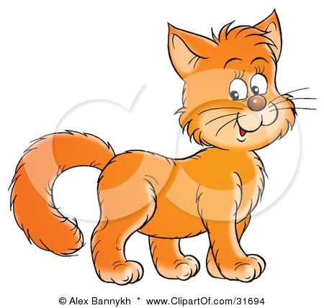
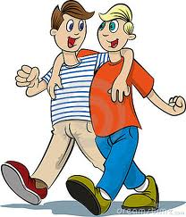
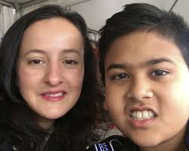
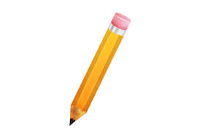
Example of preposition
Simple
The cat is on the table.
Double
Two boy s are entering into the room
Compound
The boy sat beside his mother.
Phrase
Please give me a pen a instead of pencil.

Slide 14
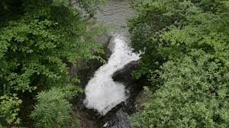
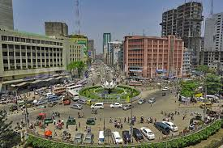
participle
The river flows past the village.
Disguised
It is 12 O, clock
Detached
What is Dhaka famous for?

Slide 15
*Fill in the gaps with preposition from the box.
with—for—to—with—out—of Man has an unquenchable thirst (a) — knowledge. He is never satisfied (b) — what he has known and learnt. The curiosity (c) — knowing.
coupled (d) — the indomitable spirit (e) — adventure has inspired him to undertake and carry (f) — dangerous tasks.
Pair work

Slide 16
Group work
Find out the preposition from the sentences
Education is the back bone of a nation. No progress can be made without education . Ignorance is similar to darkness.

Slide 17
Evaluation
*What is preposition?
*How many kinds of preposition are there ?

Slide 18
Home work
Make five sentences with following preposition.
On , to, behind, of with

Slide 19
Thank you all .

