Slide 1
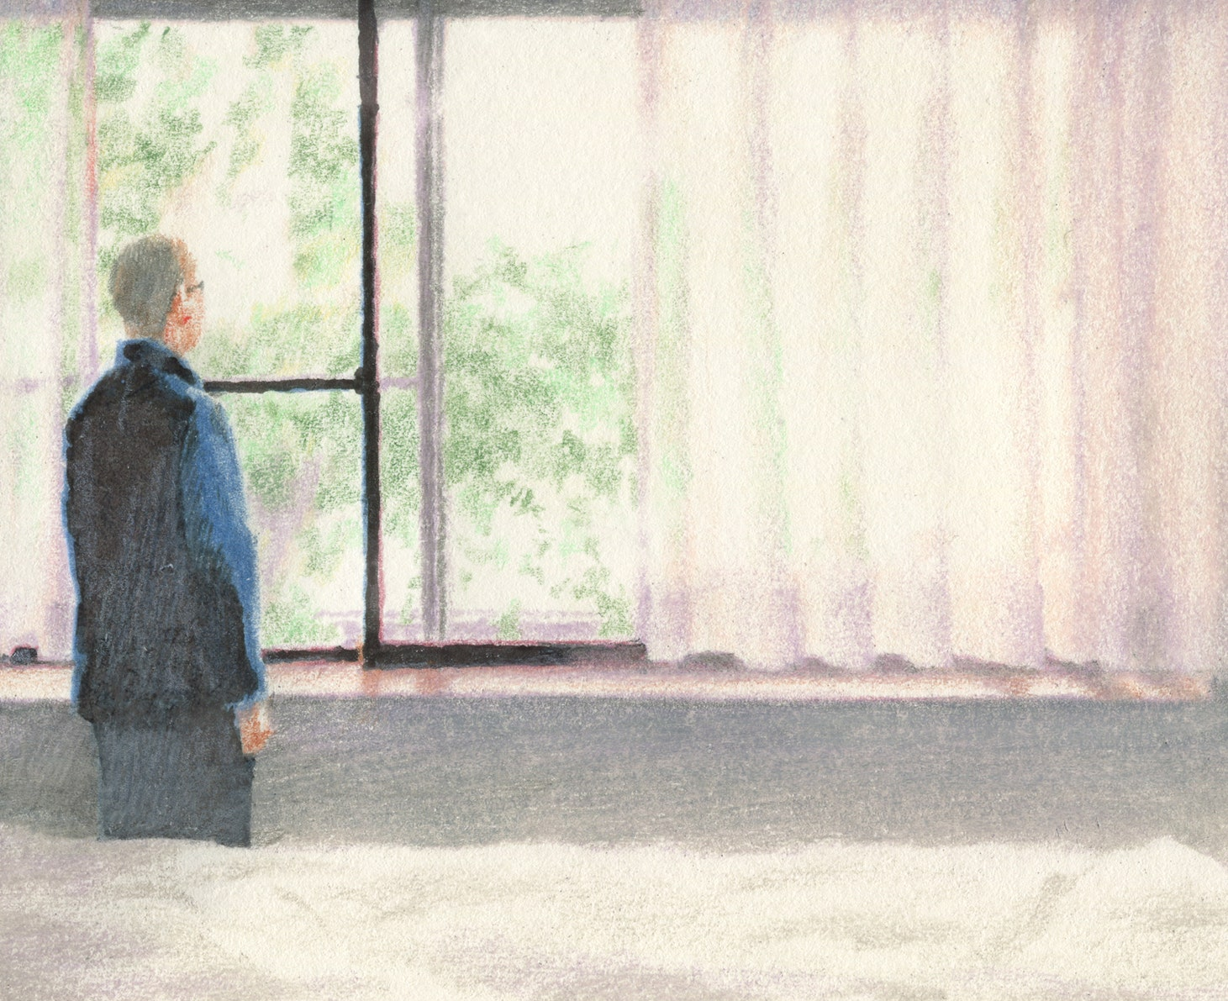
Welcome

Slide 2
Md. Saiful Islam Chowdhury
Senior Teacher
C. J. M High School,
Mohara , Chandgaon , Chattogram.
saifulcjm@gmail.com Mob: 01991945882
ENGLISH FOR TODAY
Class : Nine-Ten
Unit-One, Lesson-1
Time: 40 minute

Slide 3
Look at the pictures
Eating together looks happy.
Eating alone looks monotonous.
Which one do you dislike between the two?

Slide 4
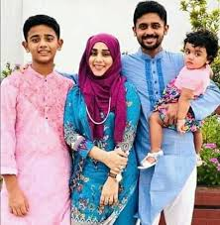
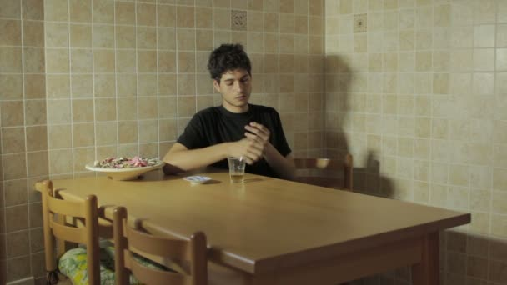
Look at the picture
Living with family
Living alone
Which one do you dislike between the two ?

Slide 5
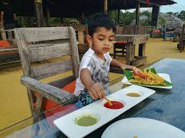
Today our Lesson is
Can you live alone
Unit-One ; Lesson – One

Slide 6
Learning outcomes
After completing the Lesson students will be able to –
1. Read and understand texts through silent reading ;
2. Narrate incident ;
3. Participate in discussions ;
4. Listen to and understand others ;
5. describe something in writing .

Slide 7
Listen the text attentively.
Teacher’s Model reading.
B. Read the story and answer the questions that follow.
Long ago, a young man found life in the family in his village full of problems and sufferings. Quarrels, ill-feelings, jealously, enmity - all were part of everyday life there. So he left his house and went to a jungle to live by himself. There he made a nice little hut with wood, bamboo and reeds. “Ah, how happy I am here!” said the man to himself. But one day he found some mice in his hut. The little creatures soon made holes in his blanket. So he brought a cat to kill the mice. The cat needed milk. So he brought a cow. The cow needed grass and hay. So he brought a cowboy. The cowboy needed food. So he took a wife to cook meals. Then children were born to them, and the man found himself again in a family. So nobody can live alone, unless they are either angels or devils. People need food, shelter, companions and cooperation. They need to help each other. And if they live in a family or community, their need can be fulfilled. Hence living in society can make people good and happy citizens.

Slide 8
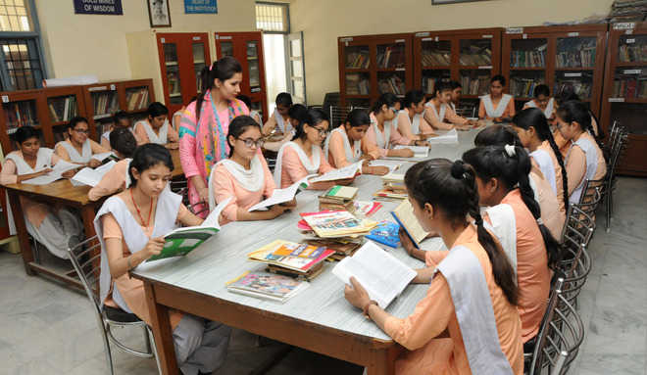
Student’s Model reading.
Go to the section “B” and start silent reading.

Slide 9
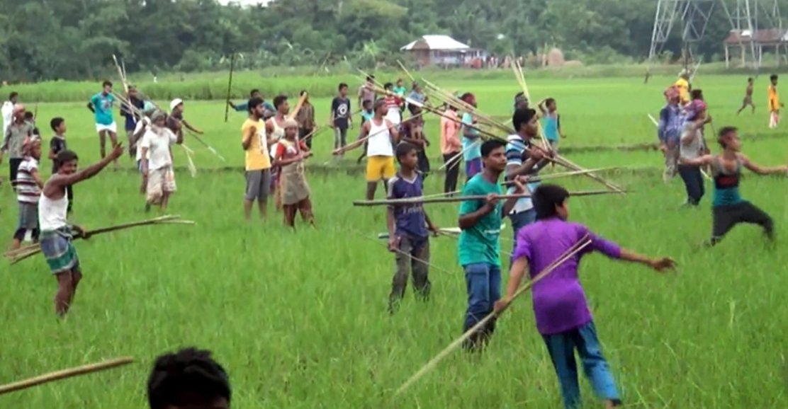
Vocabulary
Key word
Suffering
Meaning:
Hardship
The young man found his social life full of problems and suffering.

Slide 10
Vocabulary
Key word
Jealousy
Meaning:
Grudge
The girl feels jealousy to the other girl.

Slide 11
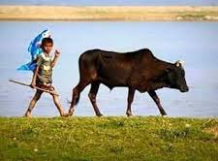
Vocabulary
Key word
Cowhand
Meaning:
Cowboy
A cowhand look after the cow.

Slide 12
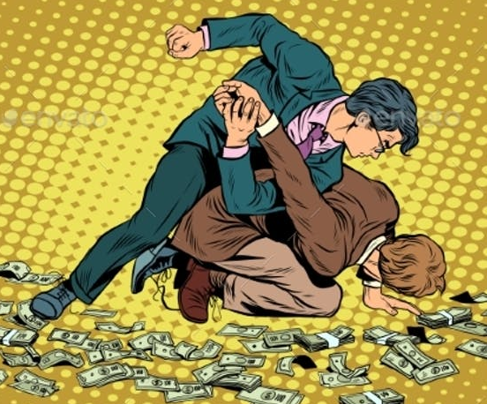
Vocabulary
Key word
Enmity
Meaning:
Animosity
Enmity destroys friendship

Slide 13
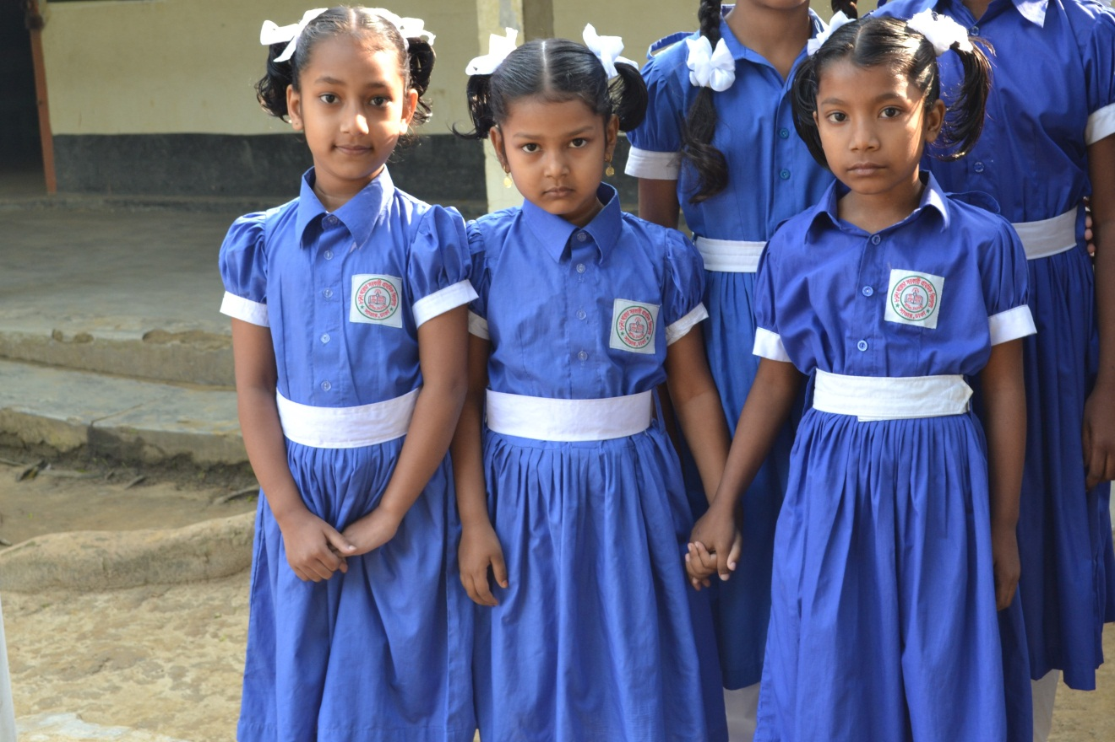
Vocabulary
Key word
Companion
Meaning:
Associate
We cannot live without Companion.

Slide 14
Choose the correct answer from the alternative.
Individual work
1.Which of the following has the closest meaning to the word ‘enmity’?
Apathy .
Venom .
Animosity.
Lethal .
2.The man – society to live in a jungle ?
Embraced .
Needed .
Departed .
Abandoned .

Slide 15
Choose the correct answer from the alternative.
3.What does the word ‘companion’ mean in the passage?
Colleague .
Partner .
Helper .
Counterpart .
4 A --- was brought to kill the mice.
Cat .
Cow .
Dog .
Maid .

Slide 16
Choose the correct answer from the alternative.
5. He made a ----- in the midst of the jungle .
Shelter .
Protection .
Farm.
Plantation .
6. The word ‘jealousy’ means -
Doubt notion.
Envy .
Notion.
Suspiction.

Slide 17
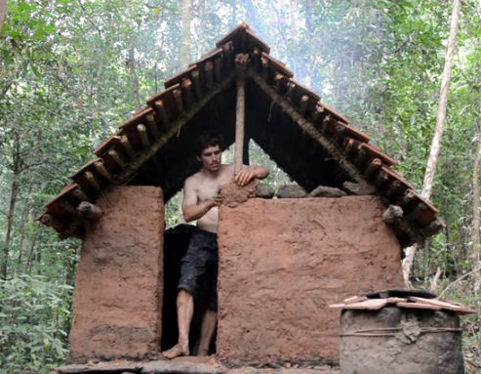
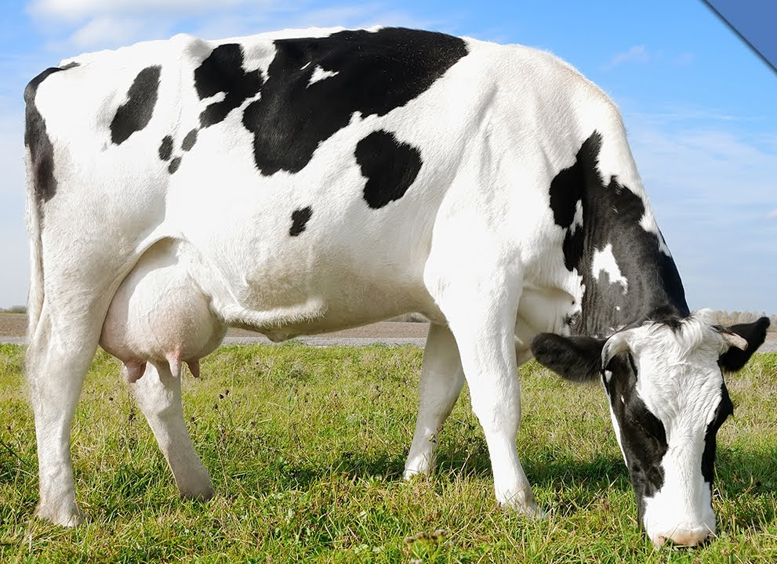
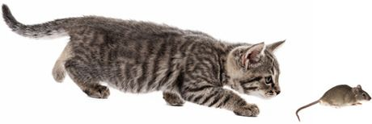
Group Work.
(Shut your book and answer the question.)
What five things did the young man do in the jungle ?
The young man made a nice little hut in a jungle .
He brought a cat to kill the mice.
He brought a cow to have milk .

Slide 18
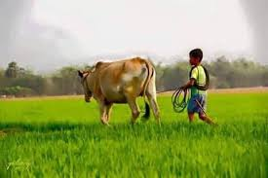
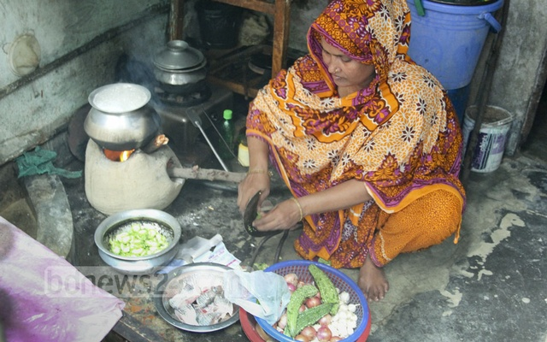
(Shut your book and answer the question.)
What five things did the young man do in the jungle ?
He brought a cowhand to tend the cow.
He took a wife to cook food.

Slide 19
Now divide into groups of five. Tell the story to the groups sequentially.
Group-1 :
Long time ago, a young man got frustrated with his social life , because he found it full of problems .
Group-2 :
So he left his house and made a nice hut in a jungle .
Group-3 :
He wished to live in the hut peacefully.
Group-4 :
But soon, in the hut, the mice made holes in his blanket.
Group-5 :
So, he brought a cat to kill the mice.
Group-1 :
And he brought a cow for milk to feed the cat .
Group-2 :
Then he brought a cowhand to look after the cow.
Group-3 :
At last, he took a wife to cook food.
G- 4:
Then children were born to them.
Group-5 :
Finaly , the man found himself again in a family.

Slide 20
Read the passage carefully and answer the following questions.
1. Why did the young man leave his house ?
2. Where did he make a hut? What did he make the hut with ?
Individual/pair work
3. Was the man happy in his hut ?
4. How did he find himself again in a family ?
5. Where and how can a person be happy ?
6. What is the moral of the story ?

Slide 21
Compare with your answer
1. The young man found his social life full of problems and sufferings . So he left his house
2. He made a hut in a jungle . He used wood, bamboo and reeds to make the hut.
3. At first, the man was happy in his hut, but soon, his happiness faded away.
4. When the young man found some mice in his hut , he brought a cat . The cat needed milk, so, he brought a cow. The cow needed grass and hay , so , he brought a cowhand. Then he took a wife and children were born and thus he found himself again in a family.
5. A person can be happy in the family and by living with the other people in the society.
6. The moral of the story is “ Man cannot live alone. ”

Slide 22
Fill in the blanks with the correct words
live
society
found
end
cooperation
Once a young man decided to (a) ……………by himself in a jungle. He left human (b) .………… ..as there were problems and suffering all the time . In the jungle he (c)…………….. .happiness that he sought . However, his happiness came to an (d) …………. .when he found mice in his hut. Eventually, he learned the importance of living in a society amidst the (e) ………………..of others.

Slide 23
Evaluation
1. What can we do at home and in the locality to become good citizens ?
To be good citizens :
First of all, we must increase our consciousness and develop our skills.
Besides going to schools we have to go to libraries and develop the habit of studying a lot .
We must show respect to our elders and sympathy to the poor and the weak.
We also have to contribute to establishing peace and harmony in the locality.

Slide 24
Home Work
Write a paragraph with in ten sentences about
The problems and comforts of living in a society.

Slide 25
Man cannot live alone .
Thank you all

