Slide 1
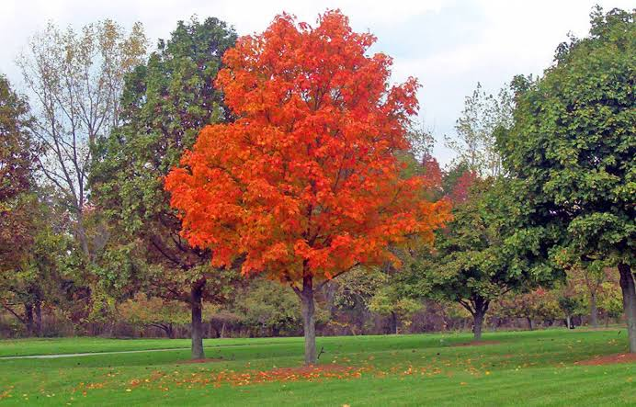
WELCOME

Slide 2
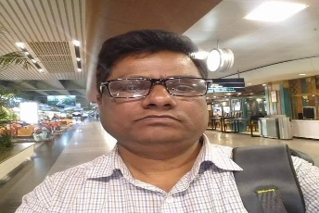
Identity
English 1st paper
Class:- eight/nine
Writing Part
Date: 29/12/2020
Md shafiqul islam
Assistant Teacher
Sonatan darussannat dakhil Madrasha , kawnia , Rangpur.
Mail: shafiqulislam42347@gmail.com

Slide 3
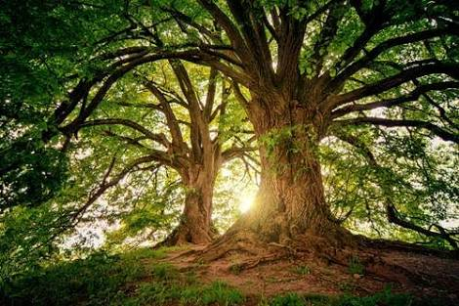
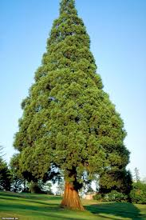
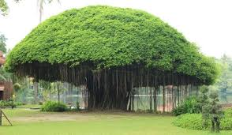
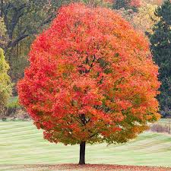
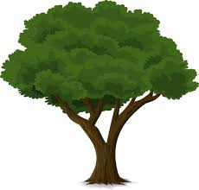
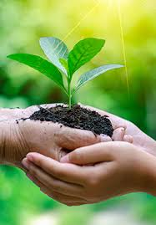
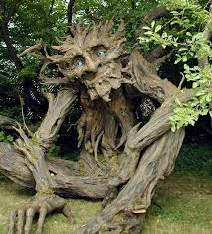
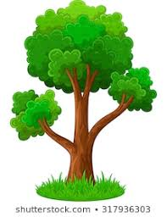
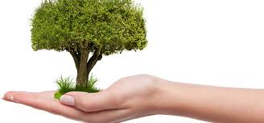
LOOK AT THE SOME PICTURE

Slide 4
OUR TODAY’S LESSON
A dialogue on
Importance of tree plantation

Slide 5
Learning outcome
After we have studied this lesson will be able to---
know importance of tree plantation.
Ask and answer the questions.
Write a dialogue.

Slide 6
Write a dialogue between two friends about the importance of tree plantation.

Slide 7
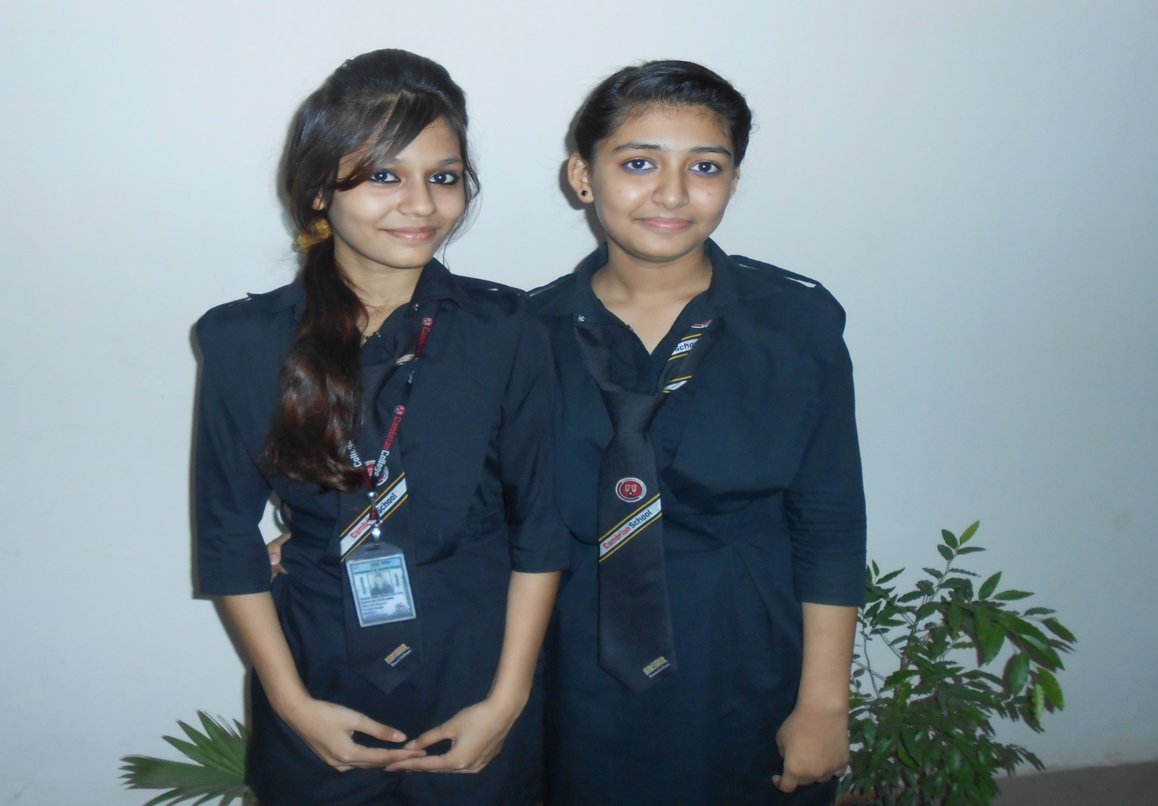
Mina
Luna

Slide 8
Mina-assalamu alaikum.
Luna-walaikum assalam.

Slide 9
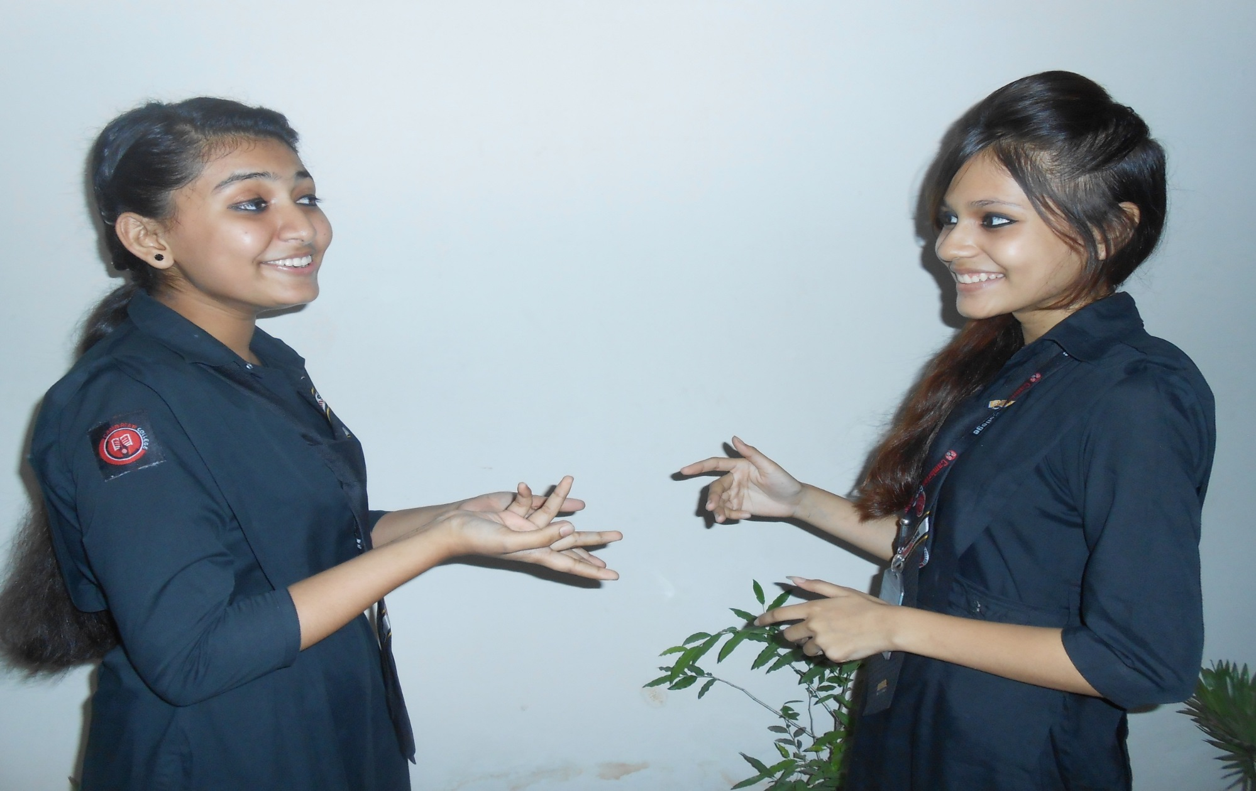
Mina-Hello friend! How are you and where are you going?
Luna-I am so so and was going to you.

Slide 10
Mina- But you are in a hurry . Any thing wrong with you?
Luna-yes , a report of the Green party regarding tree cutting culture is greatly tormenting me.

Slide 11
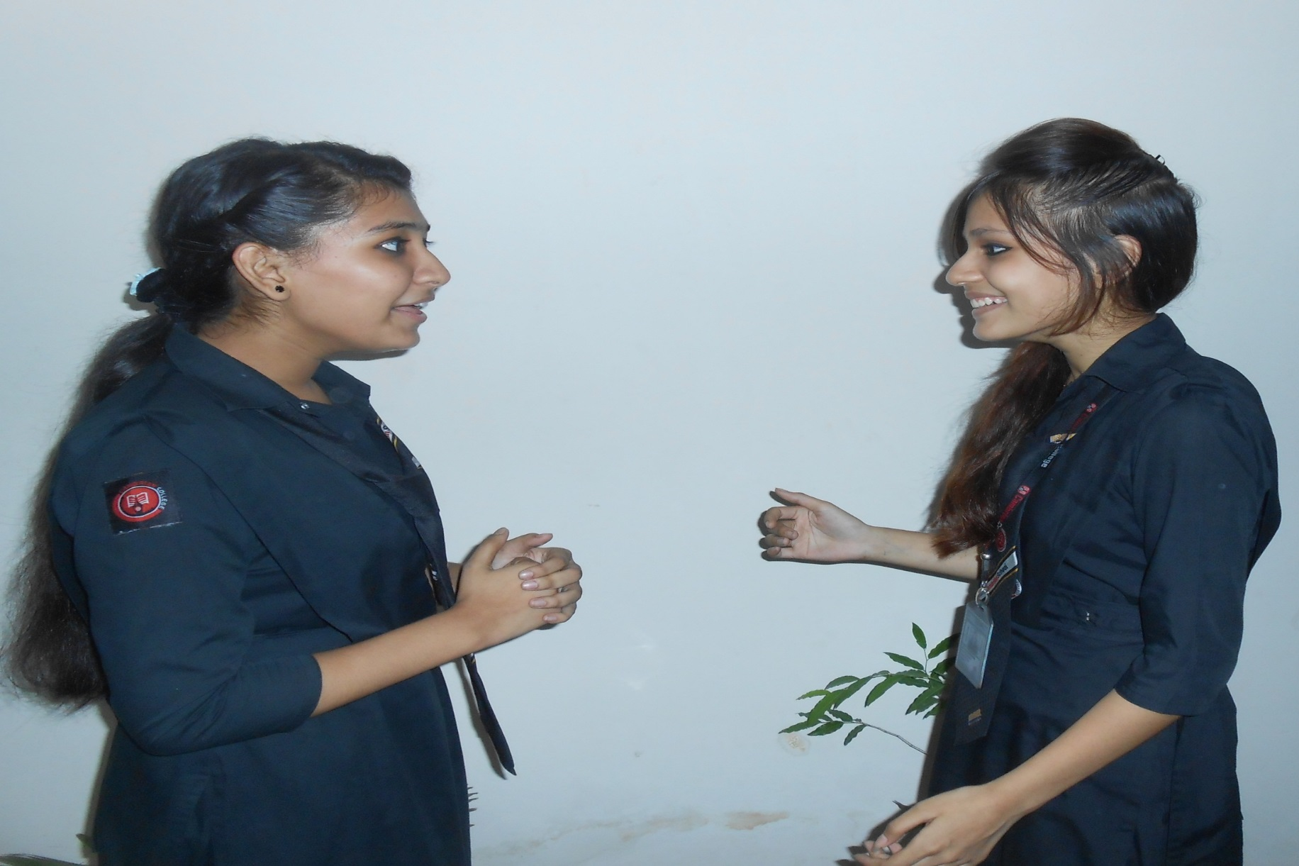
Mina-I see . To save our green environment Green party , is putting emphasis on afforestation instead of deforestation any more.
Luna-what is afforestation?

Slide 12
Mina-afforestation means planting tree systematically.
Luna-yes, tree plantation? Trees gives us shelter ,shade, food and other facilities such as maintenance of ecosystem for which natural ingredients go their own way smoothly.

Slide 13
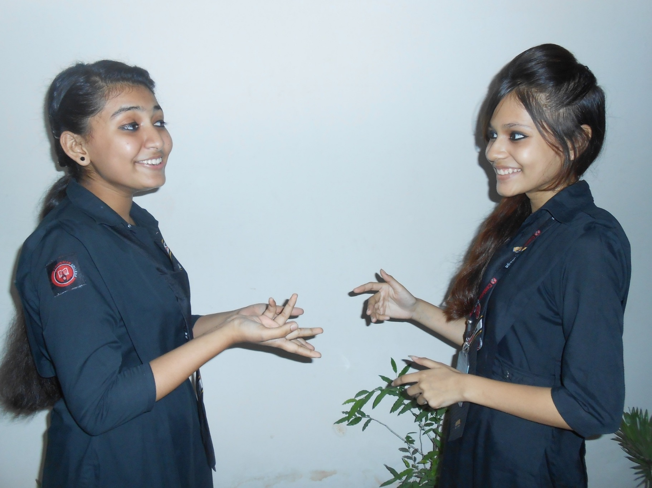
Mina-But it is a matter of regret that these are being cut down unconsciously at a result , nature is losing her ecological balance . And
Luna-And ecological factors are being endangered.

Slide 14
Mina-So we should necessary sleeps to save environment.
Luna-That is, you want to say that the necessity of tree plantation is needless to mention any more , do you?

Slide 15
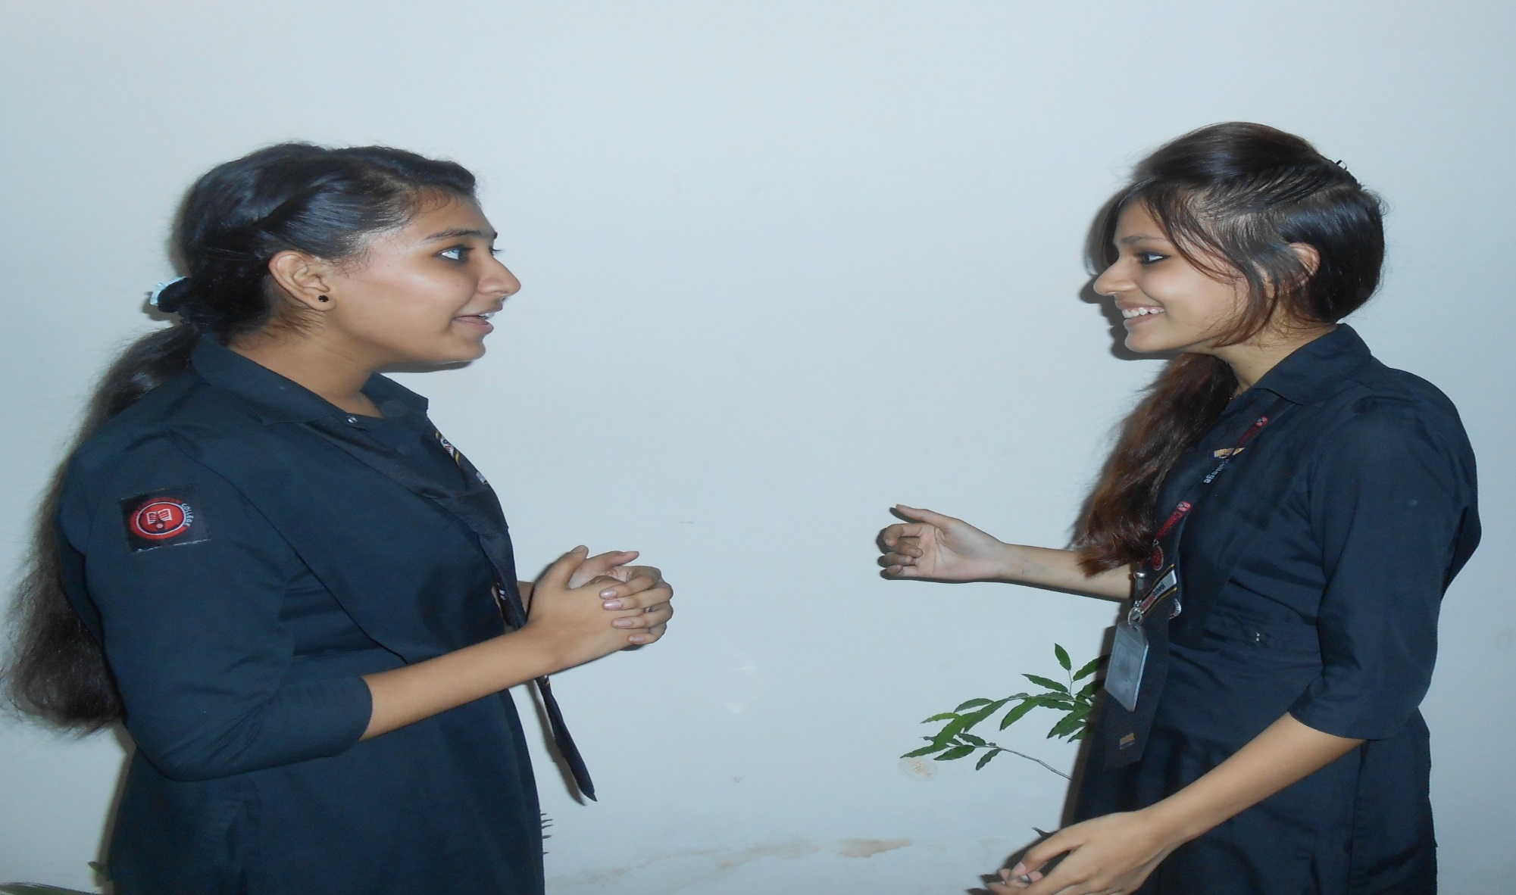
Mina-Yes
Luna-Thank you very much,.

Slide 16
Mina-Good Bye.
Luna-Welcome Too.

Slide 17
Pair Work
Every single pair is suggested to write a dialogue on.

Slide 18
EVULUATION
Answer the following question:
What does tree plantation?
What is importance of tree plantation?
Which tree is best for plantation ?
Why do we celebrate plantation?

Slide 19
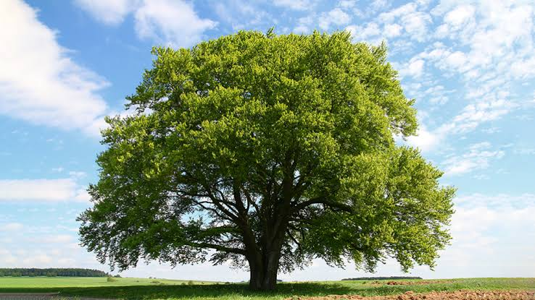
THANK YOU ALL STUDENT

