Slide 1
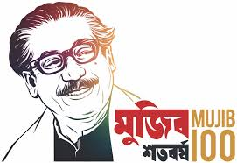
Welcome to
Multimedia Class

Slide 2
Presented by-
Mosammat Nelufa Afrose (Bithi)
Lecturer in English
Khilbaisa Rahmania Fazil(Degree) Madrasah
Sadar, Lakshmipur
E-mail:nelufa.afrose@gmail.com

Slide 3
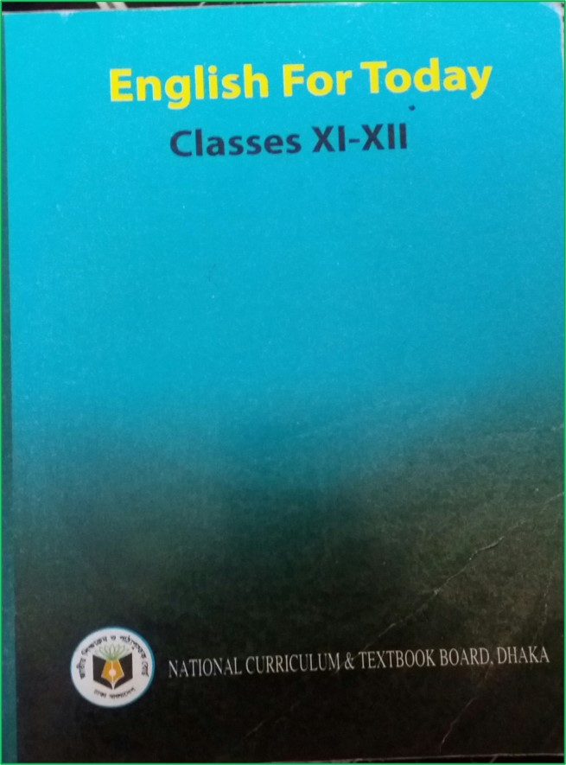
Introduction of lesson
Class: xi/xii/Alim
Subject: English 1st paper
(English For Today)

Slide 4
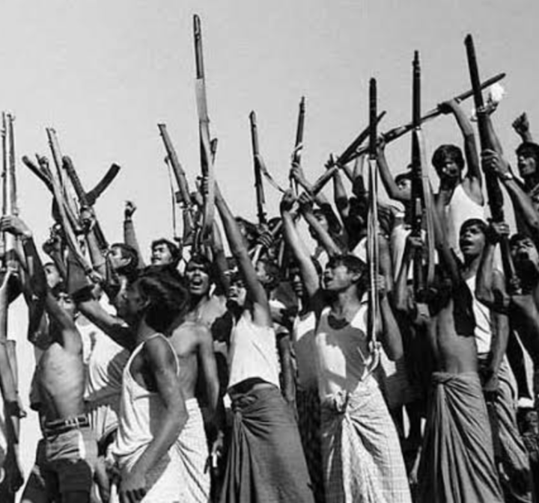
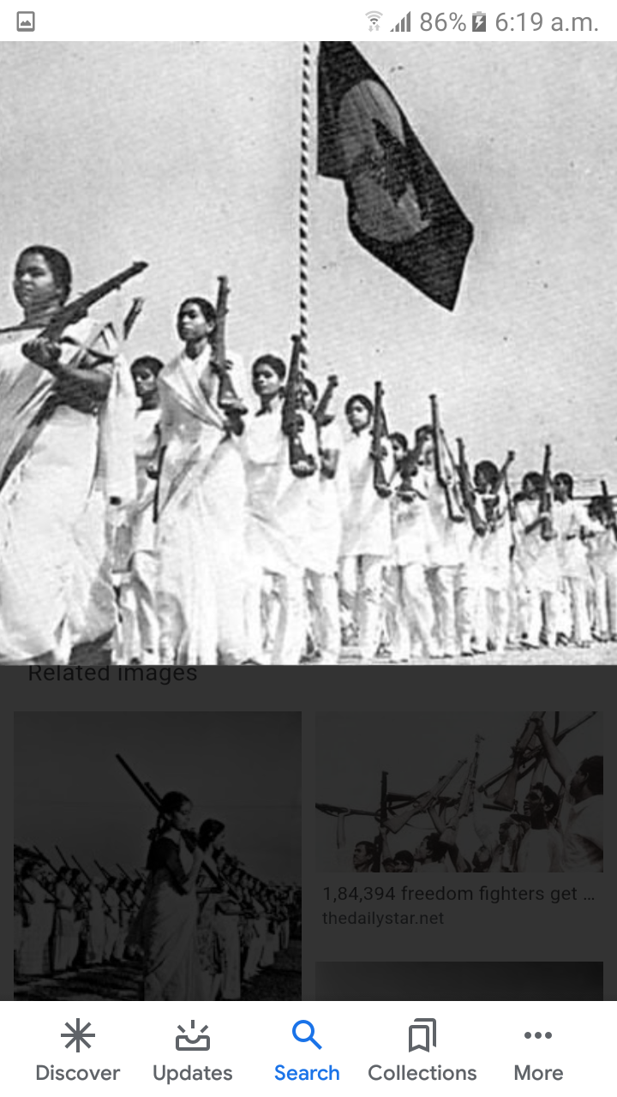
Warm up activities
Look at the pictures-
What are the pictures about?
Answer-The pictures are about our war of independence.

Slide 5
Today’s lesson
Paragraph on-
“War of Independence”
According to U-1,L-2

Slide 6
Learning Outcomes
After finishing the lesson, you will be able to learn-
What is paragraph?
Read a summary on “War of Independence” with pictures for writing Paragraph on “War of Independence.”
Vocabulary.

Slide 7
Lesson
What is paragraph?
Paragraph (comes from the Ancient Greek parágraphos, means "to write beside") is a self-contained unit of discourse in writing dealing with a particular point or idea. A paragraph consists of one or more sentences. Paragraph is usually an expected part of formal writing, used to organize longer prose.
Every paragraph consists of three main parts: a topic sentence, some supporting sentences, and a concluding sentence.

Slide 8
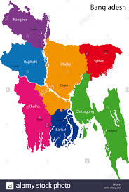
Read on "War of Independence" with pictures
Bangladesh is our beloved homeland. It has become independence in 1971. There is a bloody history behind the independence. The war of Independence is a glorious period in the history of our country. The war was fought against the Pakistan army .

Slide 9
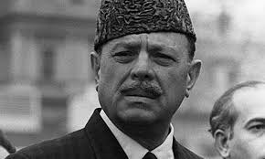
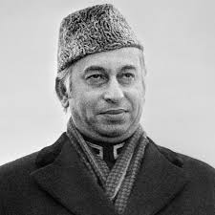
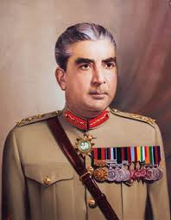
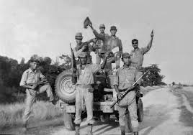
After independence from British, the Pakistani ruling party and their followers began to treat East Pakistan i.e. Bangladesh as their colony. From 1947 to 1970 innumerable Bengalis were killed and tortured by the Pakistan autocratic rulers. They deprived us politically and economically, culturally and in every sector of national and international perspectives.
Ayub Khan
J. Ali Bhutto
Yahya khan
Pakistani Army

Slide 10
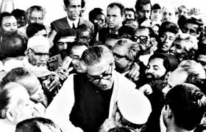
Therefore under the leadership of Bangabandhu Sheik Mujibur Rahman a violet mass movement was launched. Awami League got a landslide victory at the election of the National Assembly of Pakistan in December 1970.But the power had not been handed over to Awami League even though people voted for them to majority. Besides, Yahia khan hatched a conspiracy.

Slide 11
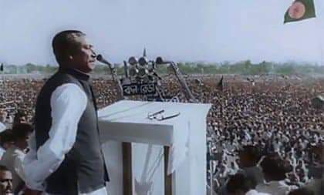
Bangabandhu , the great leader of the Bengalee delivered his epoch-making speech on 7th march,1971. He technically but clearly declared that after long 23 years deprivations, torture, exploitation and injustice , the only way left for the Bengalee was the struggle for independence.

Slide 12
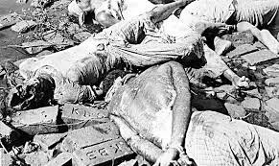
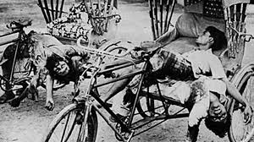
On a fateful night of March 25,1971 the Pakistani Army cracked down upon the innocent and armless people of East Pakistan. They kill people, torture women, burn houses, loot property. Bangabandhu was taken as a prisoner to West Pakistan.
Scenery of 25 march, black night.

Slide 13
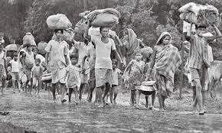
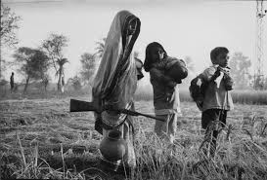
Many people fled away and took shelter in neighbouring country, India.

Slide 14
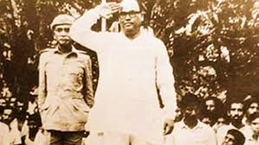
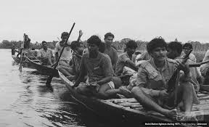
A new government was formed at Mujibnagar. The Mukti Bahini was organized and trained. They began to hit back the Pakistani hoarder. In fact, everyone in Bangladesh was freedom-fighter and did his best to help the Mukti Bhaini. The Mukti Bhaini reattacked the Pakistani army. The Mukti Bhaini and the Indian forces formed a joint command and inflicted crushing blows on the enemy in every sector. They compelled the Pakistani to surrender.
First acting president of Bangladesh
Mujibnagar Government.
The Mukti Bhaini .

Slide 15
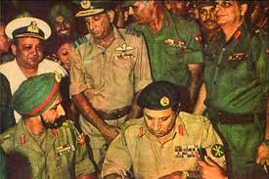
On the 16th of December 1971 , the Pakistani soldiers surrendered their arms to the joint command at a ceremony in Ramna Race Course garden, Dhaka. Thus after long nine months of massacre the War of Liberation came to an end and we won freedom.

Slide 16
Pair work
Write down name of 7 warriors of our great valor.

Slide 17
Vocabulary.
Colony- a country or an area that is governed by people from another more powerful country.
Autocratic- holding unlimited powers of government.
Mass Movement- The 1969 uprising in East Pakistan (ঊনসত্তরের গণঅভ্যুত্থান). It is a democratic political movement in East Pakistan (now Bangladesh)
Independence - Freedom from the control or influence of others.
Massacre – indiscriminately slaughter/ killing in large number.

Slide 18
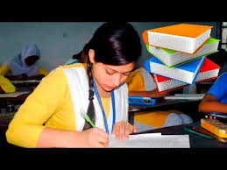
Individual work
Write 5 sentences about the independence of Bangladesh.

Slide 19
Evaluation
Answer the following questions:
1.Why was the War of Independence inevitable for the people of East Pakistan?
2. Can you tell about the 23 tragic years history of deprivation?
3.What was the ultimate consequence of the 7th march speech?
4.What do you know about 25 march fateful night?
5.How many people give their lives for independence?

Slide 20
Home work
Write a paragraph on “War of Independence”.
According to Board question no-7

Slide 21
Thanks to all

