Slide 1
Welcome to My multimedia English class

Slide 2
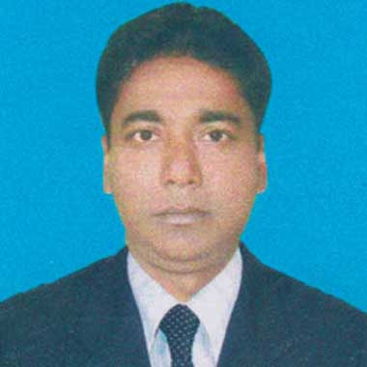
Azimnagor Computer Technical School & Commercial College
Subject – English 1st paper
Class – Nine
Time – 45 mins

Slide 3
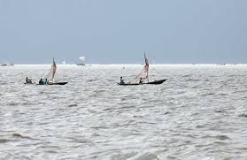
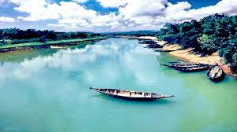
Look at these pictures .
What can you see in these picture ?

Slide 4
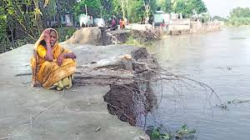
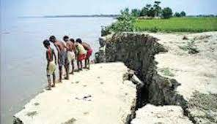
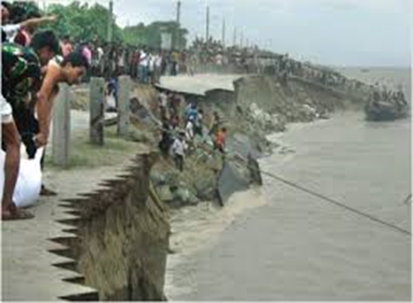
Look at some another pictures.
What can you see in these picture ?

Slide 5
Let`s watch a video clip
Now discuss with your partner what should we to protect our lives and properties from the river erosion. Then write it within three sentences.

Slide 6
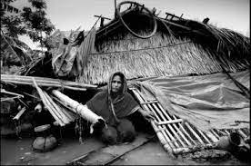
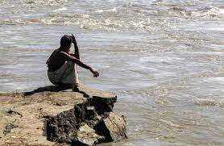
So, today we’ll read about
The greed of the mighty rivers
Unit – Five
Lesson-1

Slide 7
Learning outcomes
By the end of the lesson, the students will be able to..
write about the effects river erosion;
write the answers of the questions related to this lesson;
complete the summary of Meherjan's life;
say the meaning of key words.

Slide 8
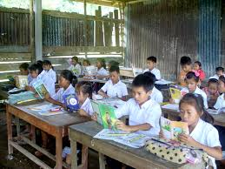
Dear student read the text silently
If you don’t understand anything, let me know.
Your silent reading is being monitored.

Slide 9
Now my dear students, we will share our ideas about some difficult vocabulary of this lesson.

Slide 10
Erosion
Meaning
The process of eroding ( remove soil or rock )or being eroded by wind, water, or other natural agents

Slide 11
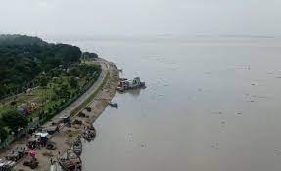
Embankment
Meaning
A wall of stone or earth made to keep water back

Slide 12
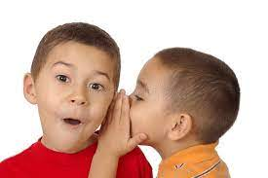
Whisper
Meaning
To speak silently to somebody so that other people cannot hear what one is speaking

Slide 13
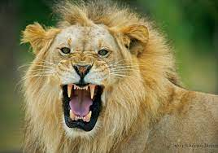
Roar
Meaning
To make a loud deep harsh sound of tiger, river or any animals.

Slide 14
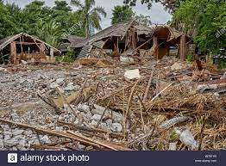
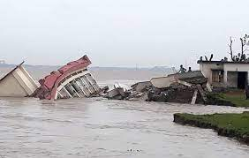
Demolish
Meaning
To pull or knock down something or Destroying something

Slide 15
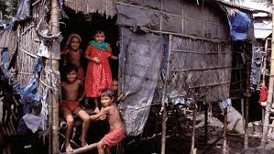
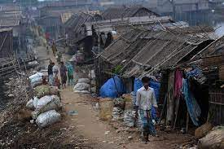
slum
Meaning
A overcrowded urban area inhabited by very poor people

Slide 16
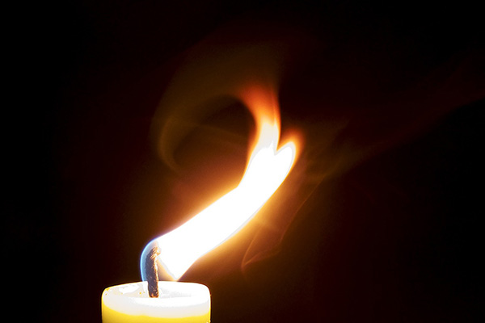
Unsteady
Meaning
Not normal or a libel to fall or shake.

Slide 17
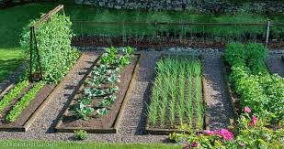
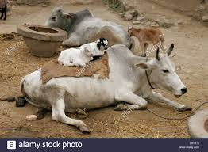
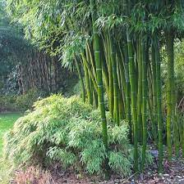
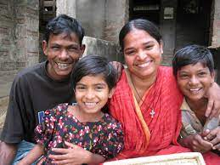
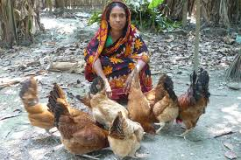
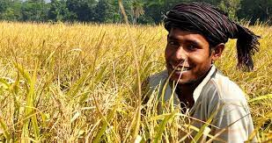
.
Look at these pictures..
Now discuss with your partner about above picture and say about Meherjan

Slide 18
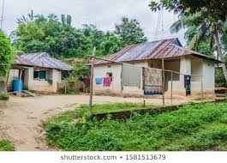
Not a long Meherjan had everythings-
Family
Bamboo bush
Vegetable garden
Cattle
home
Cultivable land

Slide 19
The roaring river Jamuna took only a day to demolish Meher's house, trees, vegetable garden and the bamboo bush

Slide 20
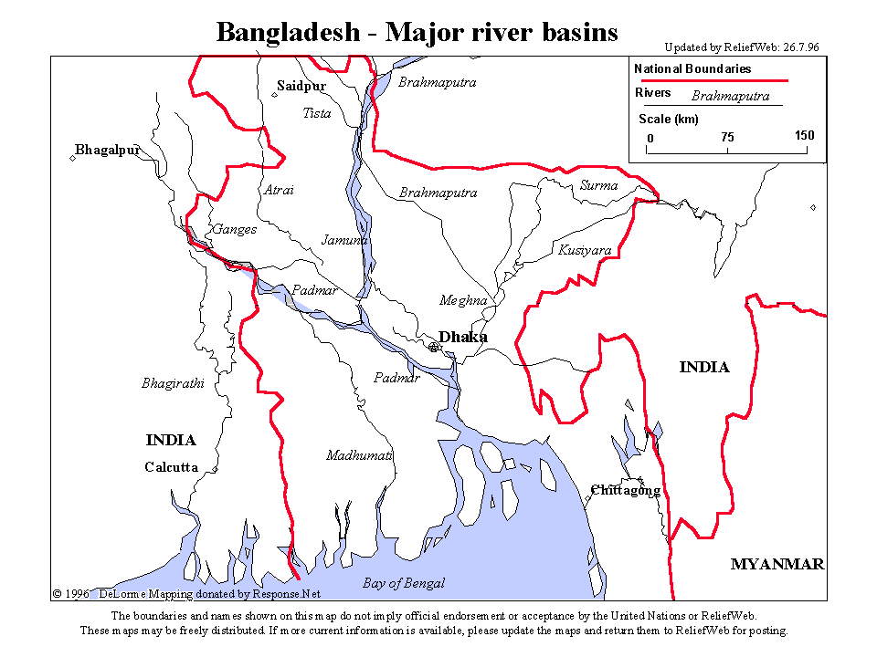
Bangladesh is a land of rivers that affect its people. Erosion is a harsh reality for the people living along the river banks.

Slide 21
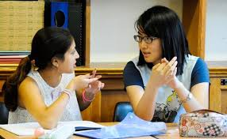
Now Work in pair.
Write the meaning of bellow phrase that is closest to the meaning in the text.
“mighty rivers’
Rivers that have huge volumes of water and very strong currents
“landed property’
A piece of land on the bank of river
Whispering wind
Wind that blows from across the river
Dancing flames
A flame that is made unstable by strong wind

Slide 22
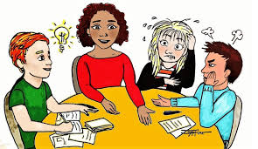
Now Work in Group
Answer the following questions.
1 . Who is Meherjan ?
2. Where she lives in ?
3. Why Meherjan lives in a slum ?

Slide 23
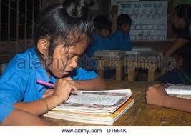
Evaluation
Complete the summary of Meherjan’s life with suitable word
Meherjan is a typical……………. Woman who lives in a slum. She lost her shelter and properties………………. The erosion of the river Jamuna. She also lost her family.Her husband had died of diseases casued by poverty and………………….. Now, she is only a………………… Like Mehejan there are many people who have become the………………of the river erosion. River erosion is still posing…………… to the lives and properties of thousands of people. People living………………. The rivers are the most likely victims of river erosion. Each year about………………….. People become homeless due to river erosion in Bangladesh.Meherjan’s live is just one………………… of how climate change…………………. The lives of thousands of people.
homeless
due to
Shortage of food
Slum dweller
victim
threats
Close to
one lakh
example
affects

Slide 24
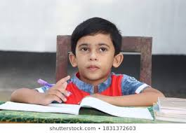
Home work.
Write a summary about Meherjan.

Slide 25
Thanks to all

