Slide 1
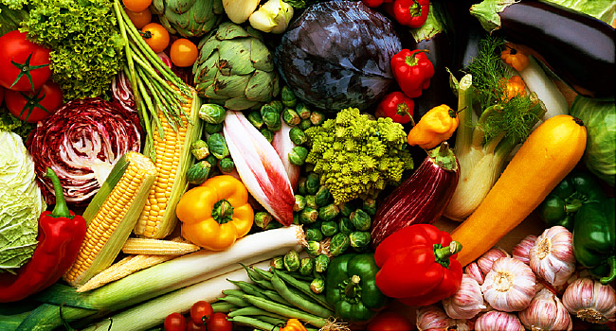
Welcome Everybody

Slide 2
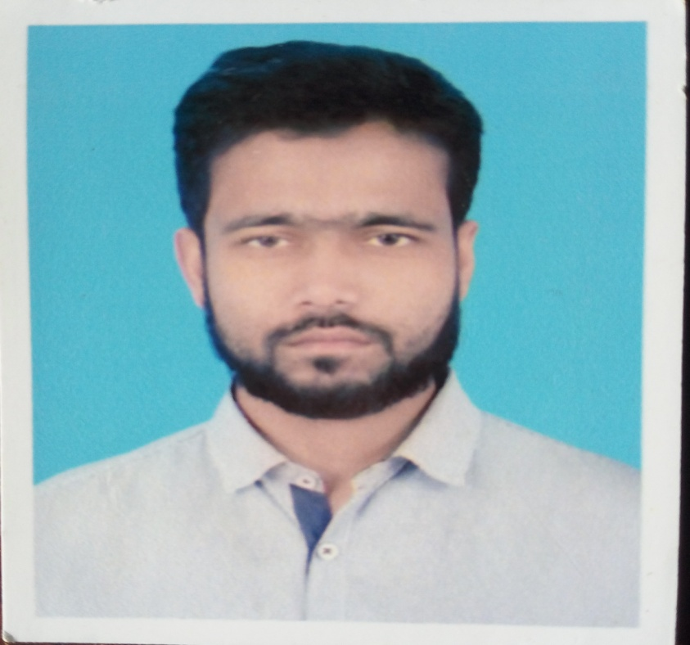
Introducing Teacher
Md Rabeul Hasan
Asst. Teacher in English
Shaharpar G A Dakhil Madrasah
Debidwar, Cumilla

Slide 3
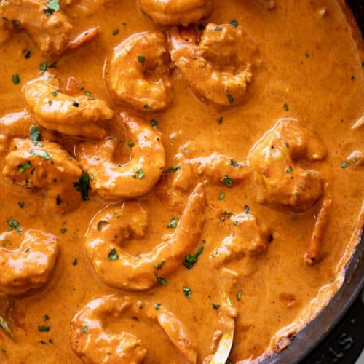
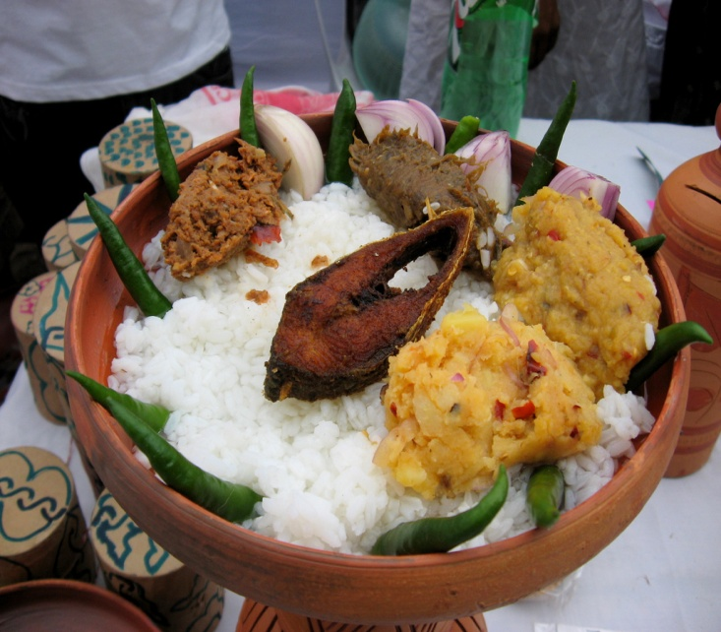
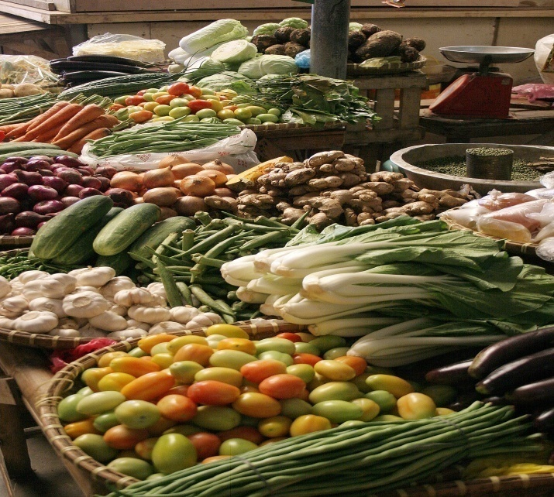
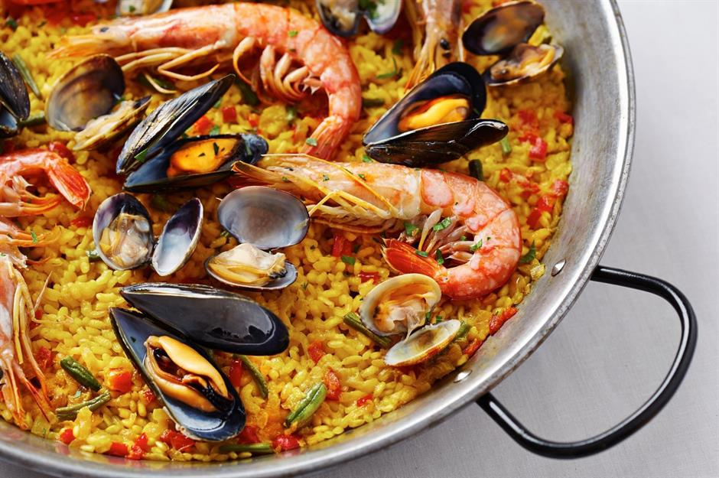
Look at the picture

Slide 4
So,our today’s topic is
Bangladeshi Cuisine
বাংলাদেশি খাবার
Unit-01, Lesson-05

Slide 5
Learning outcomes
After we have studied this lesson, we will be able to-----
ask and answer questions
Infer meaning form context from silent reading
Participate in short discussion
write answers to questions

Slide 6
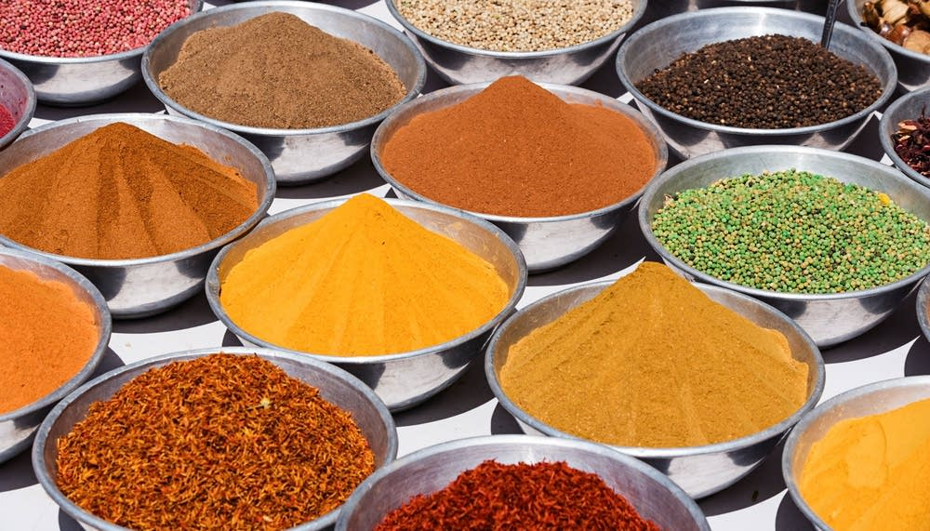
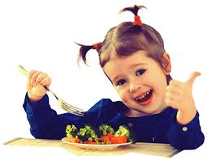
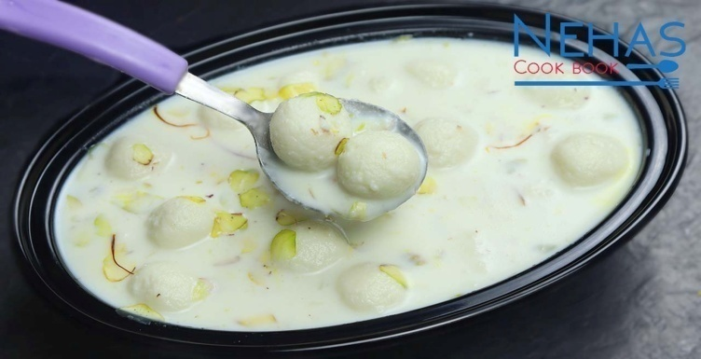
Vocabulary
মশলা
Spices
Delicious
Tasty
appetizing
Stomachic

Slide 7

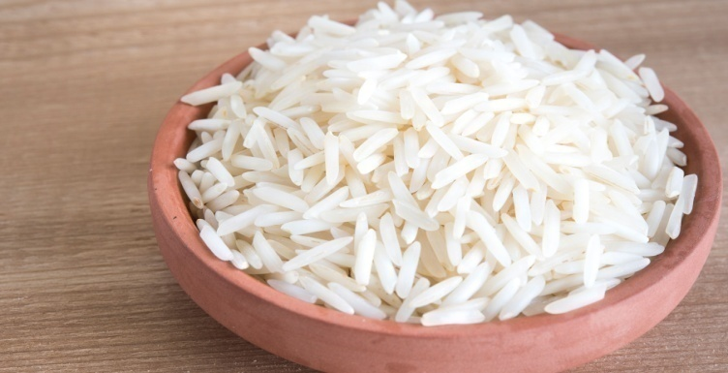
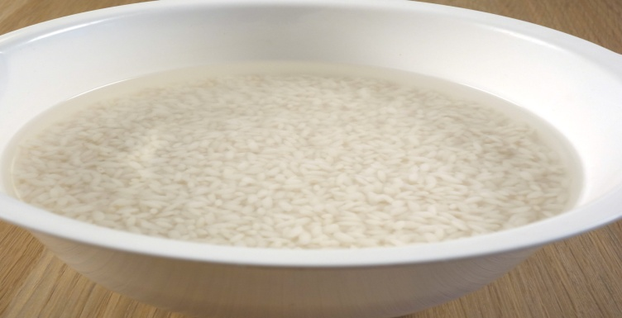
Vocabulary
Variety of vegetables
Different kind of vegetables
Steamed rice
গরম ভাত
Soaked in water
পানিতে ভিজিয়ে রাখা

Slide 8
Dear students
Read the passage carefully and silently.
Bangladeshi cuisine is rich and varied with the use of many spices. We have delicious and appetizing food, snacks, and sweets. Boiled rice is our staple food. It is served with a variety of vegetables, curry, lentil soups, fish and meat. Fish is the main source of protein. Fishes are now cultivated in ponds. Also we have fresh-water fishes in the lakes and rivers. More than 40 types of fishes are common.

Slide 9
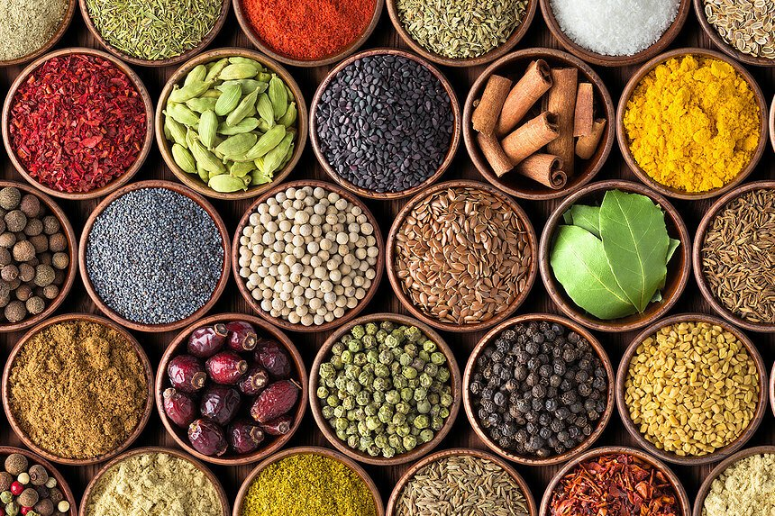
Look at the picture
Bangladeshi cuisine is rich and varied with the use of many spices.

Slide 10

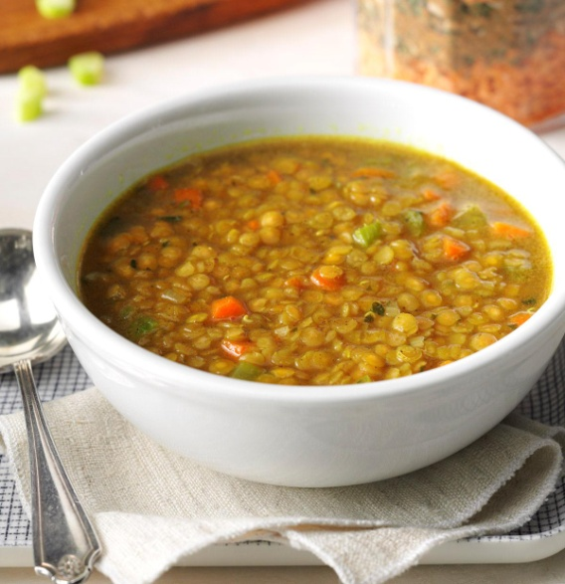
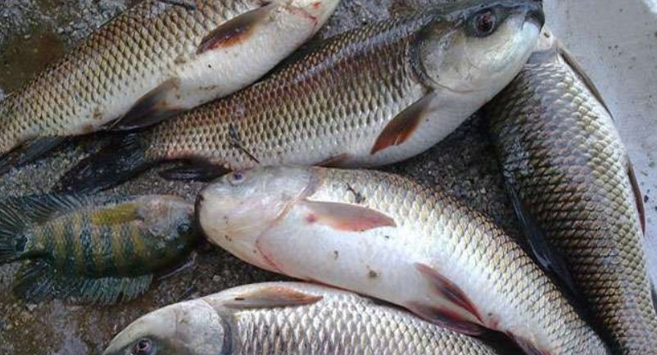
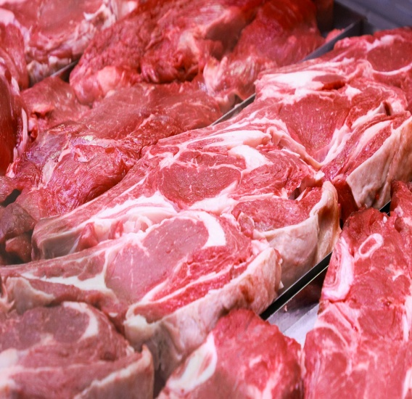
Rice is our staple food. It is served with variety of vegetable, curry, lentil soup, fish & meat.

Slide 11
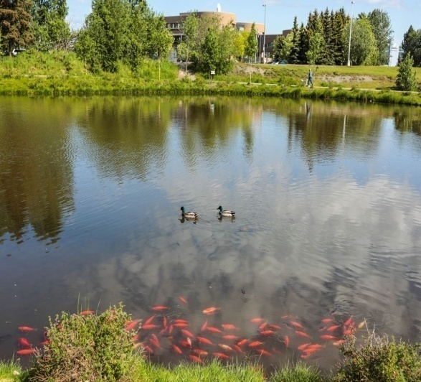
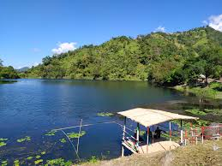
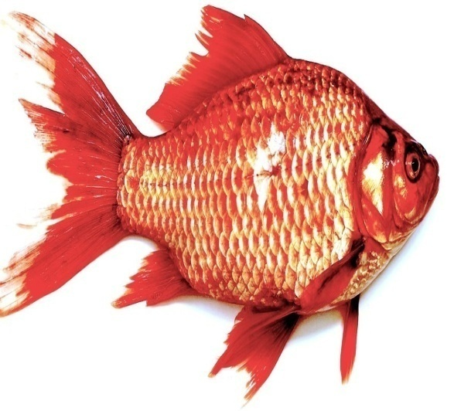
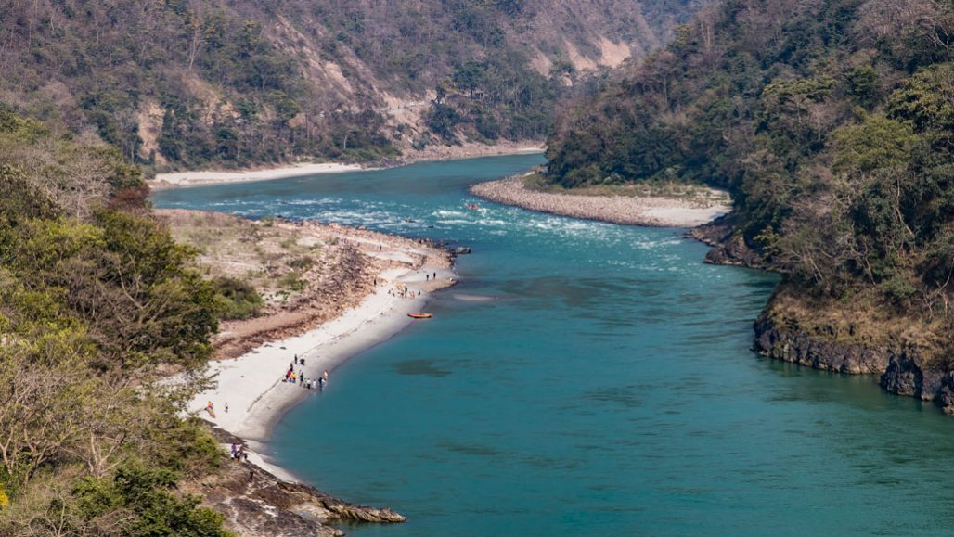
Fish is the main source of protain. Fishes are now cultivated in ponds. We have also fresh water fishes in the lakes & rivers.

Slide 12
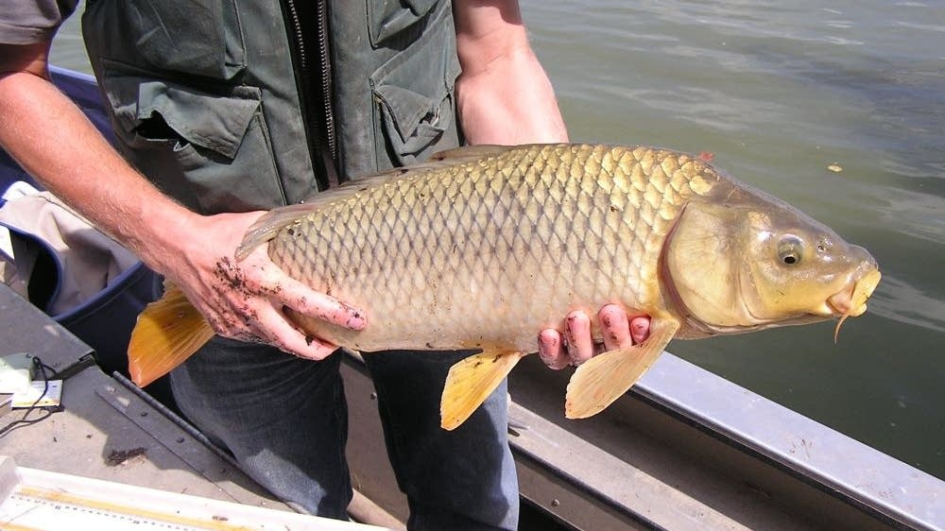
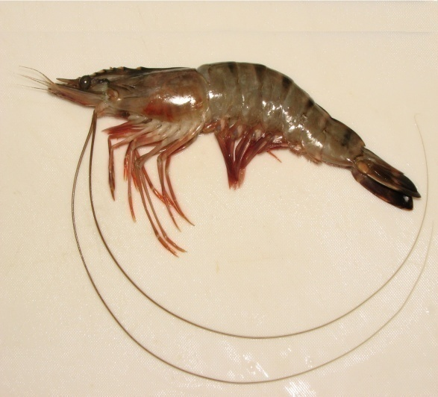
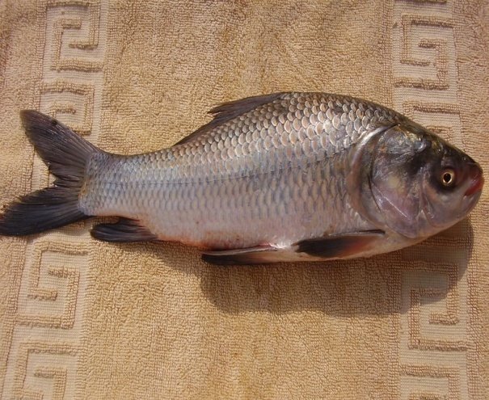
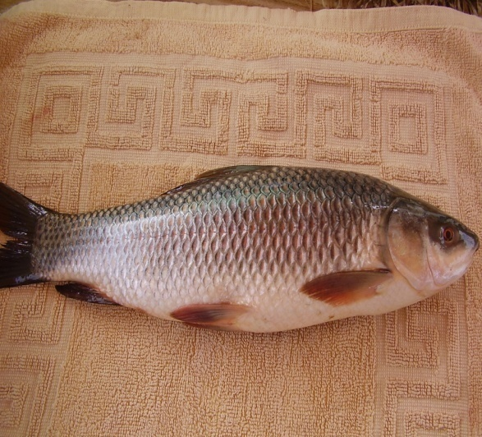
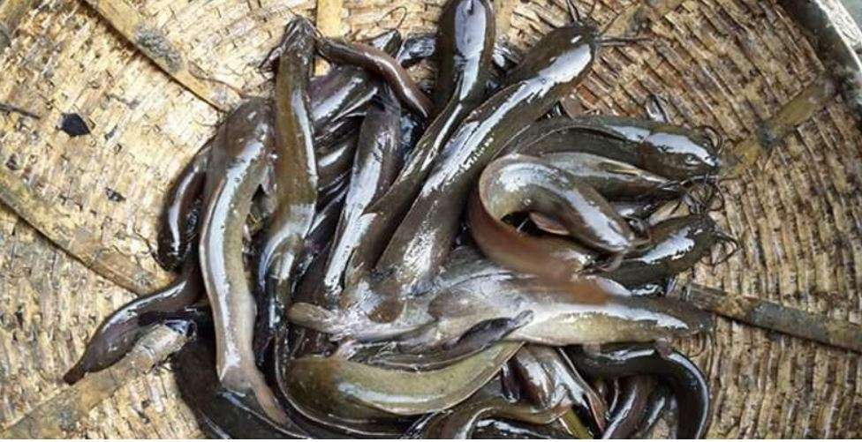
More than 40 types of fishes are common. Some Of them are Carp, Rui, Katla, Magur(catfish), Chingri(prawn).

Slide 13
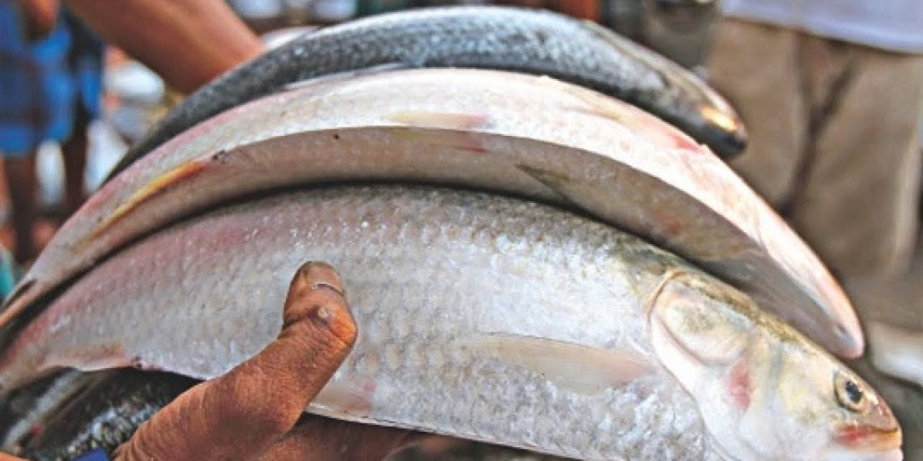
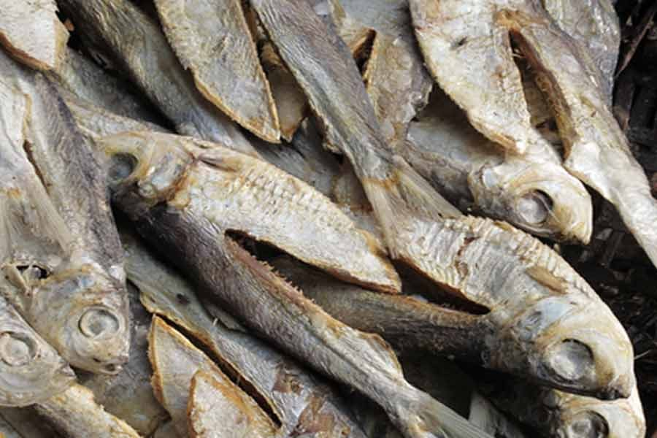
Hilsha & Dried fish also popular among the people of Bangladesh.

Slide 14

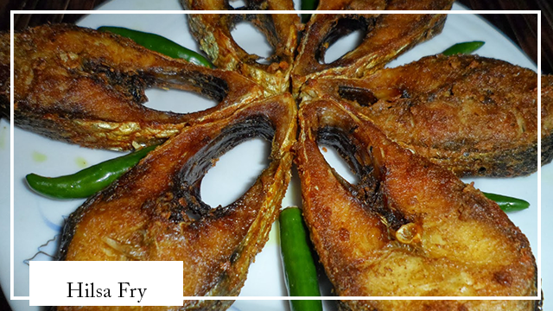
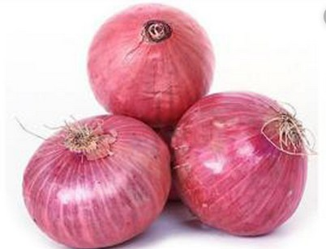
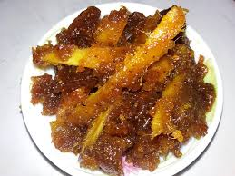
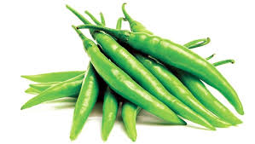
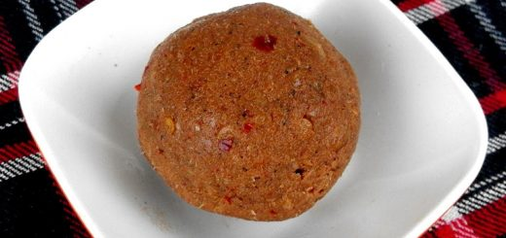
Panta Ilish is a traditional platter of panta bhat. It is steamed rice soaked in water and served with a fried hilsa slice, pickles, dried fish, onion & green chilli. It a traditional piatter of Pohela Boishak.

Slide 15
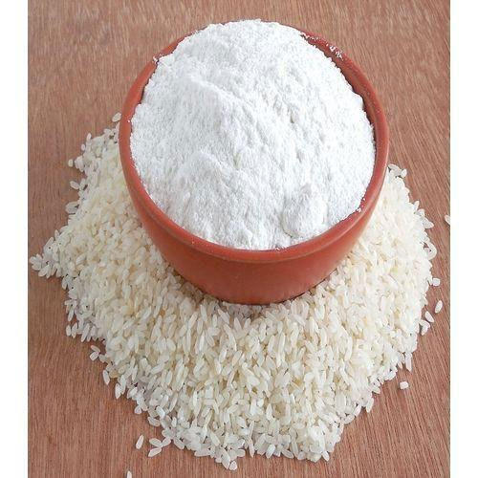
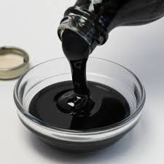
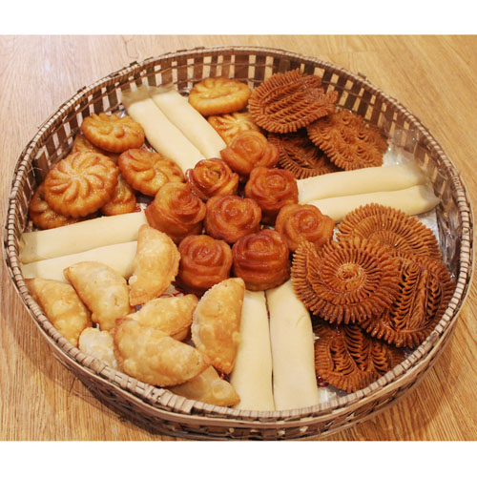
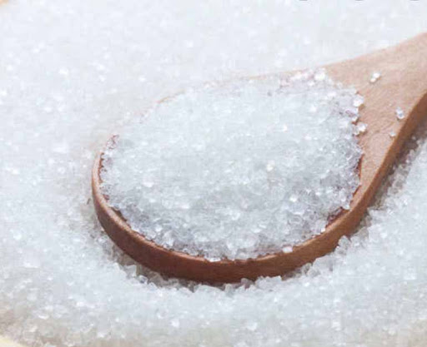
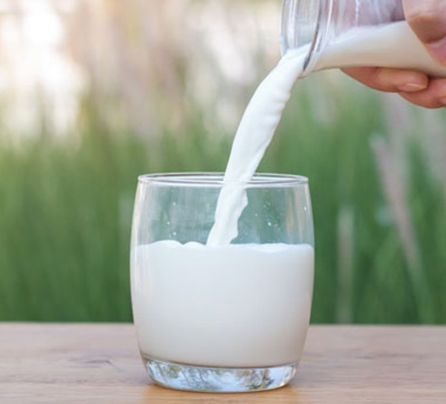
Almost all Bangladeshi fond of pitha. It is made from rice flour, suger, molasess & and sometimes milk. Every year different organization arrange pitha festival.

Slide 16
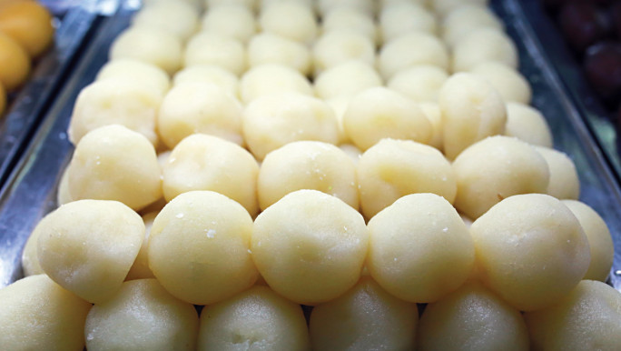
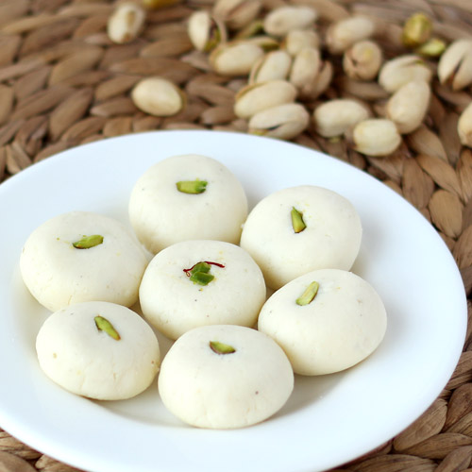
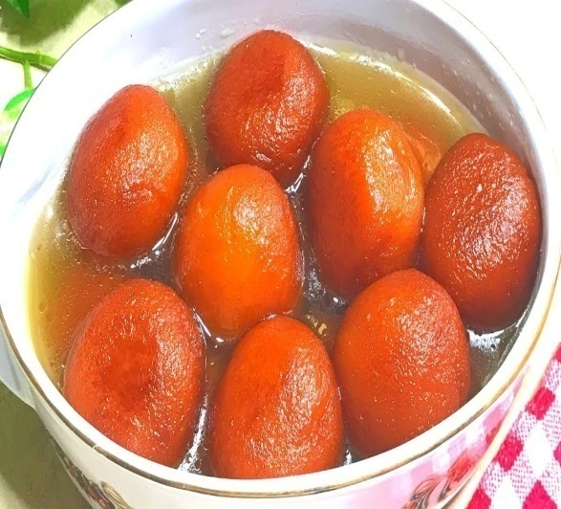

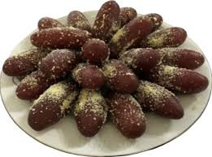
Sweets are distributed when there is a good news like birth, wedding & promotion. We have many types of sweets. Of them Rosgolla, Sondesh, Golapjam, Kalojam & Rosmalai are popular.

Slide 17
Individual Work
True or false? If false, give the correct information.
1 Our foods are rich because they have a lot of oil in them.
2 We get protein mostly from fish.
3 On Pohela Boishkh the traditional food is steamed rice and fried hilsha.
4 Pitha Uthsab takes place almost all the year round in Bangladesh.
Sweets are not much appreciated by the people of Bangladesh.
Check the answer
False, Correct answer: Our foods are rich because they are varied with uses of many spices.
True
True
False, Correct answer: Pitha Uthsab takes place in winter in Bangladesh.
False, Correct answer: Sweets are much appreciated by the people of Bangladesh.

Slide 18
Pair work
Discuss and answer the questions in pairs.
1 Describe a Bangladeshi food that you like best.
2 Make a list of the things you and your partner eat every day.
3 Make two lists of food eaten by the urban and the rural people.
4 Why are there differences between the food eaten by the urban and the food eaten by the rural people?

Slide 19
Home work
Read the text in B again and answers the following questions.
1 What has made Bangladeshi food so special?
2 Where do we get the fishes from?
3 Apart from fish, what other foods do we eat with rice?
4 Why are sweets an important part of our life?

Slide 20
Allah Hafiz

