Slide 2
Presented by
Hafiza Khanam.
Assistant teacher.
99 No. Nilokhi G. P. S.
Gopalganj Sadar,
Gopalganj.
khanamhafiza1987@gmail.com
Class: One
Subject: English
Unite : 24.
Numbers.
Lesson:1-3,
Page : 48

Slide 3
Lets watch the video
We were watching a video.
Now tell me what about the video is?

Slide 4
Today’s lesson
Numbers

Slide 5
Learning outcomes
By end of the lesson students will be able---
Reading:
2.1.1 recognize and read cardinal numbers up to 10.
Writing:
2.1.1 write cardinal numbers up to 10 in figures.

Slide 6
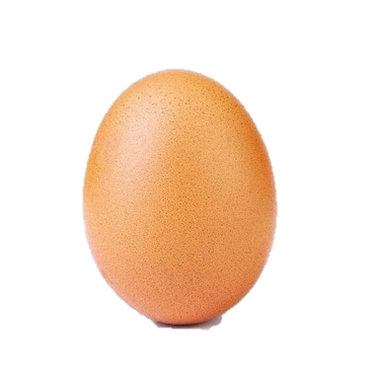
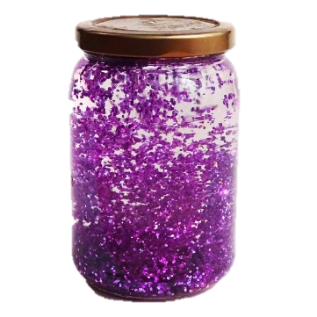
7
3
5

Slide 7
= 9
How many apples are there?
Let’s count.

Slide 8
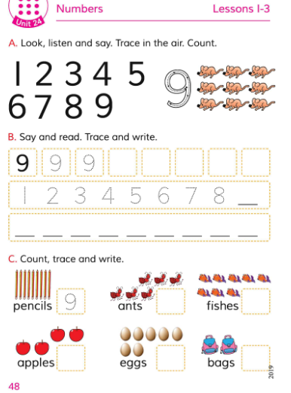
Open at page 48

Slide 9
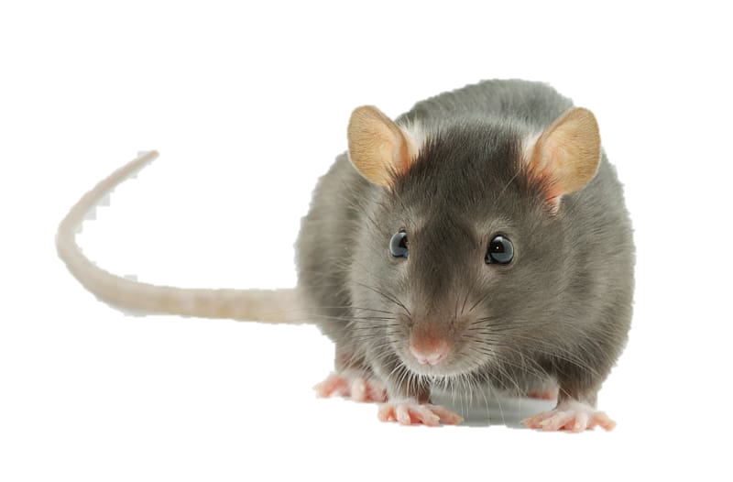
1
2
3
4
7
8
9
5
6
9 rats
How many rats are there?
Let’s count.
1
2
3
4
5
6
7
8
9

Slide 10
Today we will learn how to write 9

Slide 11
Evaluation
Write 1-9 on your exercise book.

Slide 12
ONE DAY WORD
Number =
Numeral(সংখ্যা)=
She dialed the number carefully.

Slide 13
Homework
Write 9 with various colors with proper direction .

Slide 14
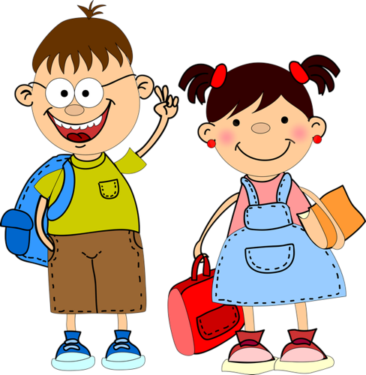
Good
bye

