Slide 2
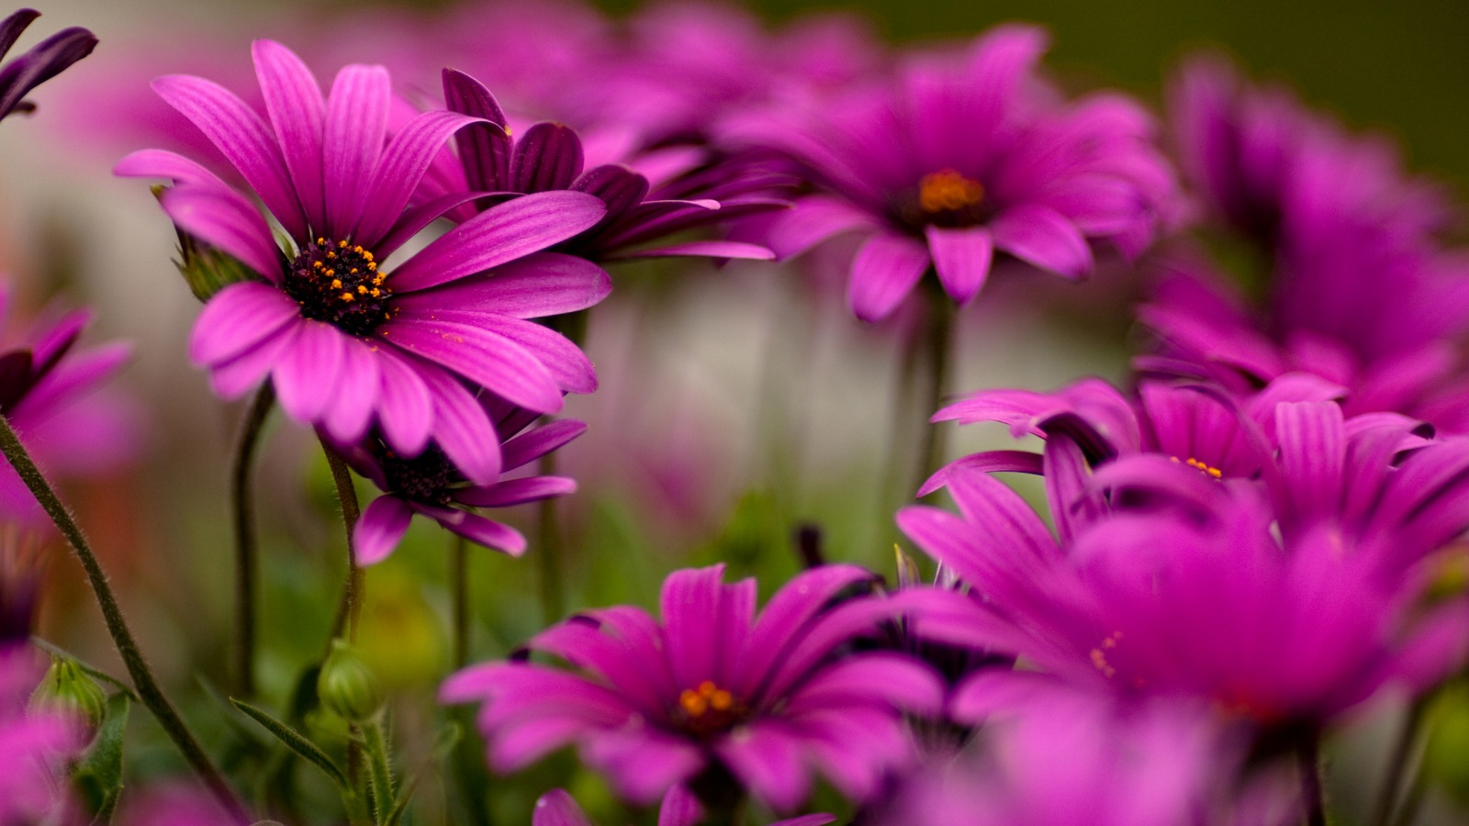
WELCOME

Slide 3
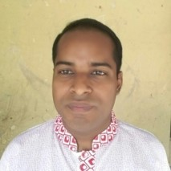
UTTAM KUMAR DAS
Assistant Teacher
Taragonj GPS
Kapasia, Gazipur.
Mobile: 01715535350
E-mail: at.uttamkumardas.pt@gmail.com

Slide 4
Class: Three
Subject: English
Time: 40 Mins.
Date: 13/11/2020

Slide 5
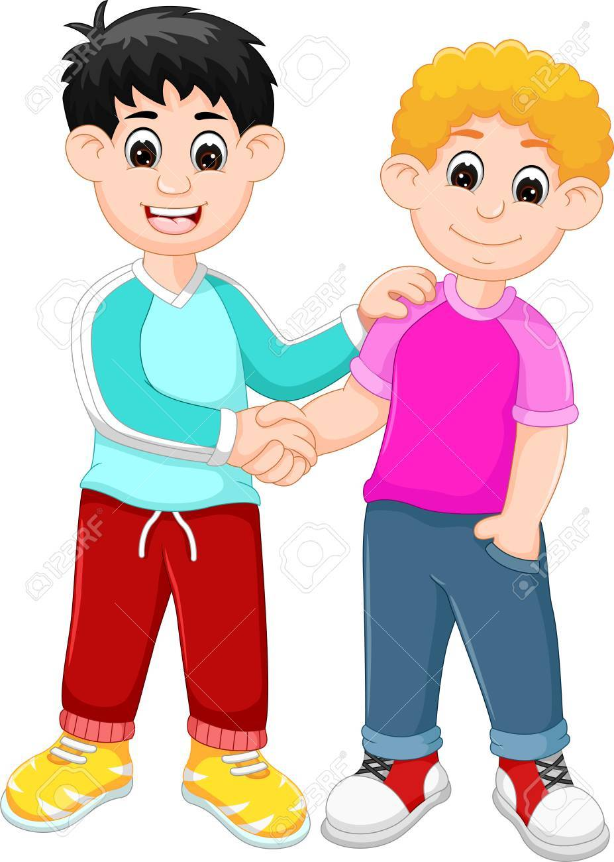
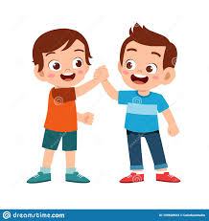
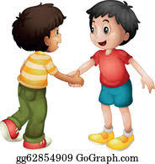
Tell about the pictures
Friends

Slide 6
My Friend

Slide 7
Learning Outcomes:
Students will be able to:
4.3.1 enjoy and understand simple stories.
5.1.1 read simple paragraphs.
10.1.1 Write short and simple paragraphs by answering a set of questions.

Slide 8
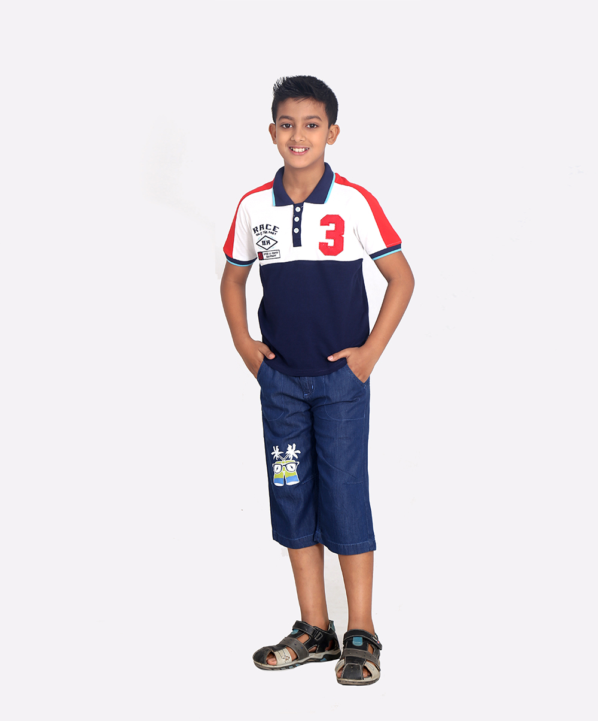
I‘m Radif. I’m eight years old.

Slide 9
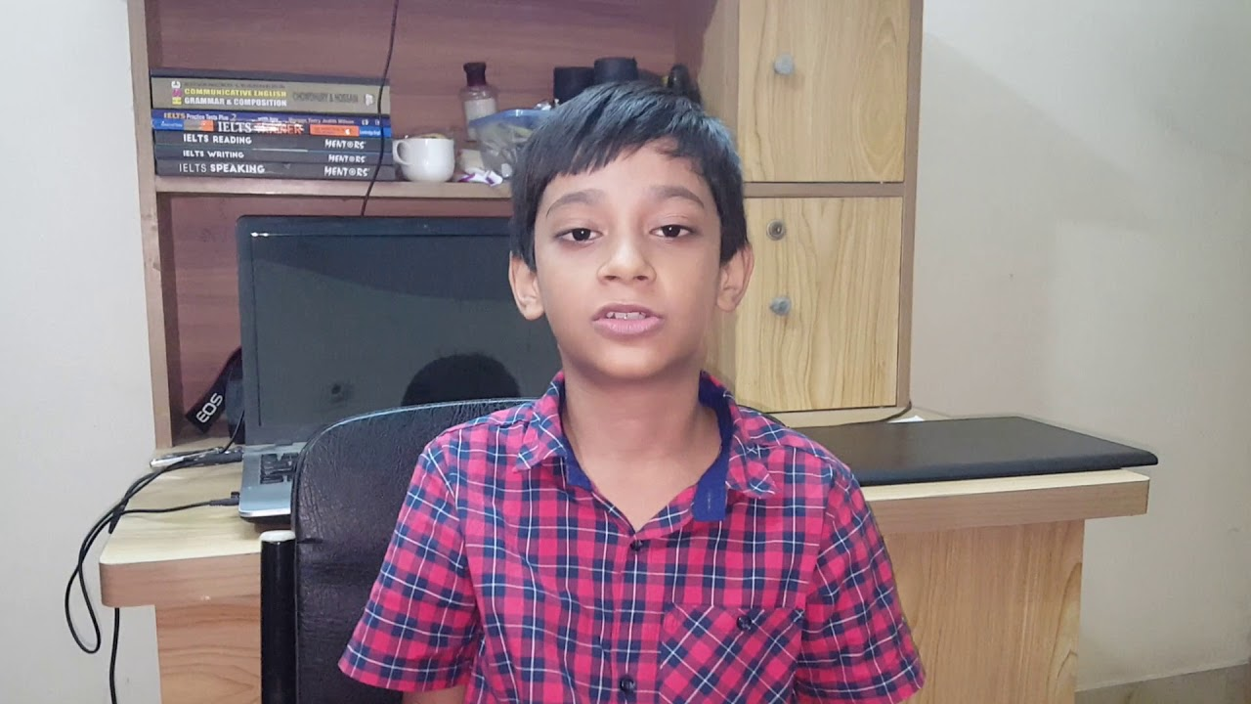
Anik is my friend. He’s eight years old , too.

Slide 10
We go to Rajbari Primary School.

Slide 11
We are in the same class. Anik sits next to me.

Slide 12
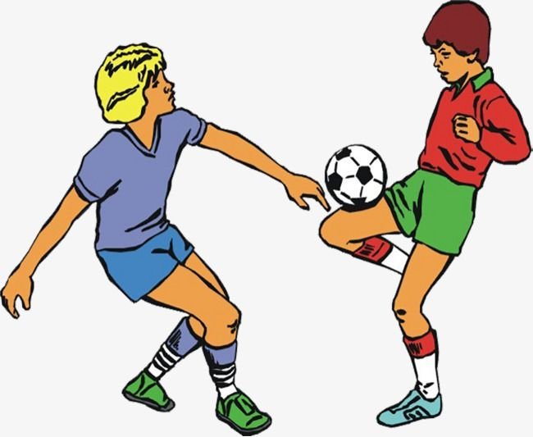
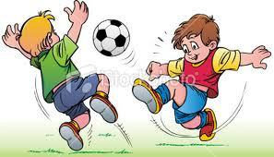
In the afternoon, we play football.

Slide 13
I’m Raif. I’m eight years old. Anik is my friend. He’s eight years old, too. We go to Rajbari Primary School. We are in the same class. Anik sits next to me. In the afternoon, we play football.

Slide 14
Read the text and answer the following questions.
1. What is his friend’s name?
Ans: His friend’s name is Anik.
2. What school do they go?
Ans: They go to Rajbari Primary School.
3. What do they do in the afternoon?
Ans: In the afternoon, they play football.

Slide 15
GROUP 1
Write three sentences about Radif answering the following questions.
How old is Radif?
What school does he go?
What does he do in the afternoon?
GROUP 2
Write three sentences about Anik answering the following questions.
a) How old is Anik?
b) What school does he go?
c) Where does he sit in the class?

Slide 16
Evaluation
Fill in the gaps with the following words:
nine
same
friend
eight
Radif is ------------ years old.
Anik is Radif’s -----------------.
They are in the ------------ class.

Slide 17
Write three sentences about your friend.

Slide 18
T
H
A
N
k
S

