Slide 1
WEL COME
MY SUPER
LEARNER

Slide 2
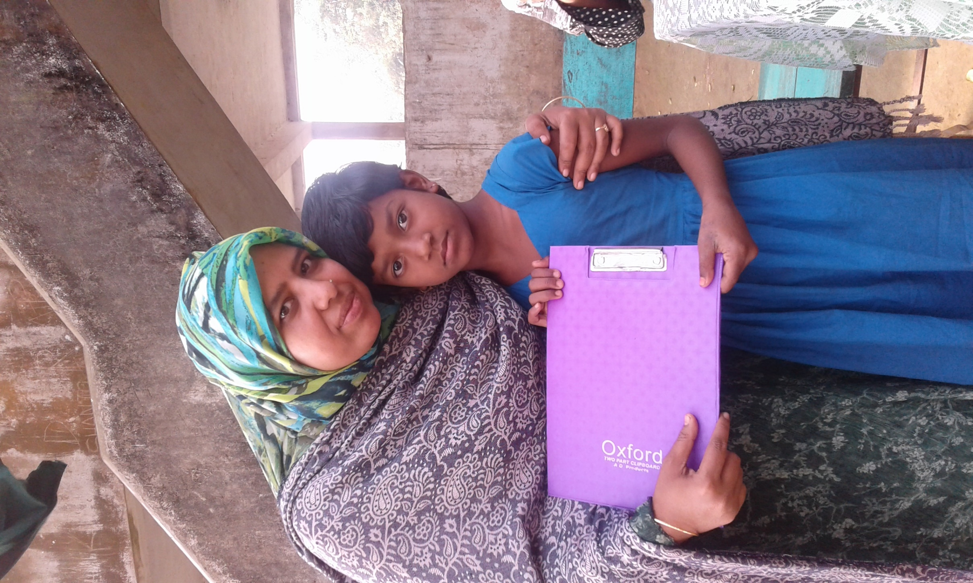
Najma Aktar
Assistant Teacher
Neyamotpur Govt.Primery School
Sadar,Sunamgonj

Slide 3
Class-One
Subject-English
Unit-17 Lesson-4-5

Slide 4
Learning outcomes
Students will be able to-
Recognize and read the alphabet both small and capital.(non-cursive)
To practice letter shapes/simple writing patterns etc.

Slide 5
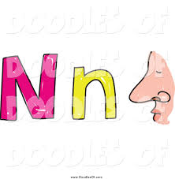
Today our lesson is Alphabet N&n

Slide 6
Ball

Slide 7
Cap

Slide 8
Fish

Slide 9
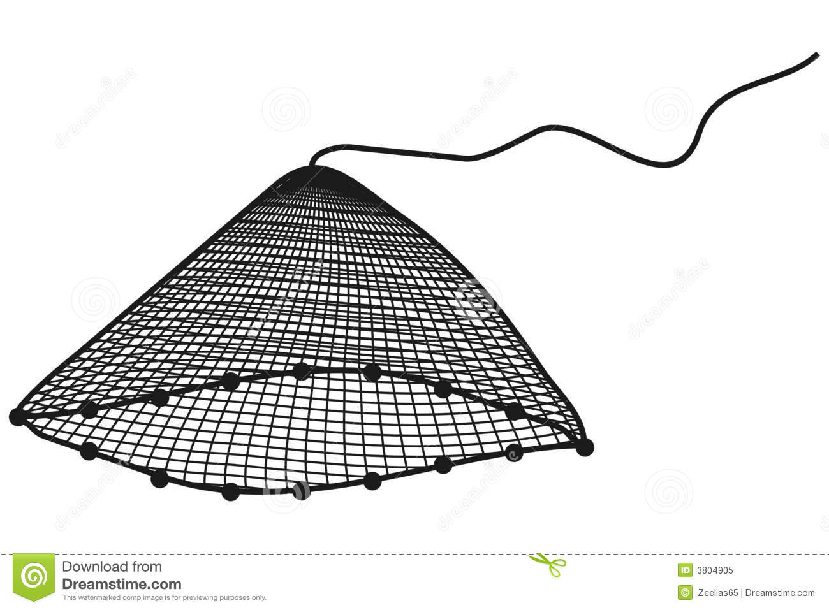
Do you see a nice picture?

Slide 10
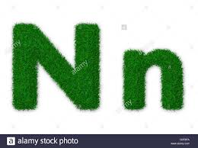

Slide 11
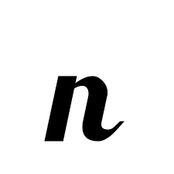
Say letter sound na

Slide 12
What`s this?
This is a net.

Slide 13
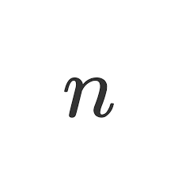
Say and read

Slide 14
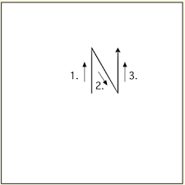
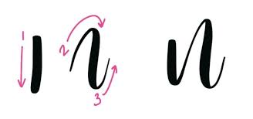
Look Trace in the air

Slide 15
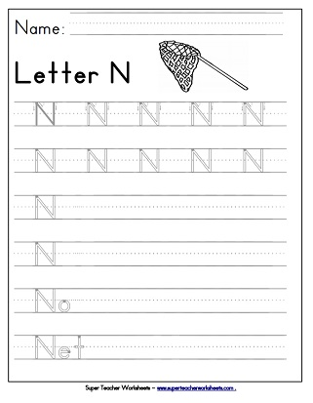

Slide 16
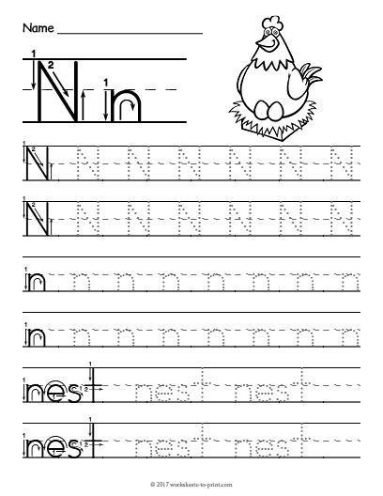
Capital letter N Alphabet Traceing

Slide 17
What`s this?

Slide 18
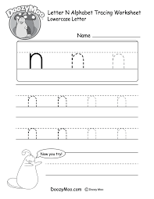
Small letter n Alphabet Traceing worksheet

Slide 19
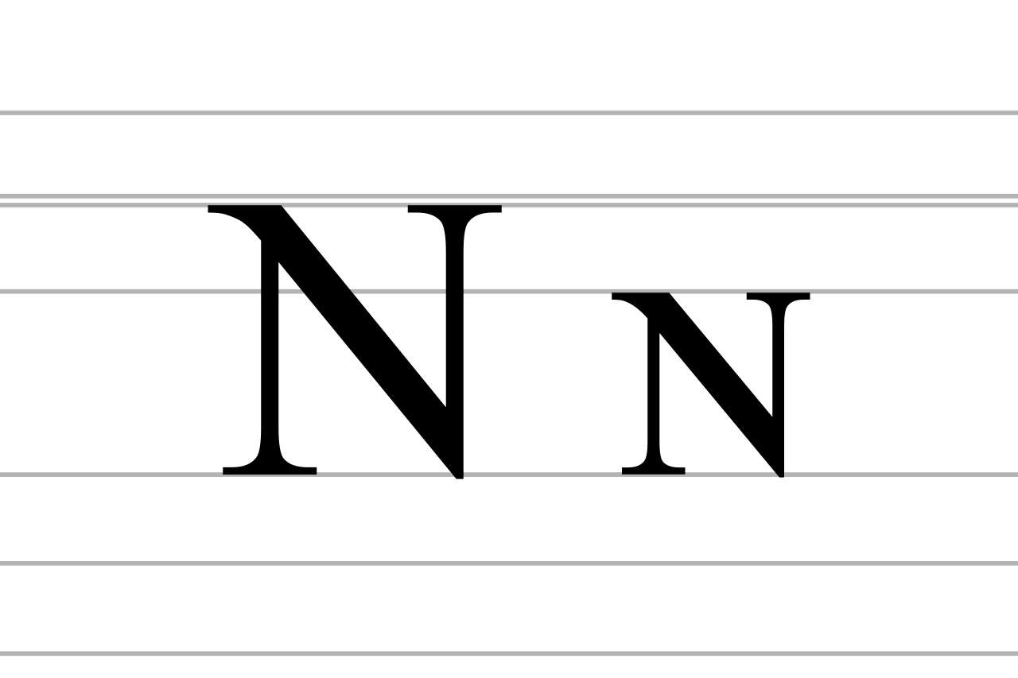
Dear students Write down on your note book capital letter N & small letter.

Slide 20
What can we learn from today`s lesson
Net
জাল

Slide 21
Write down on your note book fill in the blanks
---et
N—t
-----t

Slide 22
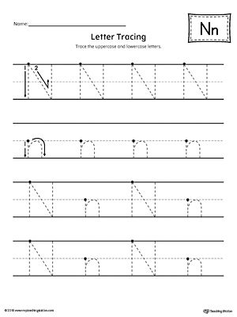
Take this home work

Slide 23
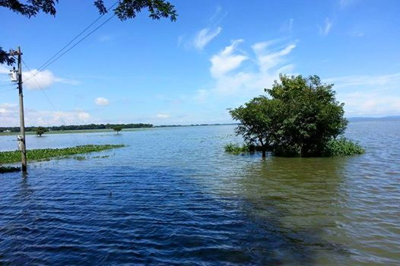
Thanks to all

