Slide 1
Welcome To everybody

Slide 2
Teacher’s
Identity
Md. Kamrul Islam
Assistant Teacher
Bag-Basantopur Govt. Primary School
Kaligang, Satkhira

Slide 3
Lesson Identity
Class :Two , Subject : English
Lesson title : Animals and where they live
Lessons 1-3
Lesson unit: (24) A . Look and say.

Slide 4
Learning outcomes
Student‘s will be able to
1.1.1 become familiar with English sound by listening to common English words.
1.1.1 repeat after the teacher simple words and phrases with proper sounds and stress.
1.1.2 say simple words and phrases with proper sounds and stress.
1.4.1 read words and phrases with the help of visual clues and simple sentence.

Slide 5
Create emotion with a video

Slide 6
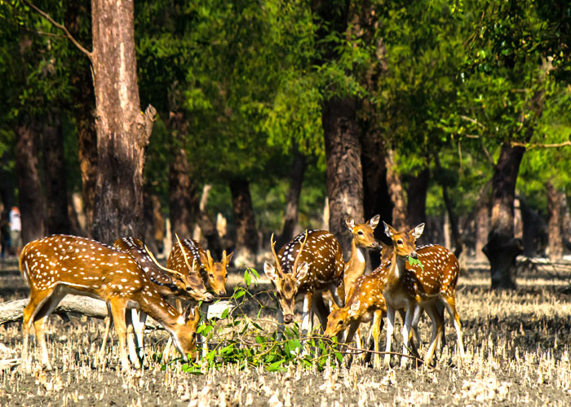
Pre knowledge assessment
Scenery of Sunderbans

Slide 7
Lesson declaration
Animals and where they live

Slide 8
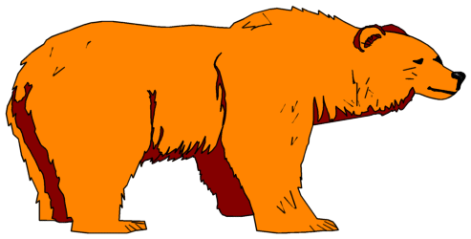
monkey
bear

Slide 9
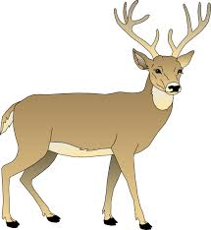
tiger
deer

Slide 10
fox
lion

Slide 11
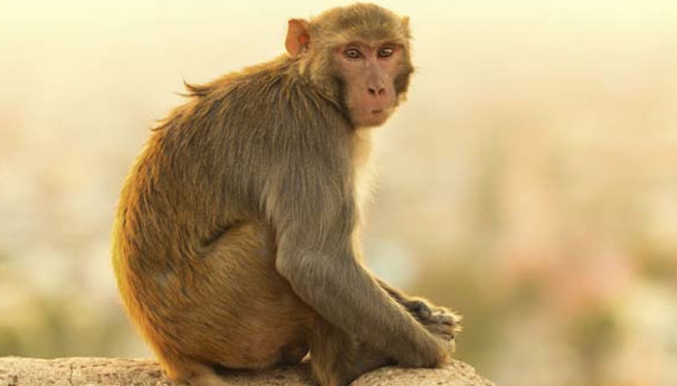
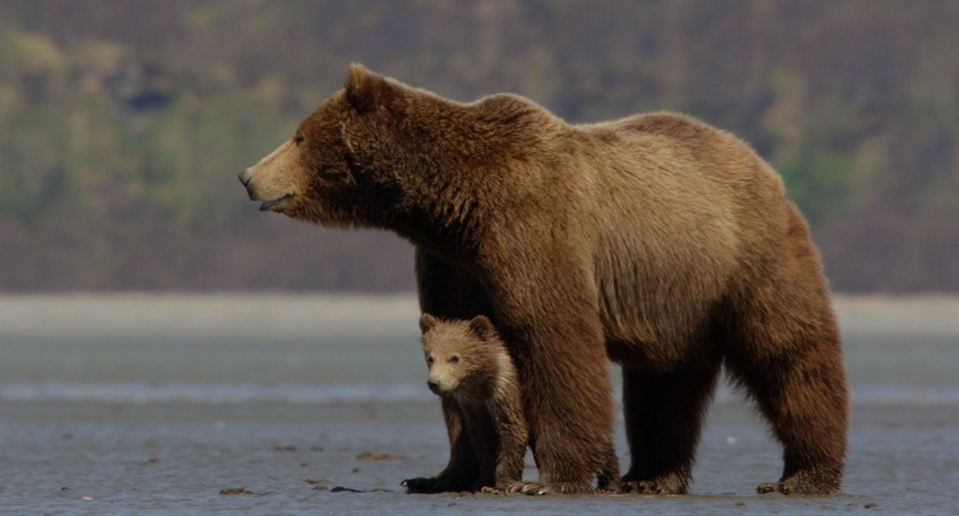
Look at the picture and repeat after me
monkey
bear

Slide 12
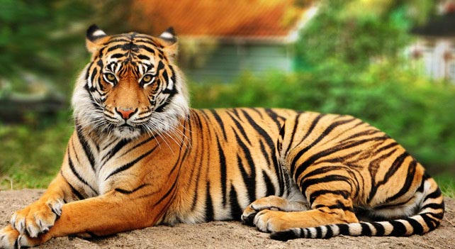
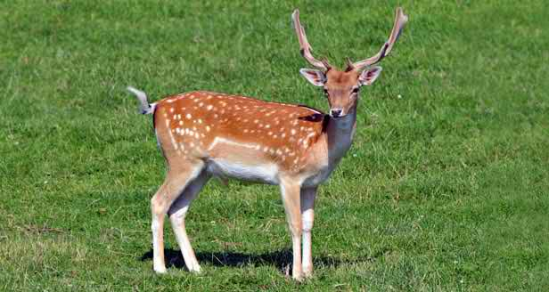
tiger
deer

Slide 13
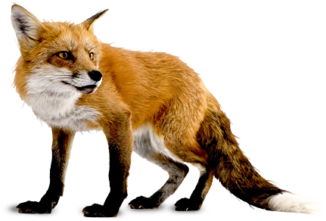
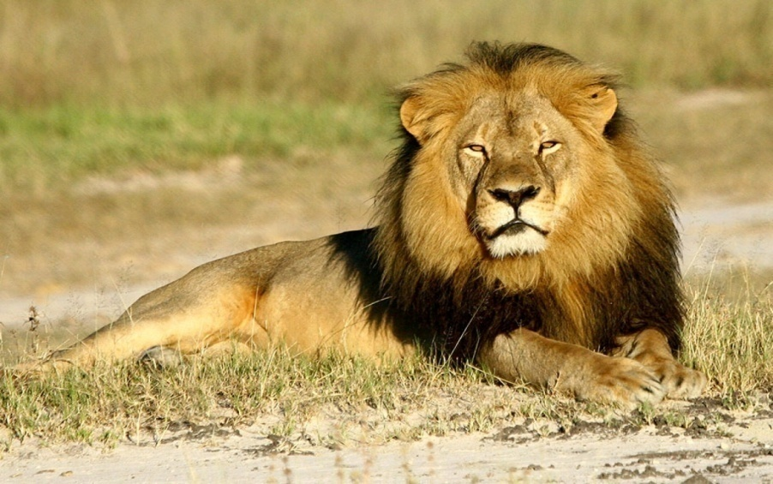
fox
lion

Slide 14
Forest animals

Slide 15
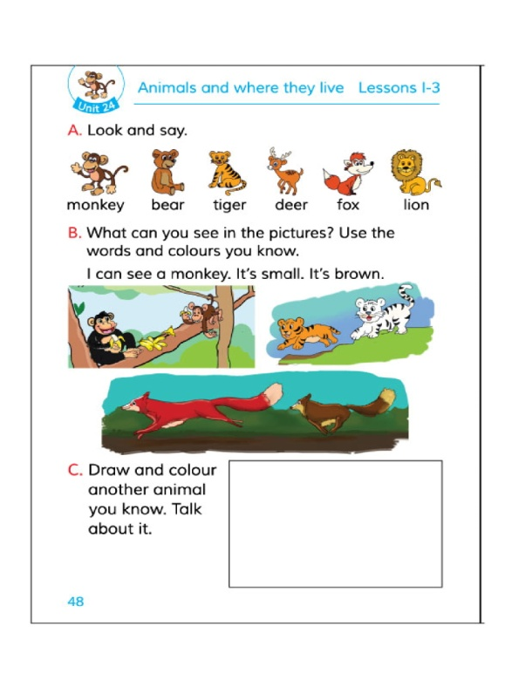
Relativity with the text book
Open your book at page 48 and read loudly.

Slide 16
Group work
Group- A
Point out the animals name
1
2
3

Slide 17
Group-B
Point out the animals name
1.
2.
3

Slide 18
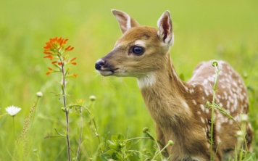
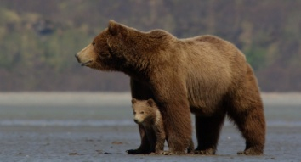
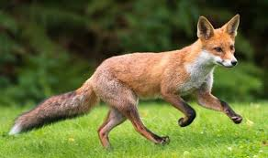
Evaluation(oral)
matching
Tiger
Deer
Lion
Fox
Monkey
Bear

Slide 19
Planned work
Talk about 5 domestic animals in your home . Use in activity A as a model.

Slide 20
Thanks all

