Slide 1


Slide 2



identity
Class: One
Subject: English
Alphabet. Lesson:4-6,
Unite : 4. Page : 3
RIBON RANI DASH
ASSISTANT TEACHER
BHARAPURNI GOVT. PRIMARY SCHOOL
LAKHAI,HOBIGONJ.

Slide 3

Lets see the video

Slide 4
Lesson Declaration
C
c
Alphabet(Cc)

Slide 5
Learning outcome
Students will be able to-
1.1.1 to become familiar with English sounds by listen to
common English word.
1.1.2 to say simple words.
1.2.1 to recognize and read the alphabet both small and
capital (non-cursive) letters.
3.1.2 write words using non-cursive small letters.

Slide 6

Look, listen and say
C
c
cap

Slide 7

Look, listen and say
C
c
Cat

Slide 8
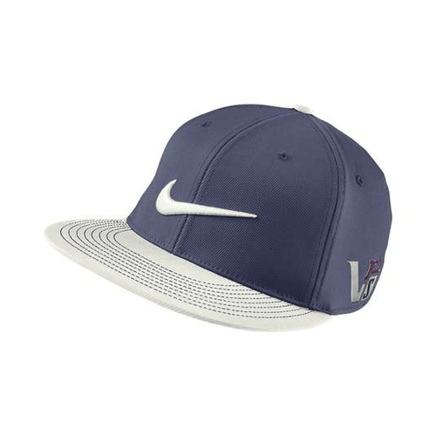
Look, listen and say
C
Cap
Capital letter

Slide 9

Look, listen and say
c
Cat
Small letter

Slide 10
Look, listen and say. Trace in the air.
C
C

Slide 11
Look, listen and say. Trace in the air.
C
C

Slide 12

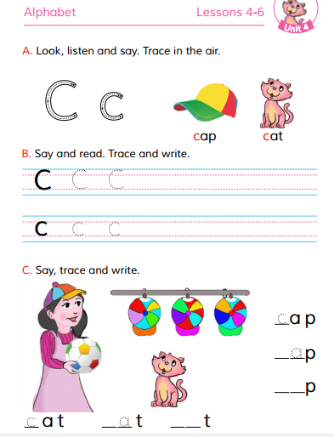
Open at page 5

Slide 13

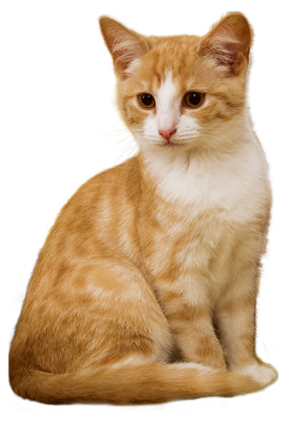


WCW
Loud reading by the teacher
Cat
Cap

Slide 14
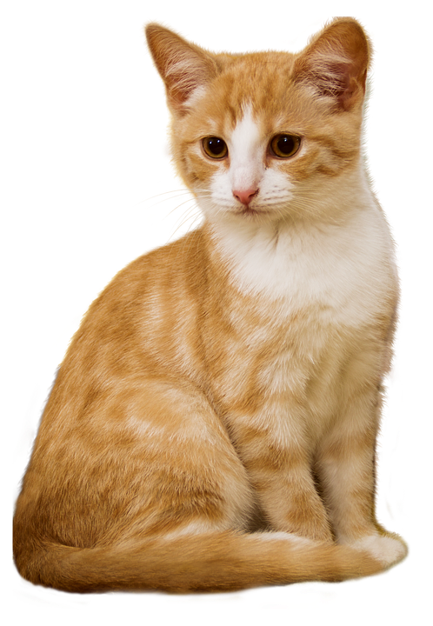
Match the pictures with the letters:
Group work
C
Cat
C
Cap

Slide 15
Say and read. Trace and write.
WCW
C
C
C
c
c
c

Slide 16
Look and say. Write.
Evaluation
Look at the picture and fill in the gaps:
Cat
Cap

Slide 17
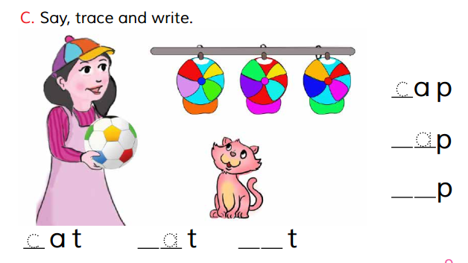
Evaluation

Slide 18



