Slide 1
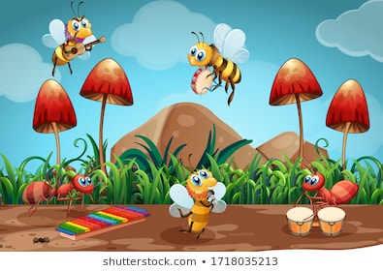
Welcome

Slide 2
Introducing
Class:One
Sub:English
Unit:2
Lesson:4-6
Time:35minutes
Margaret Adhikari
Asst.Teacher
Baligoan Govt.Primary School
Kamalgonj,Moulvibazar

Slide 3
Learning outcomes
Students will be able to ………
Listening:1.1.1 become familiar with English sounds by listening to common English words
Speaking:1.1.1repeat after the teacher simple words and phrases
1.1.2say simple words and phrase
Reading:1.2.1Srecognize and read the alphabet both small and capital (non cursive)
Writing:1.1.1to practice letter shapes/simple writing patterns etc.
1.2.1write non cursive capital letters.

Slide 4
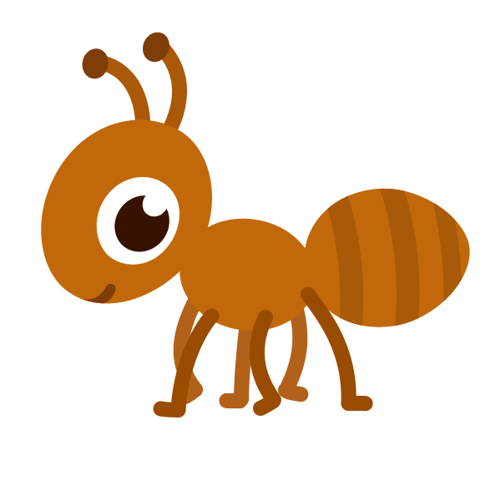
Let's see some picture

Slide 5
What’s this?
Ant
What’s this?
Apple
What’s this?
Aeroplan

Slide 6
Title declaration
Latter- A a

Slide 7
A for Apple

Slide 8
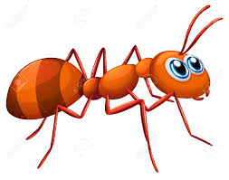
A for Ant

Slide 9
A for Aeroplan

Slide 10
Group work
By using P,W you will findout and write ‘A’ related word.
Apple
Egg
Ant
Door
Airplane

Slide 11
Open the Book page no:7

Slide 13
Find out the Letter’a’
Task
o | a | w
a | n | a
r | a | k

Slide 14
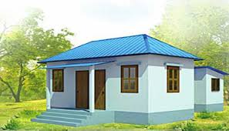
Homework
Write your exercise book capital letter A and small letter a.

Slide 15
THANK YOU

