Slide 2
Teacher’s Identity
Jahangir Alam Bhuiyan
Assistant Teacher
G P GOVT PRIMARY SCHOOL
Itna , Kishoregonj.
Email: Jahangiratict@gmail.com

Slide 3
LESSON IDENTITY
Class- five
Unit-3 lesson -1-2
Lesson Title – Saikat’s Family
Page No.- 10
Date.10.07.2019

Slide 4
Listening
1.2.1. Recognize which syllable in a word is stressed .
1.3.1. Recognize which words in a sentence are stressed.
1.4.2. Recognize and use intonation patterns for greetings and statements.
3.1.1. Runderstand Questions asked by the teacher about them.
3.2.1. Understand questions about family and friends of students .
3.4.1. Understand statements made by the teacher and students .
Speaking
1.1.1. Say words phrases and sentences with proper sounds and stress .
1.1.2. Say sentences with proper intonation
6.1.1. Say what the speaker is doing .
6.2.1. Talk about the people ,objects , events , etc.
Reading
1.5.1. Read words , phrases and sentences in the text with proper pronunciation stress and intonation .
1.7.1. Read paragraphs dialogues stories letters and other texts .

Slide 5
Let’s sing a greeting song

Slide 6
At first I will ask the following Questions
1. What title do we use to address a man? s
(Mr.)
2.What title do we use to address a married woman?
Mrs.
3.How will you address me ?
4.What title we use to address both married and unmarried woman ?
Ms.

Slide 7
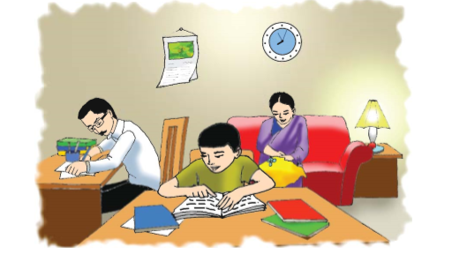
Look at the picture

Slide 8
Guess what are the people doing in the picture
Discuss about the picture with your partner ?

Slide 9
Write some sentences about the picture in your text book?

Slide 10
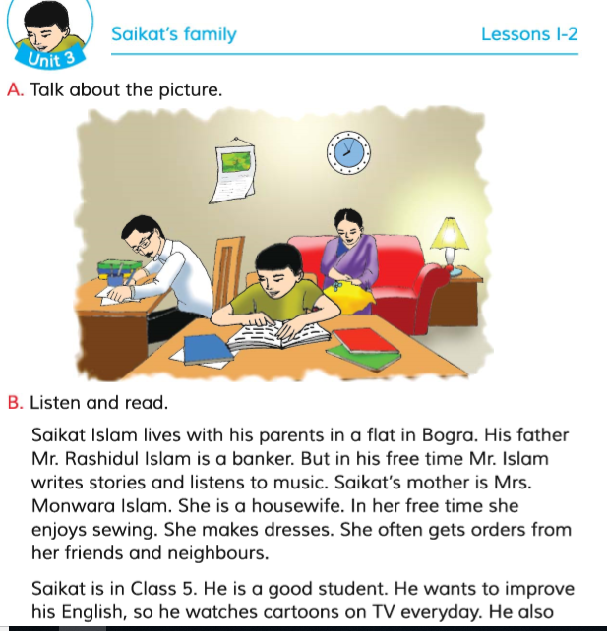
The man in the picture is Saikat and his parents .
Now open at page 10

Slide 11
Now I will read the text with correct pronunciation
Iwill play the audio clips C5U03LI-2b

Slide 12
What’s the meaning of the words:
Parents-
মাতা-পিতা
Father and mother
Banker-
ব্যাংকার
A person who works in a bank
Stories-
গল্প
Adescription of something true or imagined
Housewife-
গৃহিনী
A woman who works in a house
Sewing-
সেলাই করা
Stich cloths with niddle and thread
Improve-
উন্নতি
Make better

Slide 13
Pair Work
Make a pair with your partner and read the text care fully.

Slide 14
I will call the students one by one infront of the class and tell them to read out text with correct pronunciation

Slide 15
Try to answer the following Questions:
a)What is Saikat’s parent’s occupation?
b)Wthat do his parent’s do in their free time ?
c)What does Saikat do in his free time?
d)What does Saikat want ?
e)What does he do to improve his English?

Slide 16
Answer
Saikath’s father is abanker and his mother is a housewife.
In free time Saikat’s father writs stories and his mothr enjoys sewing .
Saikat watches cartoon on TV and read English books in his free time .
Saikat wants to improve his English .
He watches cartoons on TV and reads English books to improve his English

Slide 17
In this lesson we have learnt about what people do in their free time

Slide 18
Write five sentences about your family?

Slide 19
Good Bye

