Slide 1
welcome

Slide 2
Abdullah-Al- Mamun.
Assistant teacher
Bangalgaon govt. primary school
Keranigonj , Dhaka.

Slide 3
Class –Three
Subject –English
Unit 11:Food and hygiene
Lesson 01:Food we need
Page:75

Slide 4
Food we need

Slide 5
Learning outcomes:
Students will be able –
1.To say the lesson matter .
2.To read the word with correct pronunciation.
3.To make sentence by the new words

Slide 6
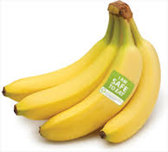
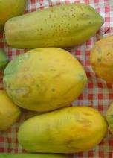
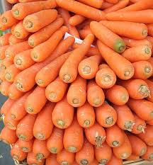
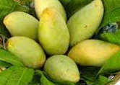
Banana
papaya
Mango
Carrot

Slide 7
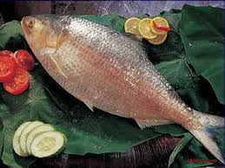
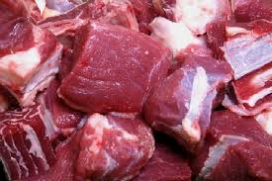
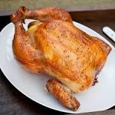
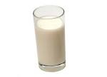
fish
meat
chicken
egg
milk

Slide 8
Word meaning
Bread –food made of flour, water mixed together and baked
Chicken –a domestic fowlkept for its eggs or meat .
Meat –the flesh of an animal as food .

Slide 9
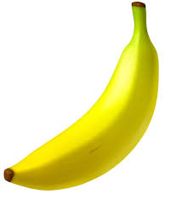
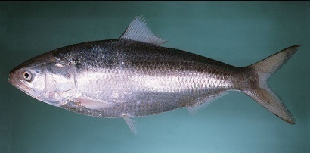
Make sentence
banana
I like banana
mango
I eat mango
fish
There are many fish in the pond

Slide 10
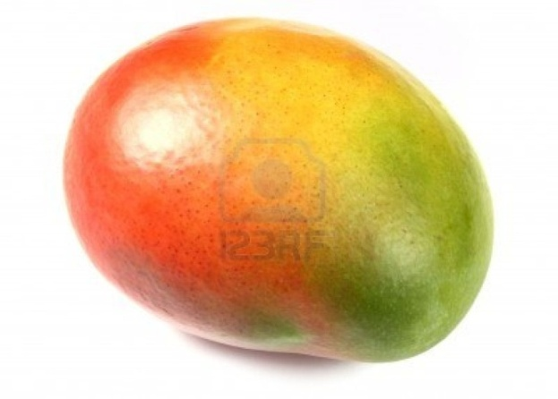
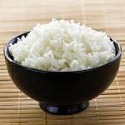
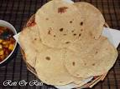
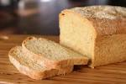
Food from plants and trees
carrot
banana
mango
ruti
rice
bread

Slide 11
Food from animals
meat
fish
chicken
egg
milk

Slide 12
Group work
Make two lists in your khata
Food from plants and trees | Food from animals

Slide 13
Evaluation
Write five sentence
1.Banana
2.Mango
3.Fish
4 .Milk

Slide 14
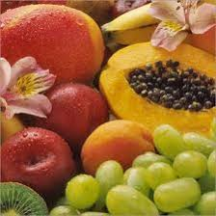
Thanks to all

