Slide 2
Introduction of the teacher.
Most. Sabekun Nahar.
Assistant teacher.
Kholabaria Govt. primary school.
Naldanga, Natore.

Slide 3
Introduction of the class.
Class : three.
Subject : English.
Unite : 5
Lesson : 1-3
Page No: 10

Slide 4
Learning Outcomes
Listening: 2.1.1 Carry out commands and instructions. Speaking: 1.1.1 Repeat words , phrases and sentences after the teacher with proper sounds and stress. 1.1.2 Say words , phrases and sentences with proper sound and stress.

Slide 5
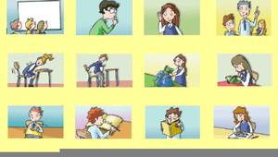
Now we will look at some picture

Slide 6
Lesson Title
Commands and instructions
Inside the classroom .

Slide 7
Teaching Vocabulary

Slide 8
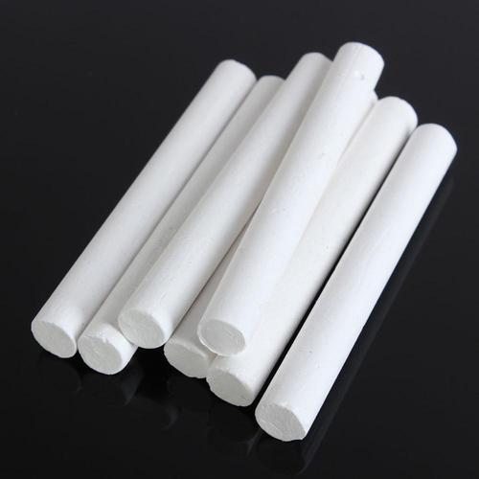
Chalk
চক/ খড়ি

Slide 9
Board
বোর্ড

Slide 10
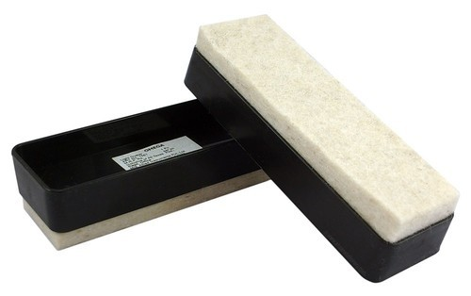
Duster
মুছনি

Slide 11
Flag
পতাকা

Slide 12
Teachers reading
A . Listen and say.
Board , Duster, chalk, Flag.
B . Listen and say .
Take the chalk .
Go to the board .
Draw a flag .

Slide 13
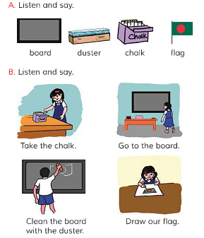
Teaching with picture .

Slide 14
Students Reading

Slide 15
Questions And Answer
What is this?
This is a flag.

Slide 16
What is this?
This is a duster

Slide 17
Group Work
Draw the flag picture by dividing it into groups of 5

Slide 18
Evalution
At the end of the lesson I will ask them what they learned

Slide 19
Homework
Make a sentence with Chalk,Duster,Board And Flag

