Slide 1
WELCOME
Dear
students

Slide 2
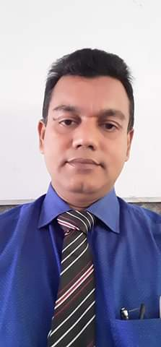
Introduction
Name: Nurul Amin Azad Assistant teacher: (English) Jahangirpur T,Amin Govt.
Pilot High School Madan,Netrakona
CLASS: Nine
SUBJECT: ENGLISH SECOND PAPER
UNIT: Eight
LESSON: one
TOPIC : Tag question

Slide 3
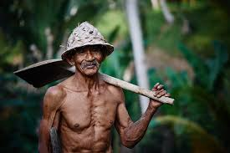
Question Tag.
He is a worker,
isn’t he?
What is this?

Slide 4
Our Today’s Lesson is
Tag questions

Slide 5
Learning Outcomes
After we have studied this lesson, we will be able to-
define question tag
identify tag operators
apply tag
different use of tag

Slide 6
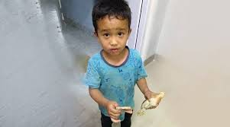
You are tasin, aren’t you?
Tag
Adding something with other
A tag question is a question that is used at the end of a statement to get the support from the listener.

Slide 7
A computer operator.
Am, is, are ,was, were, shall, should, will , would, can, could, may, might, have, has, had, must, ought, dare, need.
Tag question operators
Do, does & did (Used in action verbs)
Notes:
This slide is to teach the operators of tag questions to the students.

Slide 8
Tag question basic/contraction form of the operators.
Am not = aren’t/ain’t
Is not = isn’t
Are not = aren’t
Was not = wasn’t
Were not = weren’t
Will not = won’t
Shall not = shan’t
Can not = can’t
Could not = couldn’t
May not = mayn’t
Might not = mightn’t
Must not = mustn’t
Has not = hasn’t
Have not = haven’t
Had not = hadn’t
Do not = don’t
Does not = doesn’t
Did not = didn’t
Ought not = oughtn’t
Dare not = daren’t
Need not = needn’t

Slide 9
How to form a tag question?
1. Structure in positive statement
Jarif is a good boy,
isn’t he?
Statement + , + operator +n’t+ subject (pronoun) +?
2. Structure in negative statement
is he?
He is not your teacher,
Statement + , + operator + subject (pronoun) +?
Notes:
The rules are mentioned here how to add tag to the statements.

Slide 10
How will you add tag, if there is no operator in the sentence?
He goes to school regularly,
doesn’t she?
don’t we?
We go to school regularly,
He went to school yesterday,
didn’t he?
Notes
If there is V₁ with ‘s/es’, add tag with doesn’t/does,
2. If you find V₁ without ‘s/es’, add tag with ‘don’t/do’,
3. If you find V₂ , add tag with ‘didn’t/did’ as operator.
Notes:
How to add tags to the action verb sentences are shown in this page.

Slide 11
Exceptions
If you find ‘s/es after everybody, everyone, nobody, no one, somebody, some one, one, none, the above rules will not be effective. In that place you have to add ‘don’t they/do they’
Everyone respects him,
don’t they?
Nobody likes a man of bad temper,
do they?
never, rarely, seldom, hardly, barely and scarcely are--
treated as negative
Notes:
The rules of exceptional use of tag question are shown here. Teacher may explain it if necessary.

Slide 12
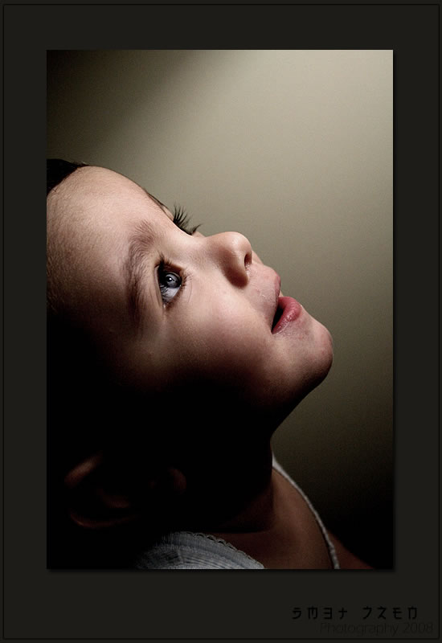
If I had wings, I’d fly,
wouldn’t I?
Subordinate clause
Principal clause
Follow
I’d visit = I would+ v₁
I’d visited = I had+ v₃
Last weak I went to picnic,
hadn’t I?
Notes:
If there is a complex sentence, students will have to follow the verb of principal clause. Teacher may make it clear to the students with the example above.

Slide 13
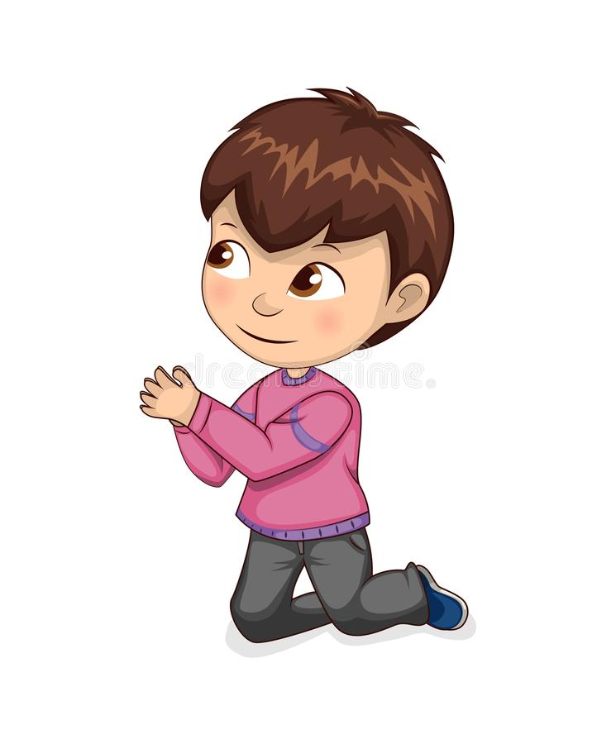
imperative tag
will you?
Forgive me,
Notes:
While adding tag with an imperative sentence, it indicates simple future . So ‘will you/won’t you’ is suggested to use.

Slide 14
Let me say something,
will you?
Let him go,
will you?
Let them enjoy the game,
will you?
Exception in one place
Let us settle the matter,
shall we?
Let’s go out for a walk,
shall we?
Notes:
The differences between let me, let him, let them and let us are shown here. Teacher may explain it if necessary.

Slide 15
Good bye (I bide good bye),
don’t I?
Hasan, (He is Hasan),
isn’t he?
Who cares (Nobody cares),
do they?
Yes, (Yes, it is)
isn’t it?
No, (No, it is not)
is it?
Good morning, good afternoon, good evening, good night, thank you, ( I bide / wish / say…) don’t I?
Notes:
Actually these are not tag related statements but recently these are shown according to modern English. In the recent curriculum we have got conversation style in tag question.

Slide 16
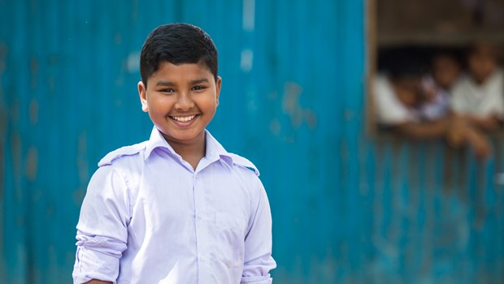
Pair Work
Add tag in every sentence of the following passage.
Rahim is a good boy. He goes to school regularly. Everybody loves him. Once he went to visit cox’s bazar. As he became ill, he could not visit Saint Martin. He told his friends, Let’s go back to Dhaka.
Notes:
Teacher may make some pairs to conduct this session .

Slide 17
Make 10 sentences using tag questions

Slide 18
Thank you so much
Notes:
Ending greeting.

