Slide 2
Introduction of the teacher
Rahela Begum Saby
ASISSTANT TEACHER
Mittavorang GOVT. PRIMARY SCHOOL
Jagannathpur,Sunamgonj

Slide 3
Introduction of the Lesson
Subject:English
Class: Two
Lesson:Parts of the body
Parts of the Lesson:Activity-A
Page No:23
Time:20 min

Slide 4
Dear students see the pictures and try to say-
what’s our today’s lesson?

Slide 5
Our today’s lesson is--
Parts of the body
Activity-A

Slide 6
LEARNING OUTCOMES
By end of the lesson students will be able to-------
1.1.1 become familiar with English sounds by listening to common
English words.
2.1.1 following simple commands and instructions.
4.1.1 enjoy the rhyme and music of simple rhymes.

Slide 7
Look, listen and say.
Teacher touch his/her body parts (hand, hair, finger, teeth, leg,) and says.
This is my------------.
Teacher do this work several times.
Then students repeat after teacher.

Slide 8
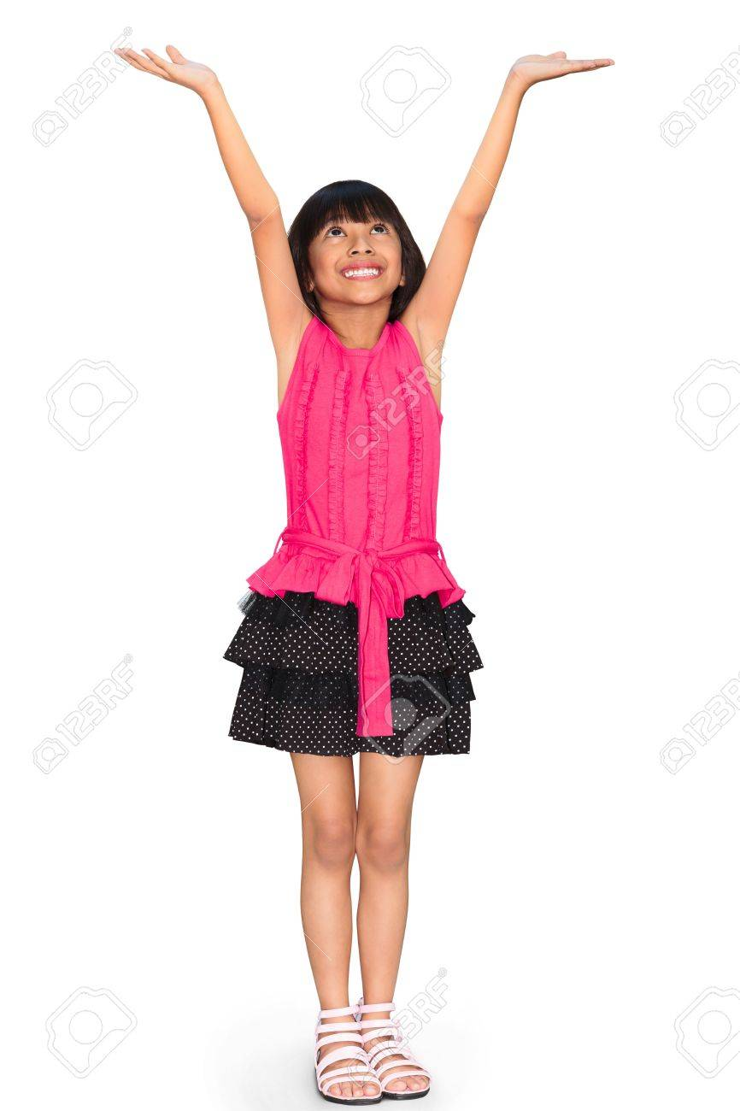
Look, listen and say.
What is this?
hair
finger
teeth
hand
leg

Slide 9
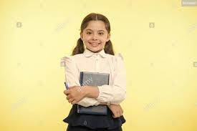
Pair work.
Listen and do.
One more

Slide 10
Open your English book at page-23 and see the Activity-A.
Repeat after me.

Slide 11
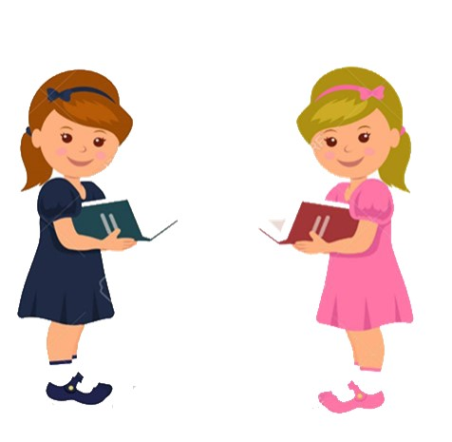
Pair work.
Point out the picture.

Slide 12
Read, say and touch.
teeth
hair
leg
finger
hand
As long as time there will be.

Slide 13
Revision of today’s lesson.

Slide 14
That’s all for today. Goodbye. See you tomorrow.

