Slide 1

Welcome.

Slide 2

Introduction
Amzad Hussain Rasel
At Teacher
Amria Islamia Alim Madrasah
Dakshin Sunamgonj.
E-mail : amzadhrasel1981@gmail.com

Slide 3
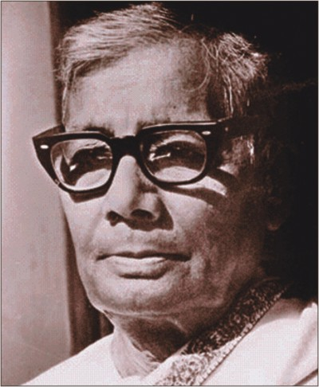
Nakshi Kanthar Math
Jasimuddin (1903-1976)

Slide 4
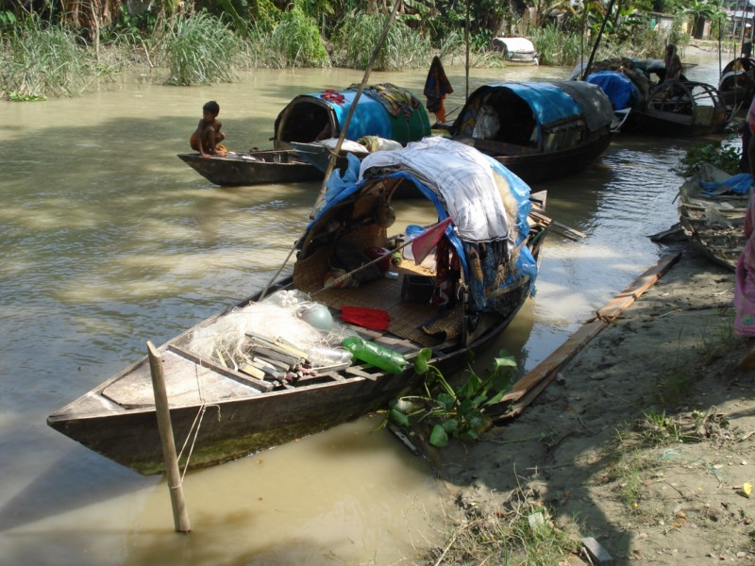
Do you know some of his famous works?
Yes.
Famous works of Jasimuddin Nakshi Kanthar Math published in 1929, Sujon Badiar Ghat first published in 1933.

Slide 5
Our today’s lesson is…
Nakshi Kantha
Unit-1, Lesson-2

Slide 6
Learning Outcomes
By the end of the lesson, learners will be able to…
Read and understand text through silent reading
Ask and answer questions.
Speak the meaning of the text.
write a summary.

Slide 7
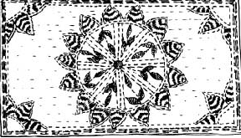
A Look at the picture and the questions. Then ask and answer the questions with your mate.
1. What do you see in the picture?
2. What is the name of it?
3. Have you seen it before?
4. What do we do with it?

Slide 8
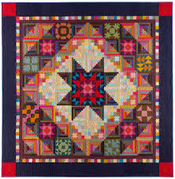
Quilt
cover
blanket
comforter
Nakshi Kantha is a kind of embroidered quilt.

Slide 9
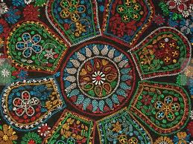
Artistic
Meaning
creative
imaginative
Nakshi kantha is made with artistic design.

Slide 10
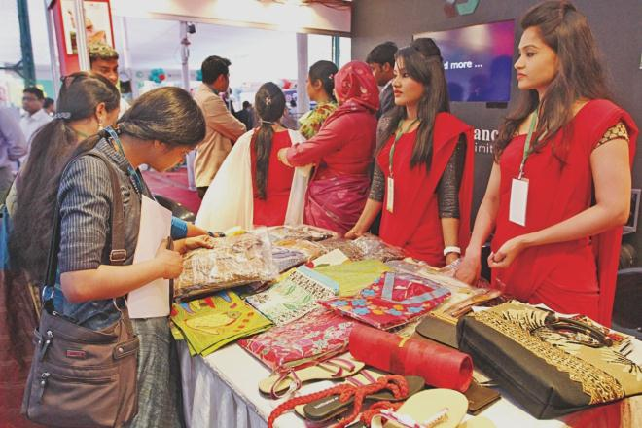
Commercially
Word Meaning: business purpose/ trade
Nakshi kantha is now made commercially which earn money.

Slide 11
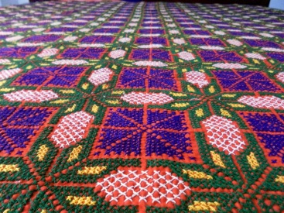
Traditional
Word Meaning: old-fashioned/old style/legendary.
Nakshi kantha is a kind of traditional craft.

Slide 12
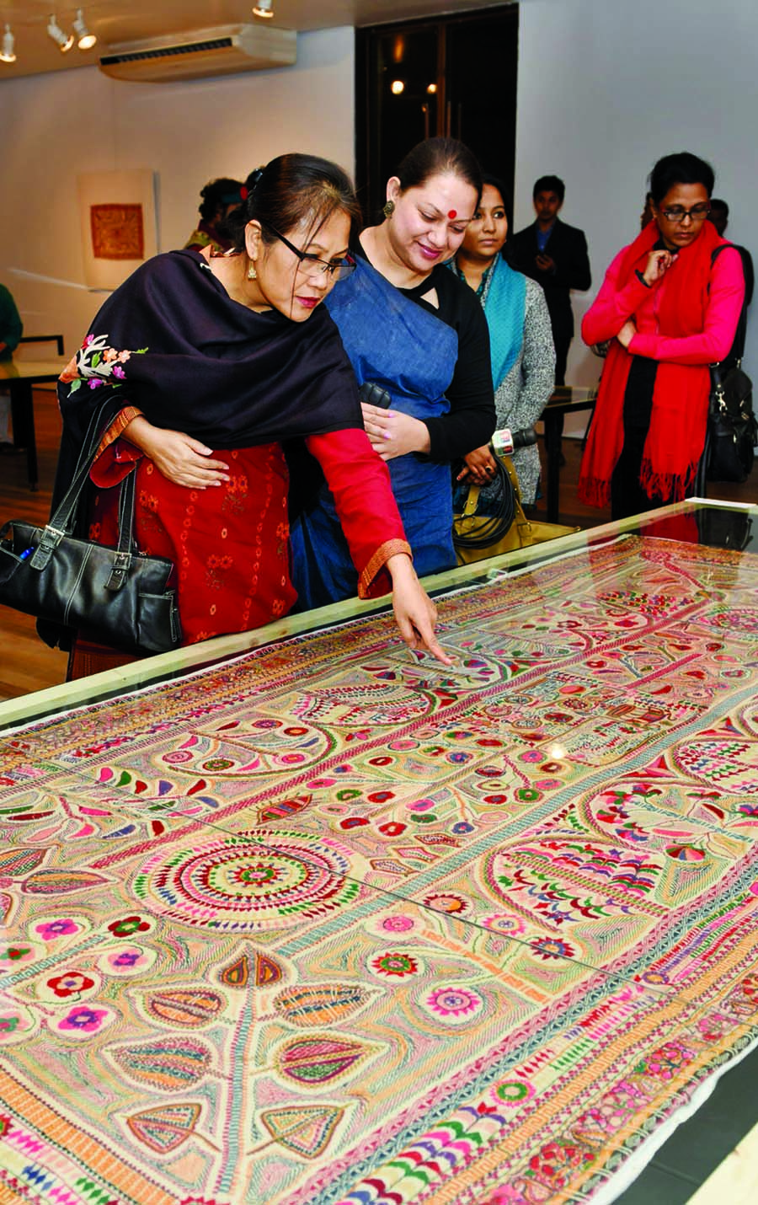
Demand
Want
Request
There is a great demand of Nakshi kantha.

Slide 13

Pattern
designed
format
It looks very beautiful because of its artistic pattern and various colour combination.

Slide 14
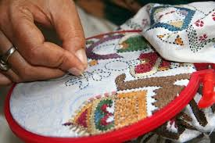
Embroidered
designed
beautified
decorated
Quilt is embrodered with thread and needle in the rural area of Bangladesh.

Slide 15
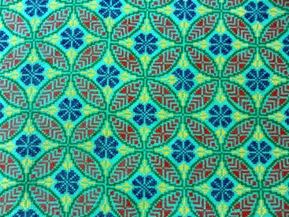
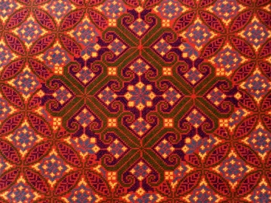
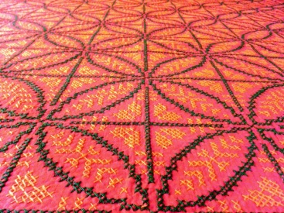
1. Artistic pattern
2. Embrodered with thread and needle
3.Various colour combination.

Slide 16
B Now read the text to know about Nakshi Kantha.

Slide 17
E. Complete the sentences with given clues
Bengali patterns years fashion rural designs quilt noksha.
Check your answers
Nakshi kantha means artistic ________
The name was taken from a ________ word _______
The art has been practised in ______Bengal for _____
Nakshi kanthas now in great demand because of their colourful ________and ________
Nakshi kathas are a kind of _____
patterns.
Bengali
Noksha.
rural
Years.
patterns
designs.
quilt.

Slide 18
F Write down five questions for the completed statements in E above.
One is done for you.
1. What does noksha mean?
Match your answer.
2. What word was taken as the name from?
3. Where has the art been practised? How long?
4. Where are they sold now?
5. Why are Nakshi Kanthas in a great demand?

Slide 19
MAY
ALLAH
BLESS
YOU.

Slide 20
Acknowledgement
GOOGLE
NATIONAL CURRICULUM & TEXTBOOK BOARD, BANGLADESH.
TEACHER`S OF AMRIA ISLAMIA ALIM MADRASA.

