Slide 1
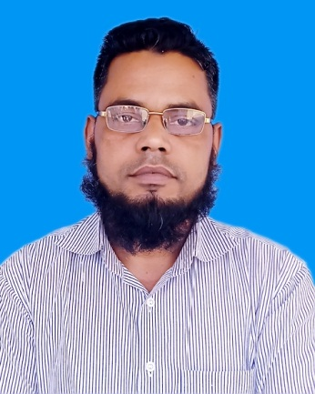
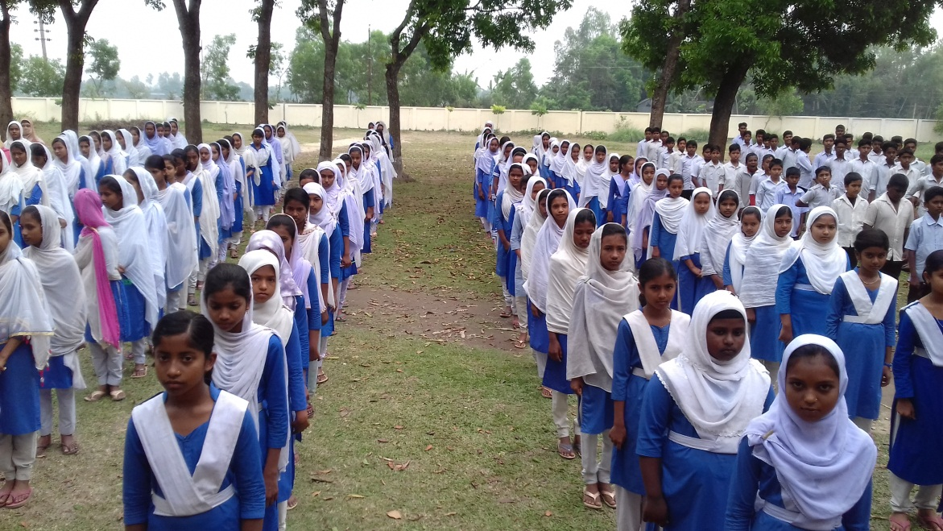
পরিচিতি
সপ্তম শ্রেণি
বিষয়ঃ ইংরেজী ১ম পত্র
Topics: Substitution Table.
মোঃ ইউনুছ আলী
সহকারী শিক্ষক
চারান উচ্চ বিদ্যালয়
কালিহাতী,টাংগাইল।

Slide 2
Make four sentences from this substitution table.
Once the town of Hemelin in Germany | came | to the Mayor to do something about rats.
The people of the town | was faced | with a great problem.
They | called | to the Town Hall
The Mayor | said | a meeting of the councilors.
Once the town of Hemelin in Germany was faced with a great problem.
The people of the town came to the to Town Hall.
They said to the Mayor to do something about rats.
The Mayor called a meeting of the councilors.

Slide 3
Make four sentences from the following table.
Alexander | crossed | to the plain land of the Punjab
He | reached | India
Then he | Came | the Khaiyber Pass.
 | was | the king of Macedon
Alexander was the king of Macedon.
He crossed the Khaiyber Pass.
He reached India.
Then he come to the plain land of the Punjab.

Slide 4
Make four sentences from the following table
Porus | came | him how he would like to be treated
But unfortunately he | asked | before Alexander
He | was defeated | and taken prisoner
Alexander | was brought | forward to defend his land from the attack of Alexander.
Porus came forward to defend his land from the attack of Alexander.
But unfortunately he was defeated and taken prisoner .
He was brought before Alexamder.
Alexander asked him how he would like to be treated.

Slide 5
Make four sentences from this substitution table.
Truthfulness | brings | a truthful person.
It | respects | the greatest of all virtues.
It | means | peace of mind.
Everybody | is | the quality of speaking the truth.
Truthfulness is the greatest of all virtues.
It means the quality of speaking the truth.
It brings peace of mind.
Everybody respects a truthful person.

Slide 6
Make four sentences from this substitution table.
William Shakespeare | wrote | born at Stratford upon Avon in England
He | is | a great poet of the entire world.
This great writer | was | relatively unknown in his life time.
But he |  | 37 plays and 154 sonnets.
William Shakespeare is a great poet of the entire world.
he was born at Stratford upon Avon in England.
This great writer wrote 37 plays and 154 sonnets.
But he was relatively unknown in his life time.

Slide 7
Make four sentences from this substitution table.
It | is | discovered by Alexander Fleming.
Penicillin | was | born in Scotland.
He |  | a very attentive student.
 |  | a name of medicine.
Penicillin is a name of medicine.
It was discovered by Alexander Fleming.
He was born in Scotland.
He was a very attentive student.

Slide 8
Make four sentences from this substitution table.
A patriot | Cares | For his / her country.
He/She | be | No country which has no patriot.
Again there |  | He/she who loves his/her county truly.
 |  | Some traitors too.
A patriot is he/she who loves his/her country truly.
He/ she cares for his/her country.
There is no country which has no patriot.
Again there are some traitors too.

Slide 9
Make four sentences from this substitution table.
Socrates | had | to spread true knowledge.
He | wanted | killed by the rolers of Athens
It | was | born in 459 BC in Athens.
 |  | a long story.
Socrates was born in 459 BC in Athens.
He wanted to spread true knowledge.
He was killed by the rulers of Athens.
It had a long story.

Slide 10
Make four sentences from this substitution table.
People of Bangladesh | is | a man gradually
Arsenicosis | kills | suffering from arsenicosis
It | are | free from arsenic and bacteria
Rain water |  | a slow process.
People of Bangladesh are suffering from arsenicosis.
Arsenicosis is a slow process.
It kills a man gradually.
Rain water is free from arsenic and bacteria.

Slide 11
Make four sentences from this substitution table.
It | are | very strictly followed in the Army.
Discipline | Is | the law of nature
We |  | to be disciplined to shine.
 |  | Derived from the Latin word “Discipulus”
Discipline is the law of nature.
It is derived from the latin word “Discipulus”.
It is very strictly followed in the Army.
We are to be disciplined to shine.

Slide 12
Bangladesh | achieved | their lives for the cause of the country's freedom.
The country | have | a country of South Asia.
Many people | Is | high hopes for the country.
Now we | sacrificed | Its freedom from the Pakistanis in 1971.
Bangladesh is a country of South Asia.
The country achieved its freedom from the Pakistanis in 1971.
Many people sacrificed their lives for the cause of the country's freedom.
Now we have high hopes for the country.

Slide 13
Shakespeare | is called | 37 plays and 154 sonnets.
He | died | in Stamford on Avon on 23th April.
He | was born | at the same day.
He | wrote | the “Bard of Avon”.
Shakespeare was born in Stamford on Avon on 23 April.
He is called the “Bard on Avon.”
He died at the same day.
He wrote 37 plays and 154 sonnets.

Slide 14
Education | is often | The right path to go ahead.
It | makes | about a change in us .
Being educated we | can choose | considered as light.
 | brings | us different from animals.
Education is often considered as light.
It brings about a change in us.
Being educated we can choose the right path to go ahead.
Education makes us different from animals.

