Slide 1
Good morning students.
How are you?

Slide 2
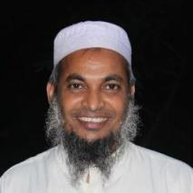
Identity
Teacher
Lesson
Dewan Rezaul Hassan
(Assistant Teacher)
Baropakhia Rothindrapara Government Primary School
Delduar, Tangail.
E-mail:drezaulhassan@gmail.com
Cell phone# 01731145063
Class: Two
Sub: English
Unit: 1 Lesson: 1(A) Lesson title: Greetings and Introductions

Slide 3
Learning outcomes:
Students will be able to:
Listening:
1.1.1 become familiar with English sounds by listening to common
English words.
3.1.1 Understand simple questions and statements about them.
3.1.2 Understand simple questions and statements about familiar
objects.
Speaking:
1.1.1 repeat after the teacher simple words and phrases with
proper sounds and stress.
1.1.2 say simple words and phrases with proper sounds and stress.
3.1.1 ask and answer questions about themselves.

Slide 4
Let us listen a song

Slide 5
Lessson declaration :
Today we will learn
Unit: 1
Lesson: 1(A)
Lesson title: Greetings and Introductions

Slide 6
Hello! Students.
I am
Dewan Rezaul Hassan
(Assistant Teacher)
Baropakhia Rothindrapara Government Primary School
Delduar, Tangail.

Slide 7
Hello! Students.
I’m Rezaul
What’s your name?

Slide 8
Hi! Mr. Rezaul
I’m Juthi.
What’s your name?

Slide 9
Hello! I’m Juthi.
What’s your name?

Slide 10
Group work:
Group practice one after another:
I’m ………………………
What’s your name?

Slide 11
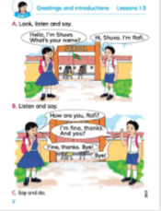
Connection with the text :
Open your
“English for Today” Book
page at # 2

Slide 12
WCW:
Repeat after me.
Hello, I’m Shuva.
What’s your name?

Slide 13
WCW:
Repeat after me.
Hi, Shuva.
I’m Rafi.

Slide 14
Pair work:
Practice in pair
Chain drill
Notes:
1st student will ask Questions 2nd student will give Answer.
Teacher will observe the class.

Slide 15
Teacher practice with students in the classroom.
Teacher ask students
Students reply.

Slide 16
Evaluation:
What’s your name?

Slide 17
Home work :
What’s your name?
Ans: I’m ………………

Slide 18
Thanks

Slide 19
See you again.

