Slide 1
WELCOME

Slide 2
INTRODUCTION
Suranjit Talukder .
(BA,B-Ed ; MSS, M-Ed ; C-in-Ed)
Assistant Teacher
Voishber Govt. Primary School.
Sunamgonj Sadar, Sunamgonj.
Class: Five
Subject: English
Unit:6,Lesson:4-5
Date:
Time:40 Minutes

Slide 3
CREATING EMOTION
Good morning , students.
Good morning , teacher.
How are you?
Fine . And you?
I’m also fine. But you are looking pale .(By showing a student)
Have you any problem?
No/Yes , Sir.
Let’s sing a song “Ak din Bangali chilamre………”

Slide 4
We eat to live . Everyday we eat different kinds of foods . Every foods are not delicious. Some foods are delicious but unhealthy.
Please tell me the names of some foods which are tasty but unhealthy.
Burger , Chips , Loly pop , Ice-cream , Sandwich,
Different Soft drinks etc.
Which foods we should eat?
The foods which are healthy foods.
Really! We should eat healthy foods.
Today’s topic is “Eat Healthy ” .

Slide 5
Learning Outcomes
Students will be able to…….
1.1.2.say sentences with proper intonation.
5.1.1. read silently with understanding paragraph.
3.1.2.write words, phrases and sentences.

Slide 6
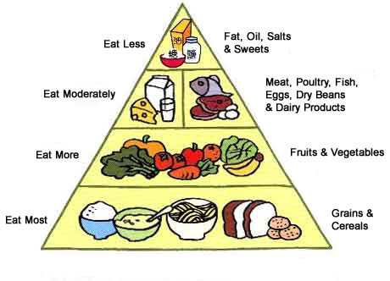
Please think about the picture and discuss in pairs.
What do you see in the picture?
It is a food chart .It is called “The Food Pyramid”.

Slide 7
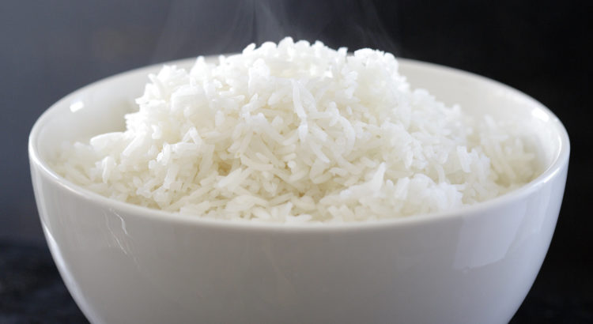
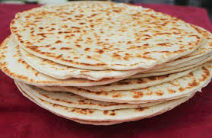
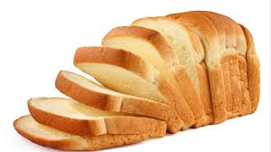
The Bottom level of the Food Pyramid
The foods we should eat most (Grains and cereals)

Slide 8
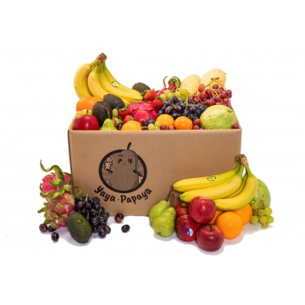
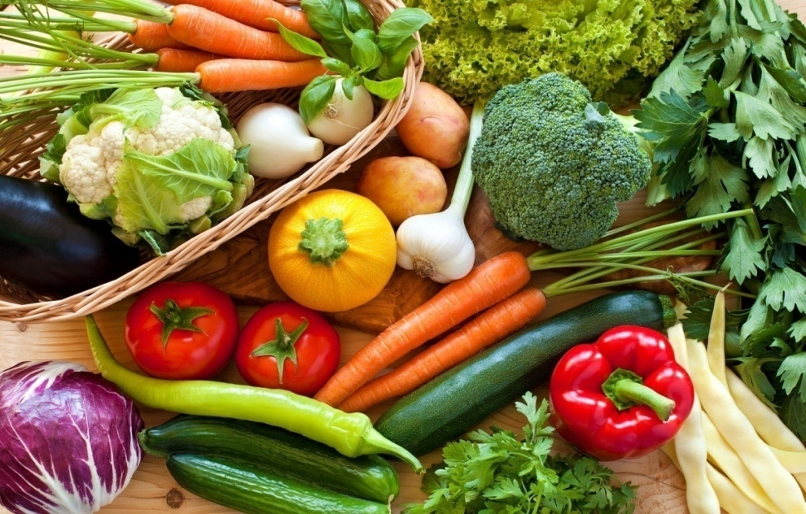
The Second level of the Food Pyramid
The foods we should eat more (Fruits and Vegetables)

Slide 9
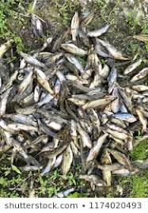
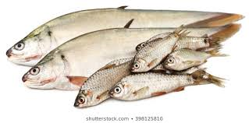
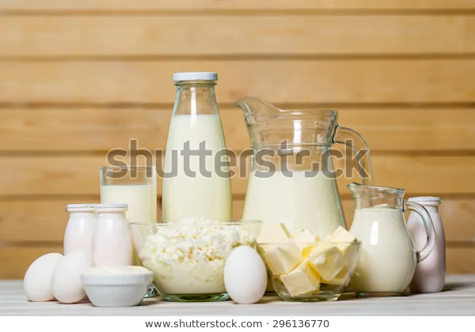
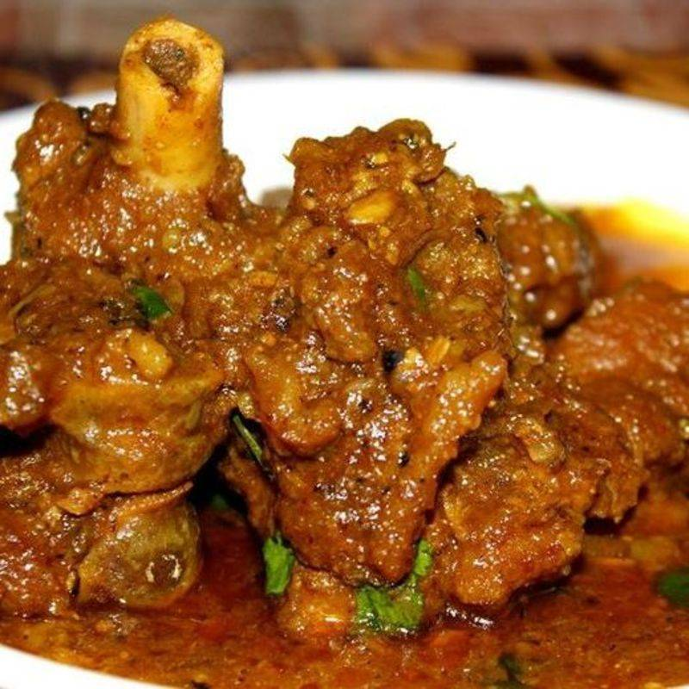
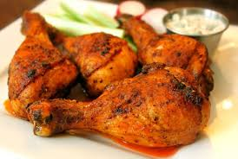
The 3rd level of the Food Pyramid
The foods we should eat moderately (meat ,poultry , fish , egg and dairy products)

Slide 10
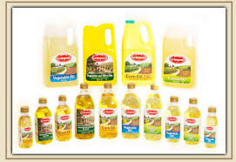
The Top level of the Food Pyramid
The foods we should eat less (Fat ,oil, salt etc)

Slide 11
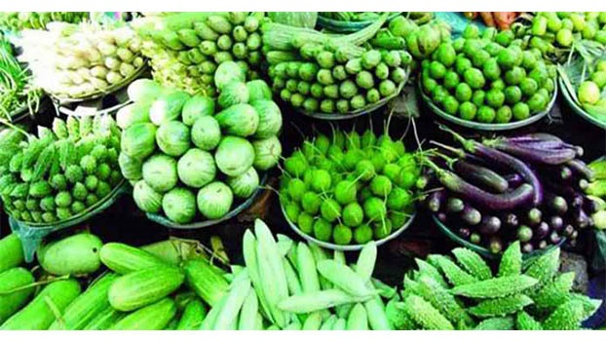
NEW WORDS MEANINGS
Fruits
Vegetables

Slide 12
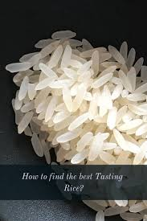
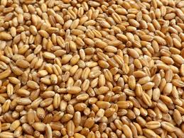
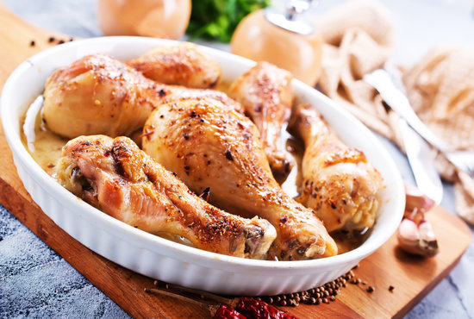
NEW WORDS MEANINGS
Grains: Corn , Crop
Chicken : Chicken meat

Slide 13
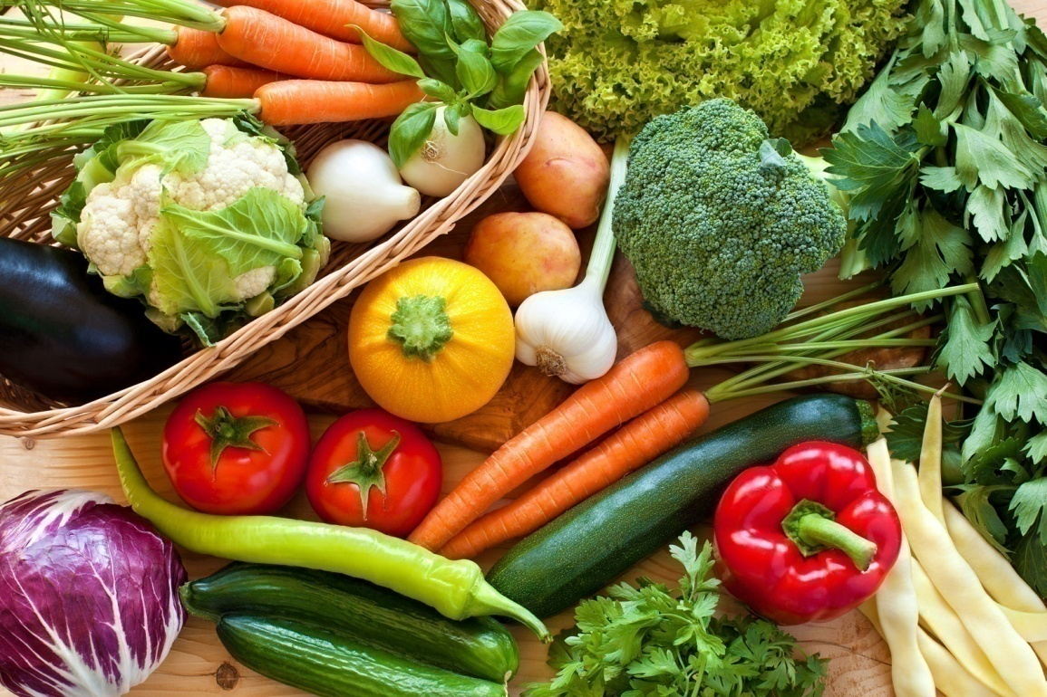
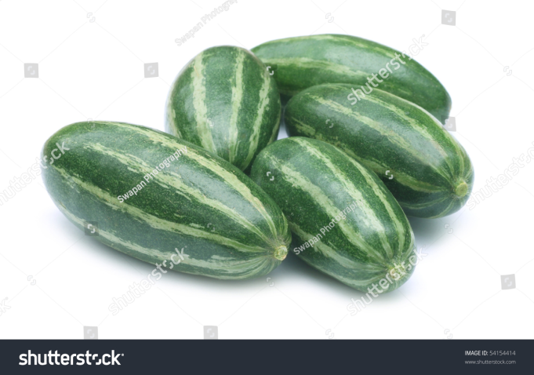
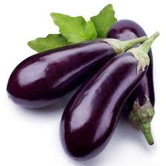
NEW WORDS MEANINGS
Vegetables

Slide 14
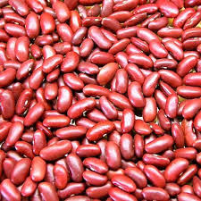
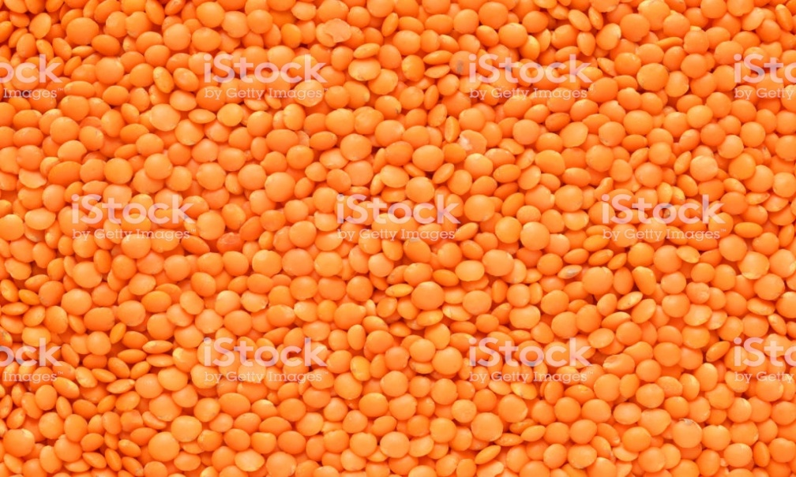
NEW WORDS MEANINGS
Beans: One kind of vegetable
Lentils

Slide 15
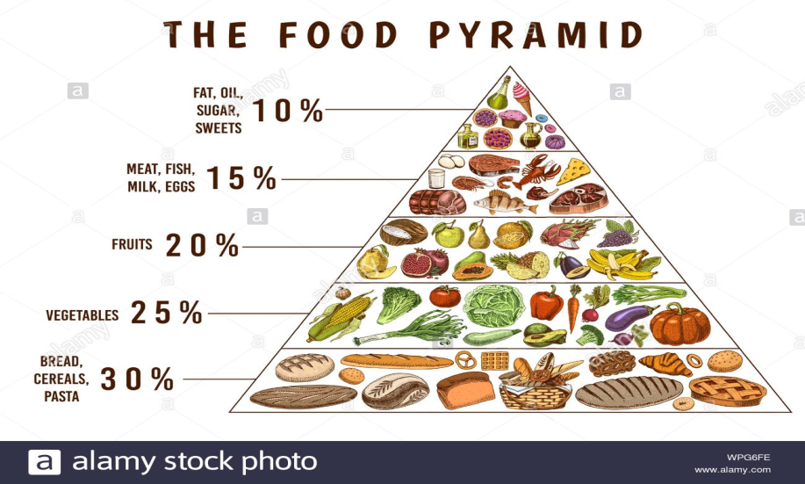
NEW WORDS MEANINGS
Dairy Products: The foods which are made from milk , egg etc.
The Food Pyramid: A chart of different food items which tells us how much of each food group we should eat.

Slide 16
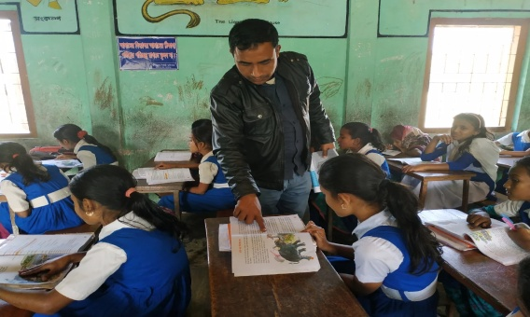
Listen to the text with me and put your finger under the line.
Now read loudly after me.

Slide 17
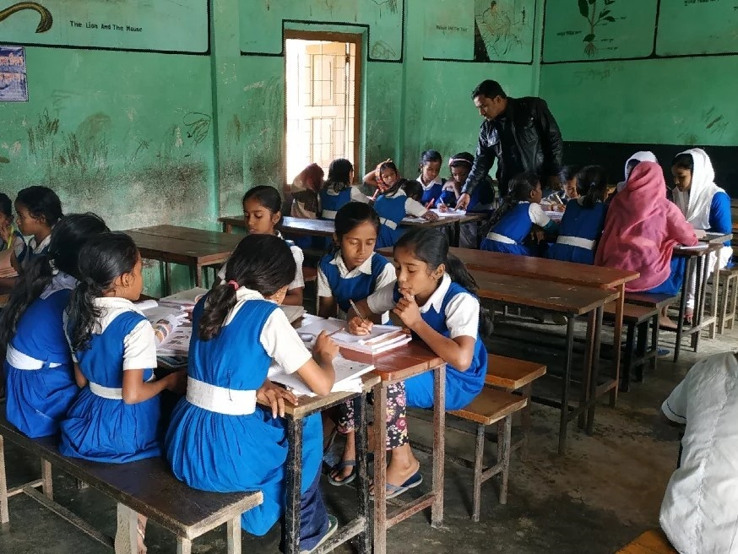
Now read the text in groups.

Slide 18
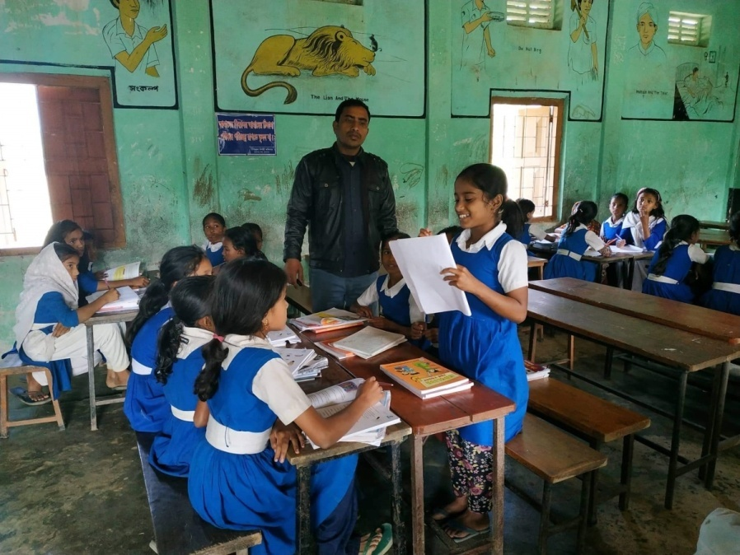
A student will be selected from every group to present their group work.

Slide 19
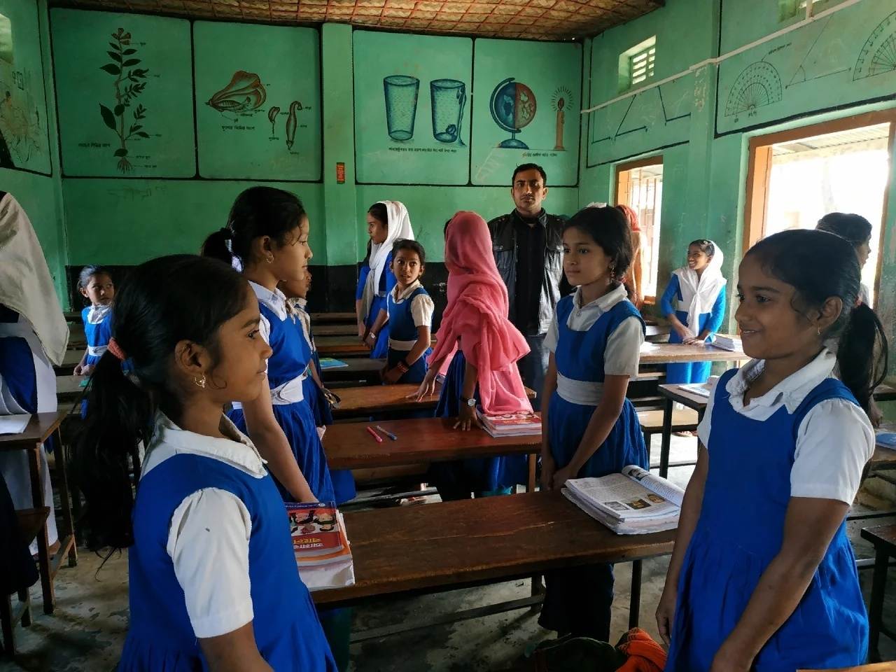
Ask and answer in pairs.

Slide 20
Ask and answer in pair
Say True or False
1.There are four levels in the Food Pyramid.
2.The bottom level of the Pyramid has food from protein and dairy.
3.Foods made of grain give us energy.
4.Eggs help our eyes.
5.Milk helps to make us strong.

Slide 21
INDIVISUAL WORK
(Write the answer )
1.Which foods help our eyes and our health?
2. Which foods give us energy?
3.What foods do you see at the bottom?
4.What do you understand about dairy products?
5.What is a Food Pyramid?

Slide 22
Homework
Write a short paragraph about “ The Food Pyramid” at least five sentences.

Slide 23
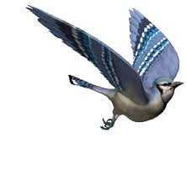
GOODBYE

