Slide 2
Teacher`s Identity
Lutfor Rahman
Assistant Teacher,
Kundarampur, Government Primary school School,
Ghoraghat, Dinajpur.
E-mail: mlutfor81@gmail.com

Slide 3
Dear students let’s enjoy the rhyme

Slide 4
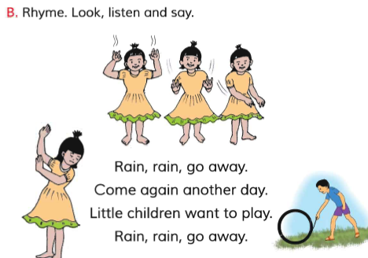
Today’s lesson is-

Slide 5
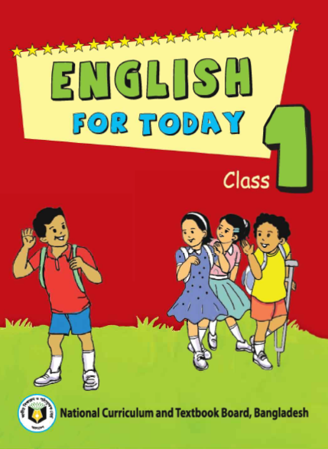
Lesson introduction
Subject : English
Class : One
Unit : 17
Lesson : 1-3
B. Rhyme: Rain rain go away
Date : 0/0/2020

Slide 6
Learning outcomes
Listening
4.1.1 : Enjoy the rhythm and music of simple rhymes
Speaking:
4.1.1:Repeat rhymes after the teacher.
4.1.2 Recite rhymes individually.

Slide 7
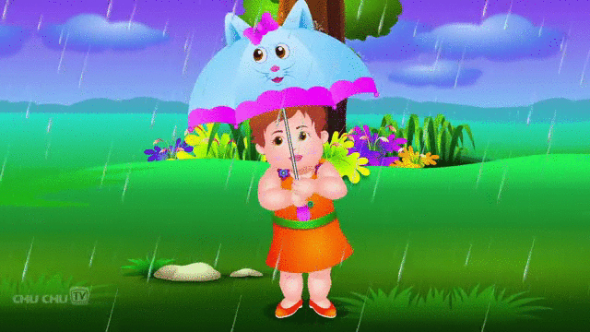
Rain rain go away

Slide 8
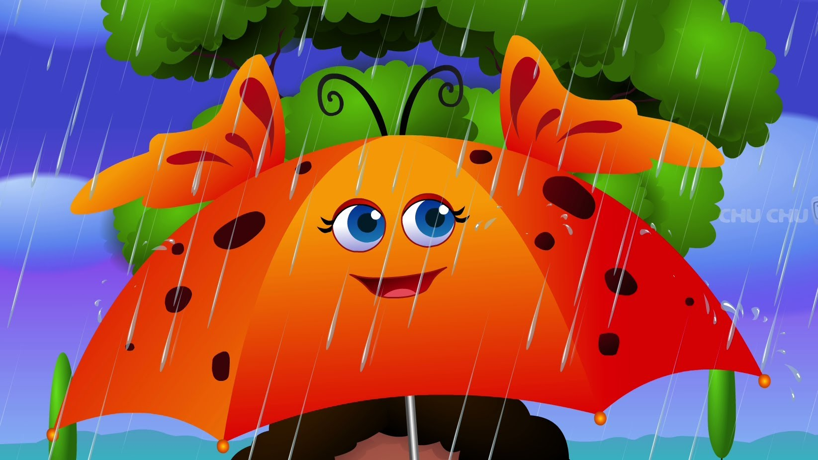
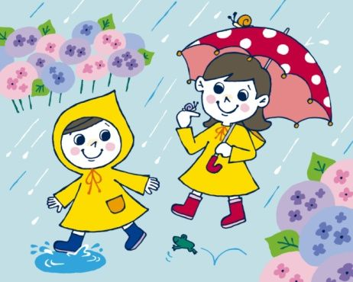
Come again another day

Slide 9
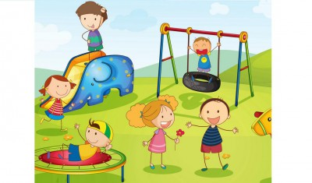
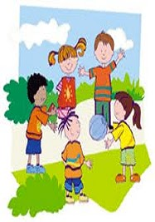
Little children want to play

Slide 10
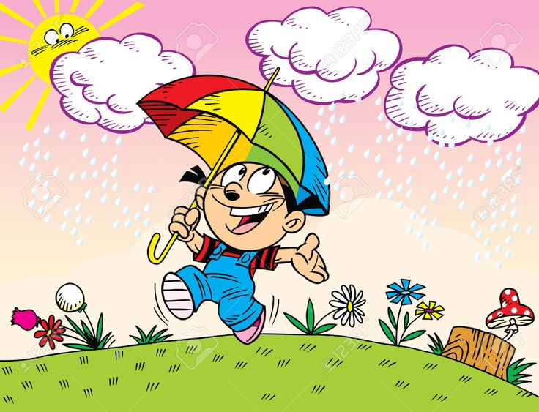
Rain rain go away

Slide 11
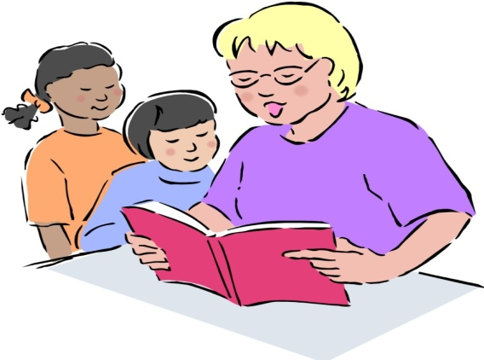
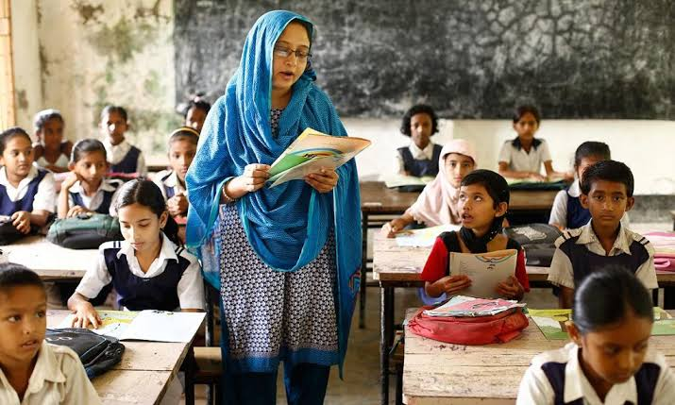
Teachers recitation
Look ,listen and say
Rain,rain,go away.
Come again another day.
Little children want to play.
Rain,rain,go away.

Slide 12
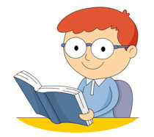
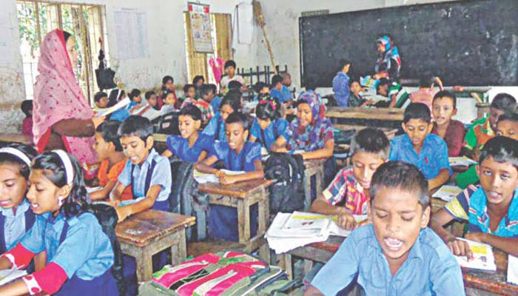
Students recitation
Imdividual Reading (IW)

Slide 13
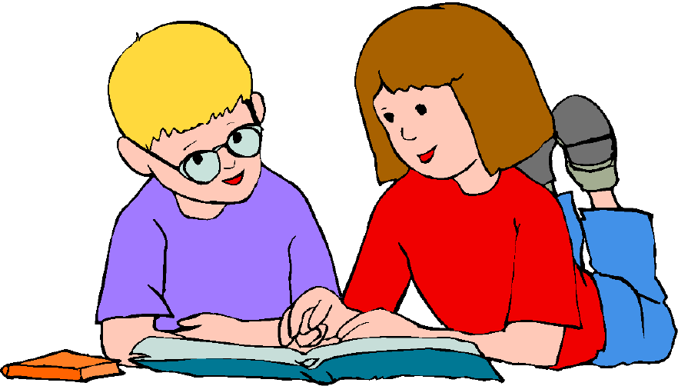
Pair Work
One student say the rhyme and other listen

Slide 14
Evaluation
1.Say –Rain rain go away
2.Say the next line: come again another day.

