Slide 1
Welcome

Slide 2
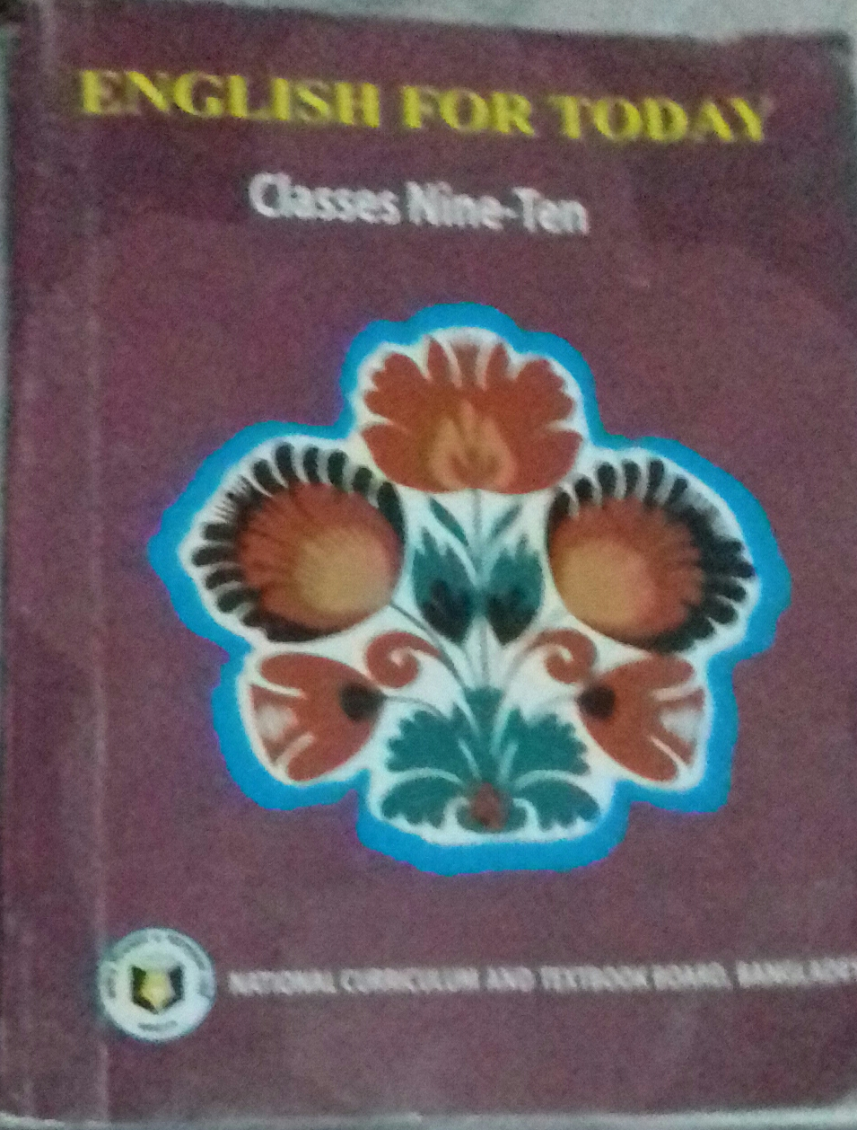
INTRODUCTION
Md.Nazrul Islam
Assistant Teacher
K.K.H.S
Porsha, Naogaon
nazrul.kkhs@gmail.com
English 1st Paper
Class IX
Unit-8 ,Lesson-2
Topic-The Somapura Mahavihara
Time-45 mins

Slide 3
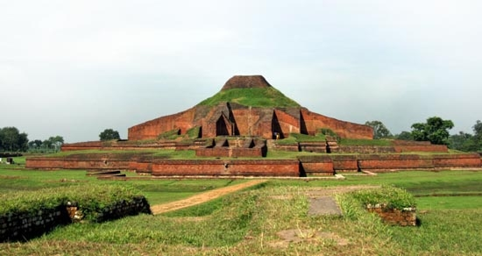
Look at the picture.
Do you know the name of the place ?
Paharpur

Slide 4
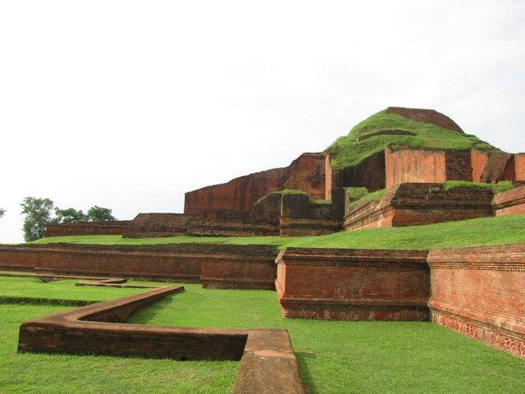
Today Our Topic is
The Somapura Mahavihara

Slide 5
Learning Outcomes
By the end of the lesson students will be able to…….
Read the passage.
ask and answer questions
describe about The Somapura Mahavihara

Slide 6
Open your book Unit 8,Lesson -2 page no 112 and Read the passage carefully.
Find out difficult words.

Slide 7
Important :
Significant
Temple :
Place for prayer for Buddhist
Ancient :
Very old
Systematic :
Done methodically

Slide 8
Pair work
Read the passage and answer the following questions.
Ans
1.Where is Paharpur situated?
1.In Naogaon District
2. What do you mean by Pahar?
2. Hill
3.What’s the previous name of
Paharpur?
3.The Somapura Mahavihara
4.What was Somapura Mahavihara?
4. Buddhist institutions
For Monks
5.Who was the second Pala king?
5. Dharmapala

Slide 9
Individual work
Choose the best answer from alternatives.
1. Paharpur is in.....side of Bangladesh
(i) Eastern (ii) western (iii) northern (iv) southern
2. The Somapura Mahavihara was.....m high.
(i) 14 (ii) 24 (iii) 28 (iv) 34
3.Dharmapala regioned ----- years.
(i) 20 (ii) 30 (iii) 40 (iv) 50
4. Paharpur is a ------area.
(i) town (ii) city (iii) Urban (iv) remote

Slide 10
Answers
1 (iii) – northern
2. ( ii)-- 24
3. ( iii) --- 40
4. (iv) --- remote

Slide 11
Home work
Write a Paragraph about the Shat Gombus Mosque.

Slide 12
Thank you all

