Slide 1
WELCOME

Slide 2
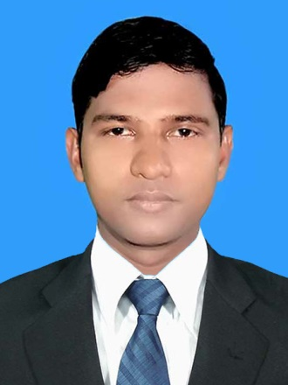
Teacher Introduction
Md. Alomgir Alam Khan (M.A. Hasan)
Asst. Head Teacher
United High School , Shimba, Raninagar ,Naogaon . Email:alomgiralamkhan@gmail.com
Mobi:01720615418

Slide 3
ENGLISH SECOND PAPER
PUNCTUATION AND USE OF CAPITAL LETTERS
CLASS : NINE
TIME : 40 MINITES
DATE : 13/02/2020

Slide 4
AIM
THE STUDENT WILL LEARN ABOUT :
PUNCTUATION
USE OF CAPITAL LETTERS
CLACIFICATION

Slide 5
FULL STOP .
AFTER COMPLITING SENTENCE IT IS USED :
I go to school . I work in the field .
IT IS USED ALSO :
U.S.A U.K S.S.C H.S.C

Slide 6
HOME WORK
He goes to college He helps his father He makes a garden

Slide 7
THANK YOU

