Slide 1
Welcome

Slide 2
Introduction of lesson
Subject: English
Class- 9-10
U-3: Event & Festivals
L- 6: Pahela Baishakh
Time 45 min
ENGLISH FOR TODAY
9- 10

Slide 3
Introduction of teacher
AMZAD HUSSAIN RASEL
ASST. TEACHER
AMRIA ISLAMIA ALIM MADRASAH
MOB- 01717569526
amzadhrasel1981@gmail.com

Slide 4
Learning outcomes:
After the lesson students will have :
1. Read the passage with meaning.
2. They explain the keyword with meaning. 3. Answer the following questions.

Slide 5
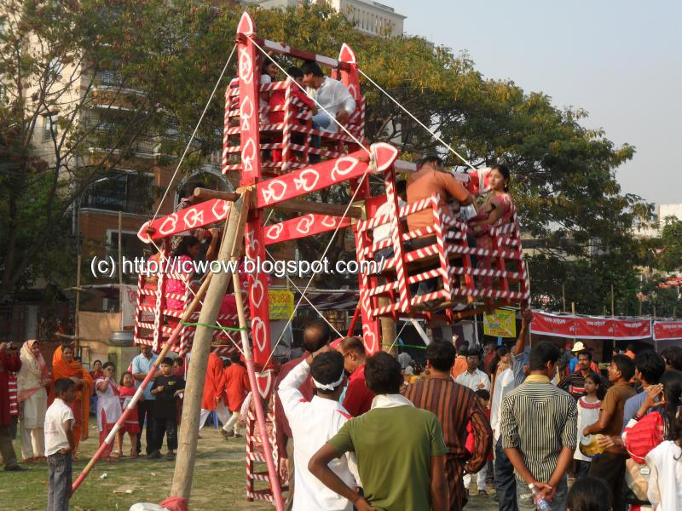
Look at the pictures

Slide 6
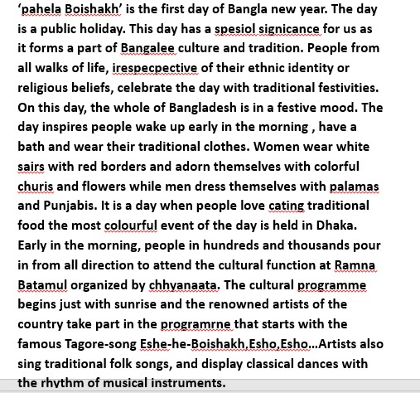
Read the text carefully

Slide 7
Pahela Baishakh
Let`s see a question

Slide 8
Teaching Vocabulary
Word
Picture
Meaning
A number of people or vehicles etc. moving steadily forward.
Procession
A display of some massage written on a piece of fabrics/clothes.
Banner

Slide 9
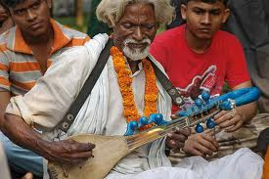
Teaching Vocabulary
Word
Meaning
Picture
A traditional or composed song typically characterized by stanzaic form, refrain, and simplicity of melody which are performed with the traditional musical instruments.
Folk song
In accordance with a customary or characteristic method or manner.
Traditional

Slide 10
Answer the right option from alternatives.
(1) Pahela Boishakh is a day of ___ (i) sadness (ii) sorrows (III) sufferings (iv) joy
(2) On this day people eat ____ food. (i) Traditional (ii) untraditional (iii) rich (iv) poor
(3) On this day both man and women dress themselves with ___ clothes. (i) old (ii) shabby (III) colorful (iv) torn
(4) The New years Day’s biggest festival is held in____. (i) Dhaka (II) Chittagong (III) Rajshahi (iv) Khulna

Slide 11
Evaluation
* What is the first day of Bangla new year?
What is the significance of pahela Boishakh?
How do the people from all walks of life cebrate the day?
Who celebrate with the traditional festivities?
when do people wake up?

Slide 12
Homework
Write a paragraph about Baishakhi Mela you ever seen.

Slide 13
Thank You

Slide 14
Acknowledgement
GOOGLE
NATIONAL CURRICULUM & TEXTBOOK BOARD, BANGLADESH.
TEACHER`S OF AMRIA ISLAMIA ALIM MADRASA.

